Slide 1
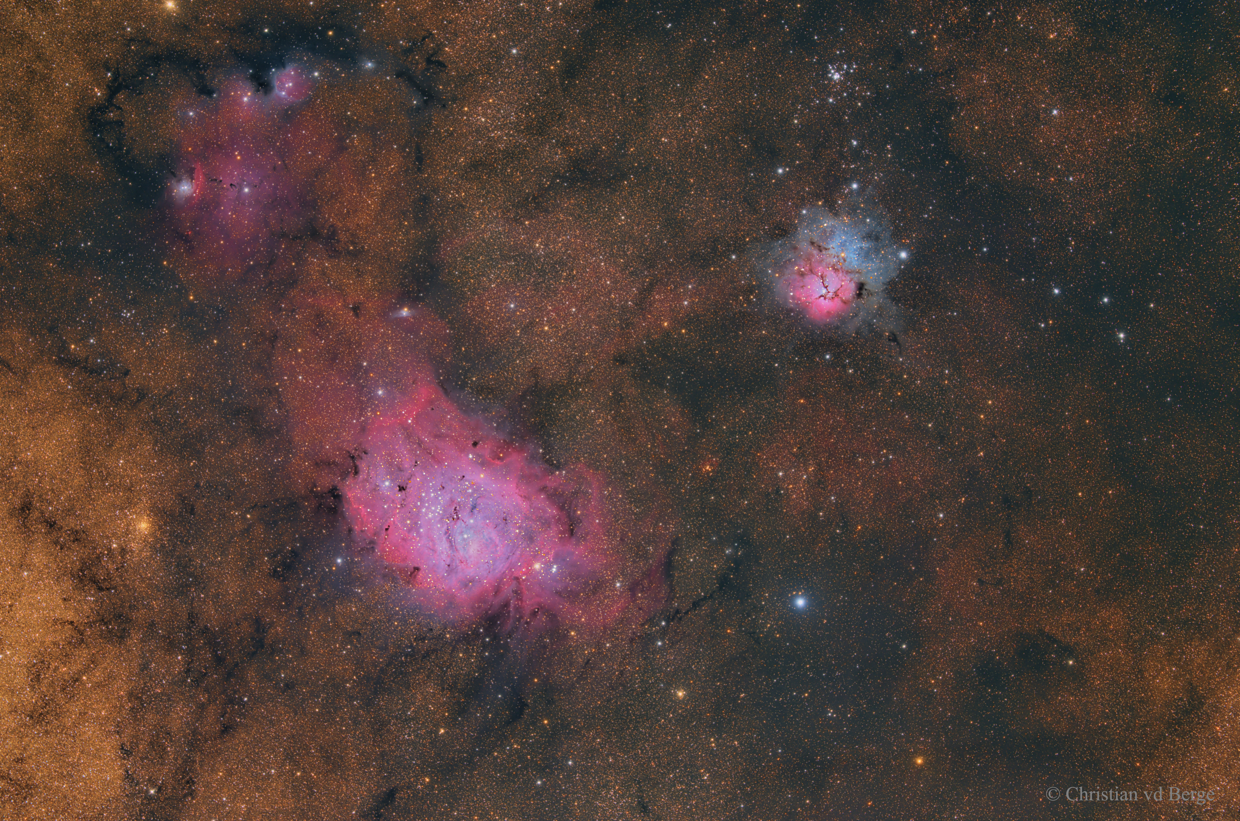

Slide 2
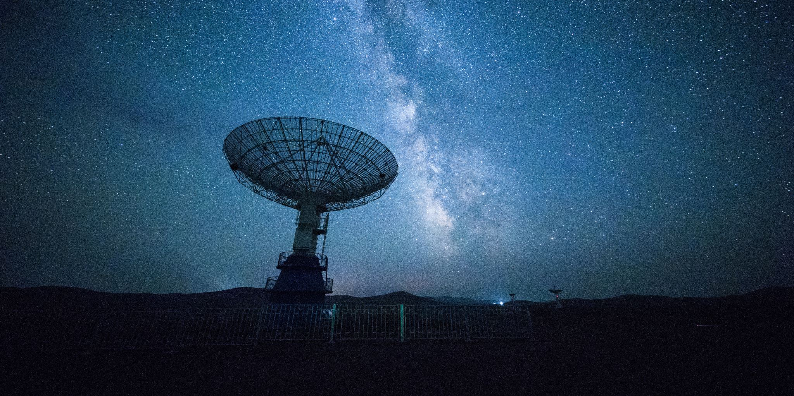
How do stars form?

Slide 3
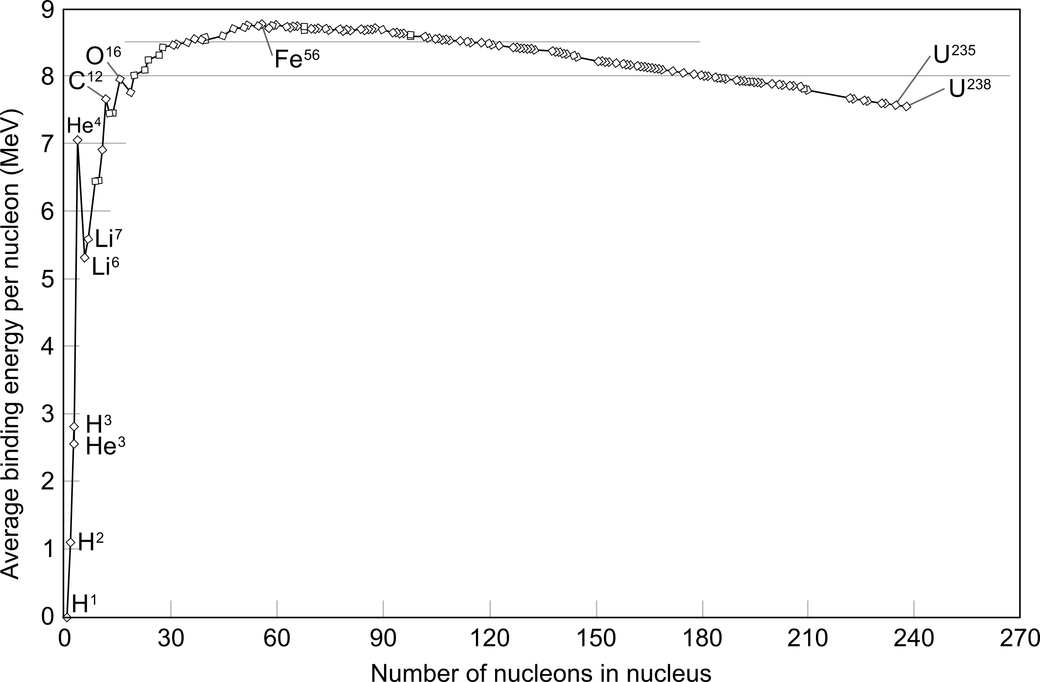
Nuclear vs. EM forces
Iron
Helium
Hydrogen

Slide 4
Stars have limited fuel supply
Stars get energy from nuclear fusion:
gravity confines plasma enabling stable fusion

Slide 5
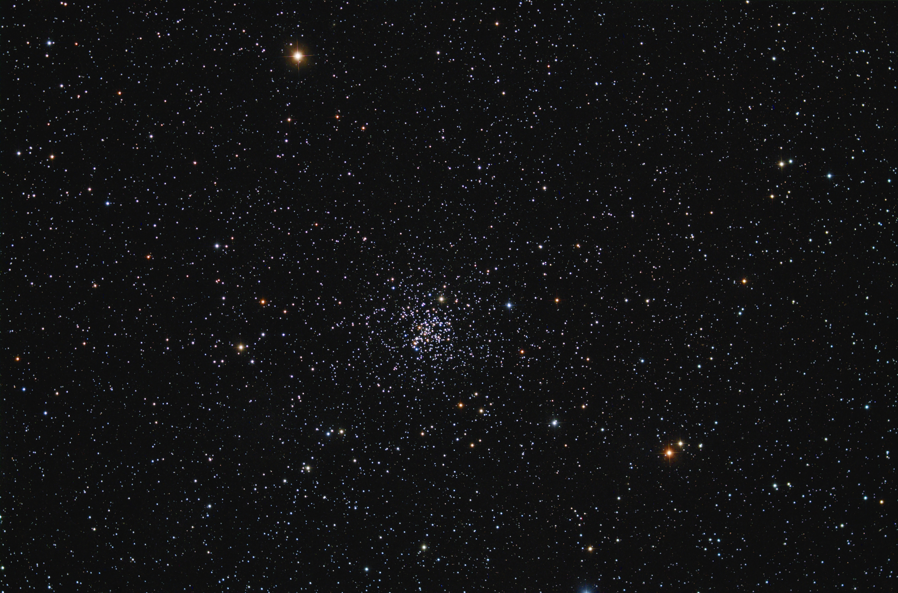
A star cluster has same-age stars
M67 image by N. Carboni & G. Parker

Slide 6
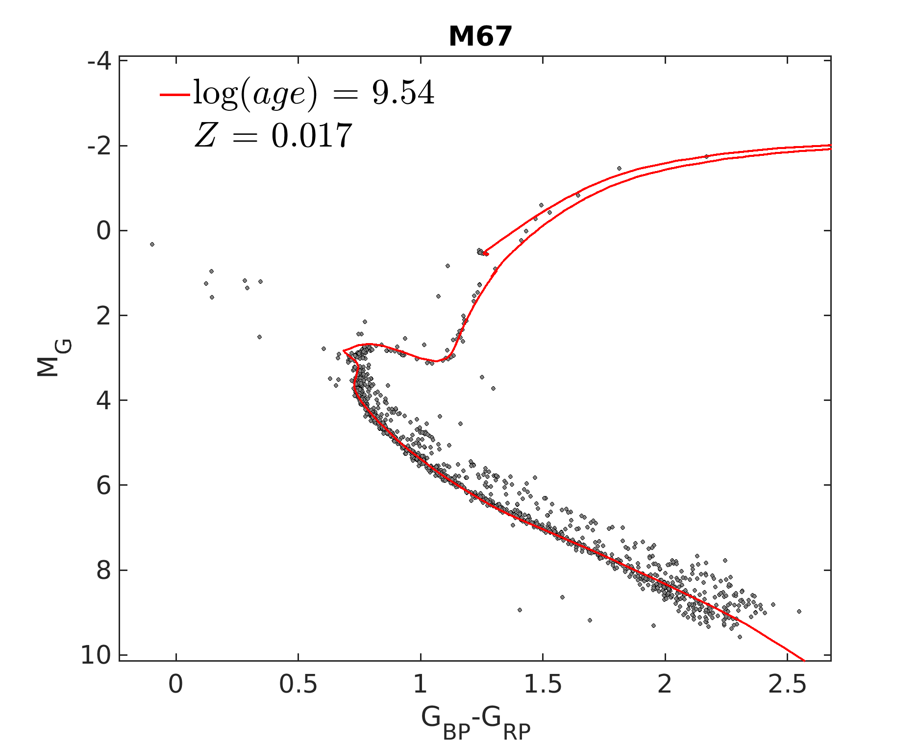
Isochrones: HR positions of same-age stars

Slide 7
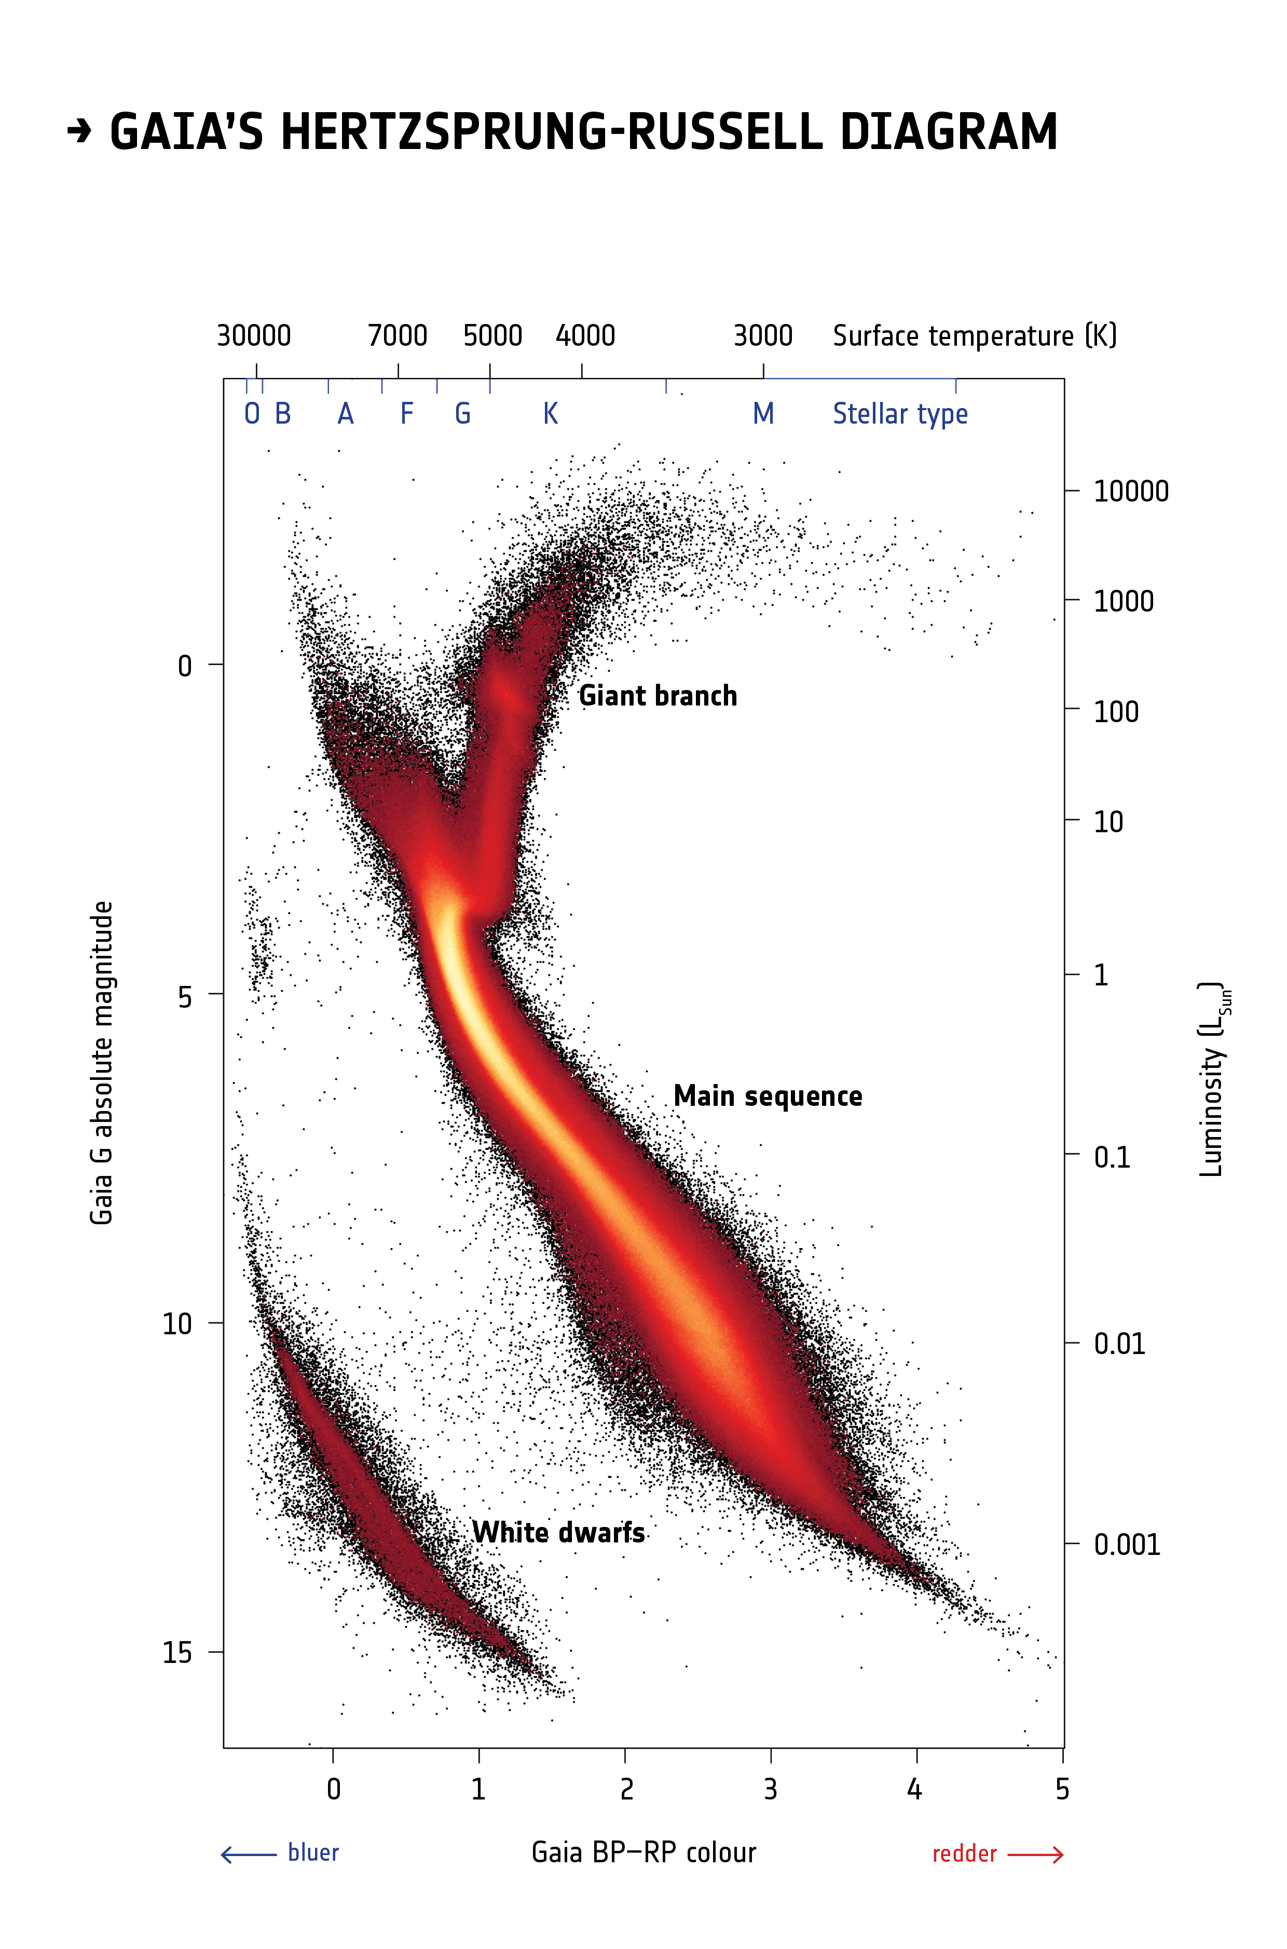
Gaia field stars HR diagram
Stars that are out of Hydrogen fuel in their cores

Slide 8
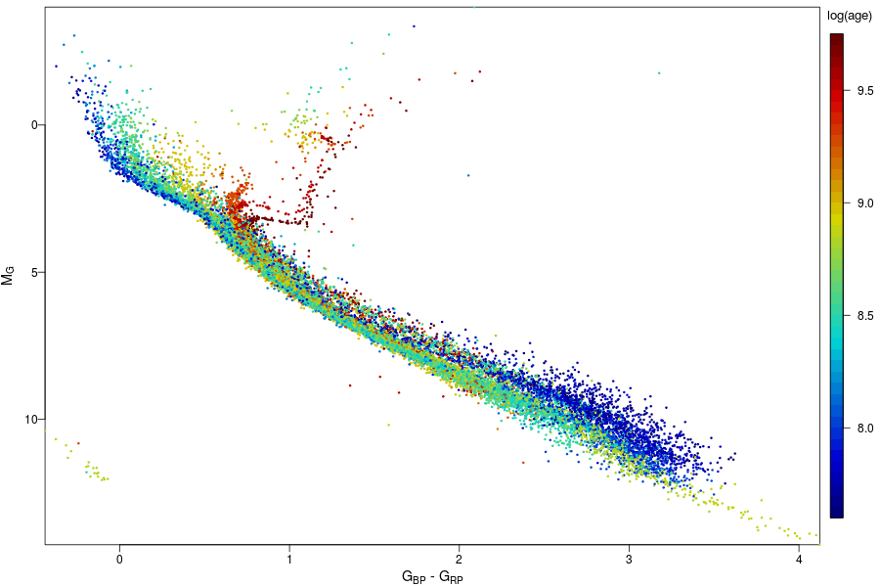
Gaia HR: open clusters
left main sequence
color is age
haven't reach main sequence

Slide 9
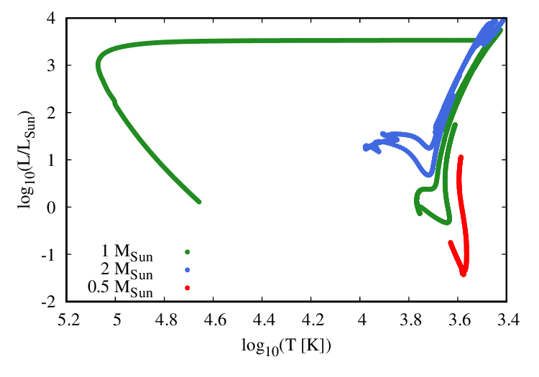
HR tracks
planetary nebula
red giant
main sequence
white dwarf

Slide 10
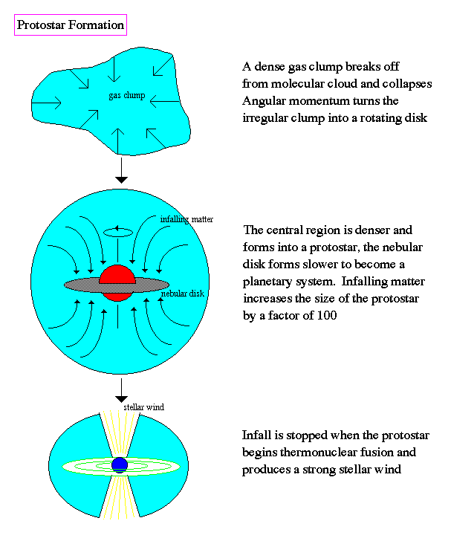
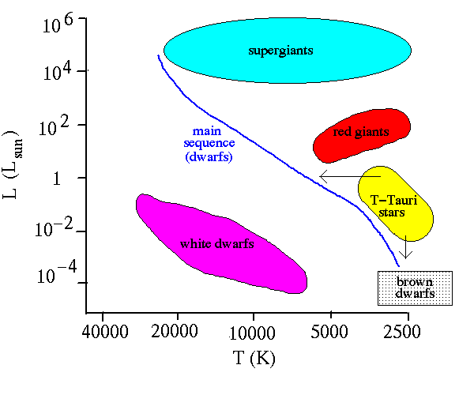
T Tauri stars

Slide 11
Interstellar space is not exactly empty
Atoms/ions/molecules
Dust grains
Electromagnetic radiation
Cosmic rays: ions with non-thermal (high) energies
Magnetic fields

Slide 12
Interstellar space is not exactly empty
Atoms
Dust grains
Electromagnetic radiation

Slide 13
Interstellar gas
Balance between pressure and gravity
Heated by stars (radiation & winds)
Cooled by thermal radiation (line and free-free emission)
Adiabatic expansion/contraction
Heat transport by turbulence

Slide 14
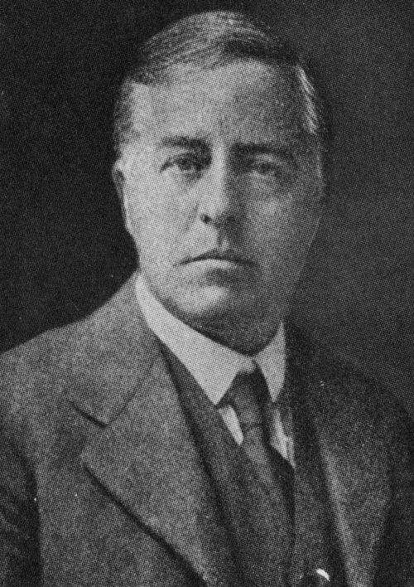
Gravitational (Jeans') instability
Gravity pulls matter in
Pressure pushes it back
When pressure wins -> oscillations (sound waves)
When gravity wins -> collapse
Equilibrium if
Sir James H. Jeans (1877-1946)

Slide 15
Two ways of thinking about Jeans' instability
To compress a gas cloud we need to apply work, but gravitational energy gets released...
If the gas cloud is compressed, it will take sound_speed times cloud_size to restore the balance. This time should be smaller than the free-fall time.

Slide 16
Jeans' mass
The gas cloud is unstable if it is either very massive at a given temperature (think galaxy formation) or very cool at a given mass (star formation)

Slide 17
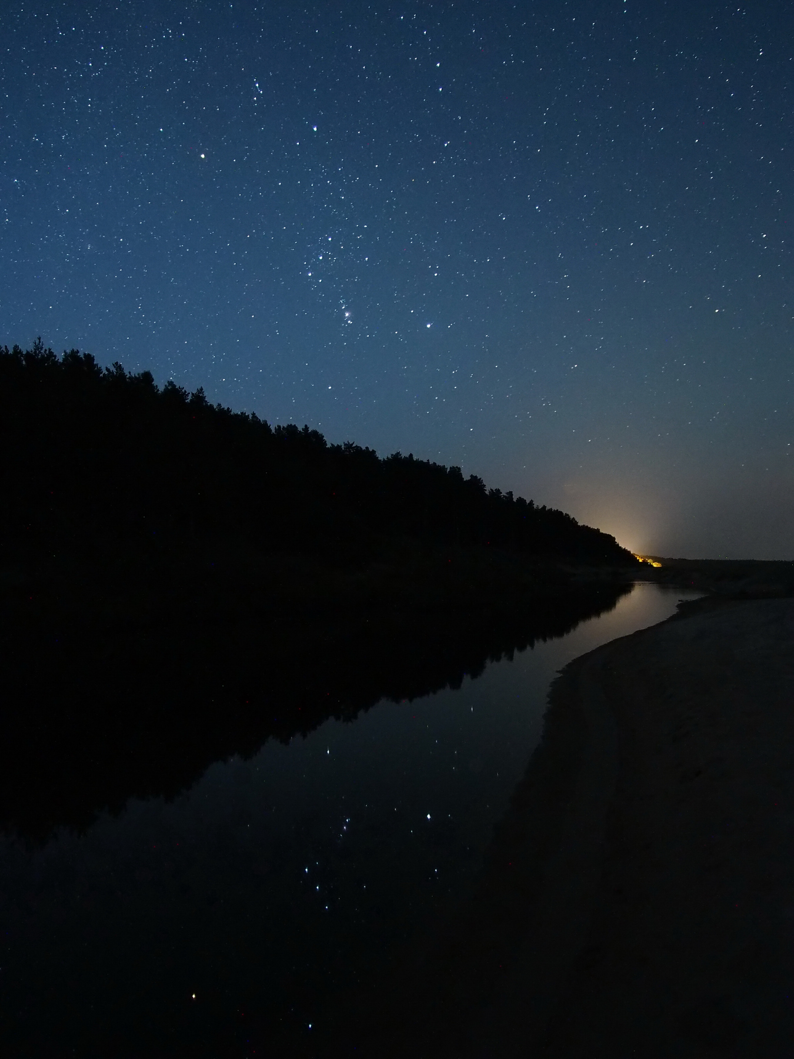

Slide 18
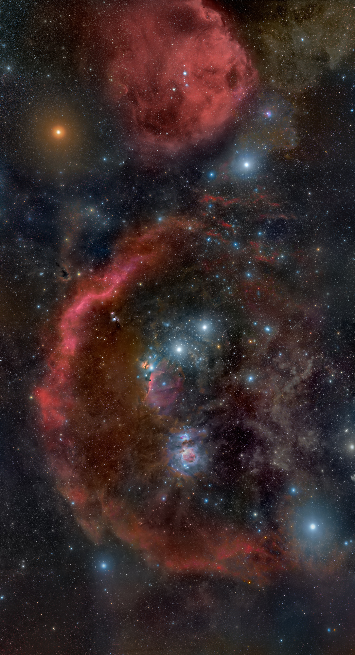
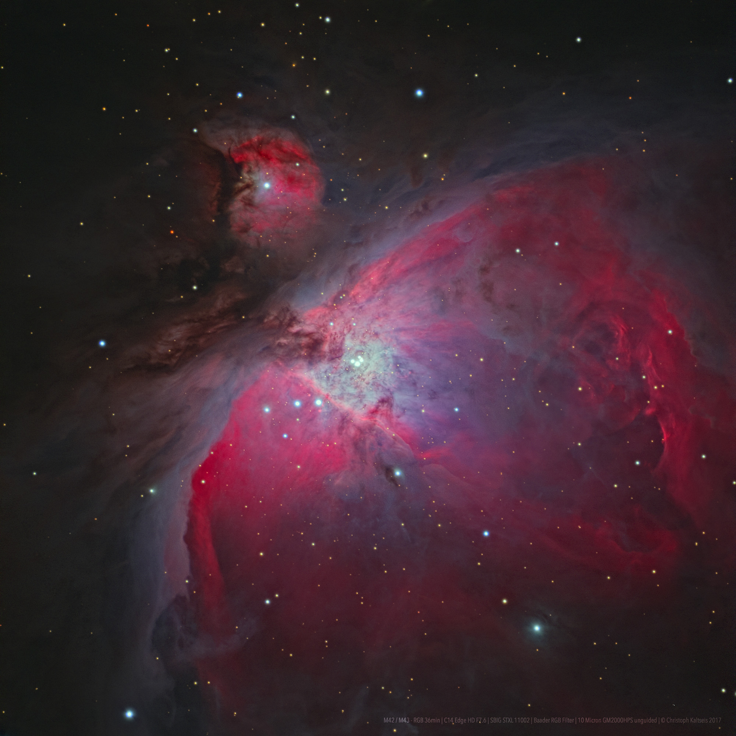
Stars form in giant molecular (cold) clouds

Slide 19
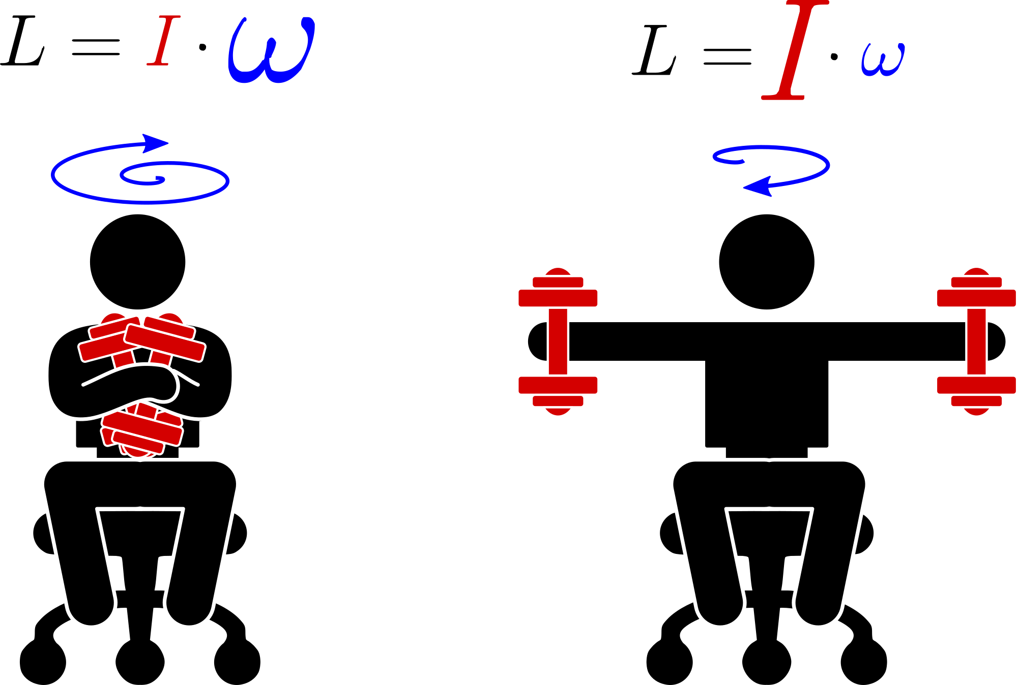
Angular momentum conservation
See the video

Slide 20
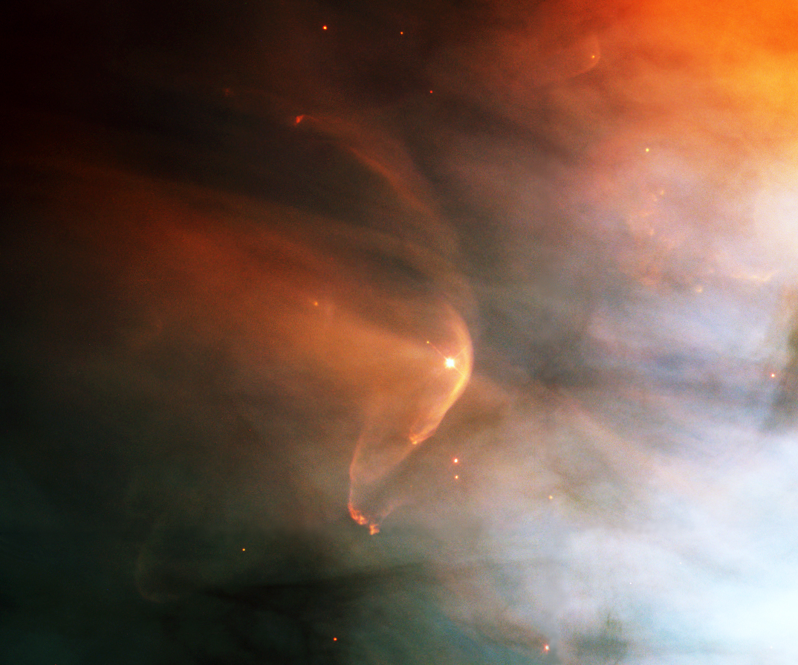
External forces may aid star formation

Slide 21
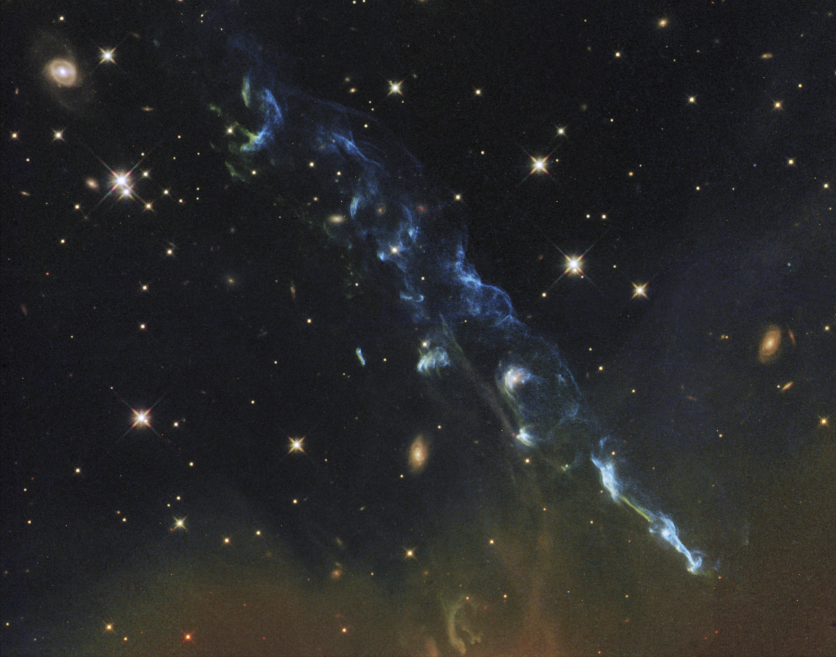
Herbig-Haro objects

Slide 22
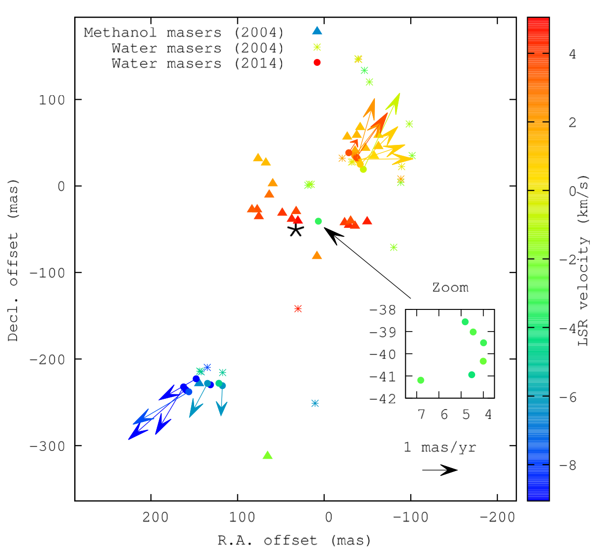
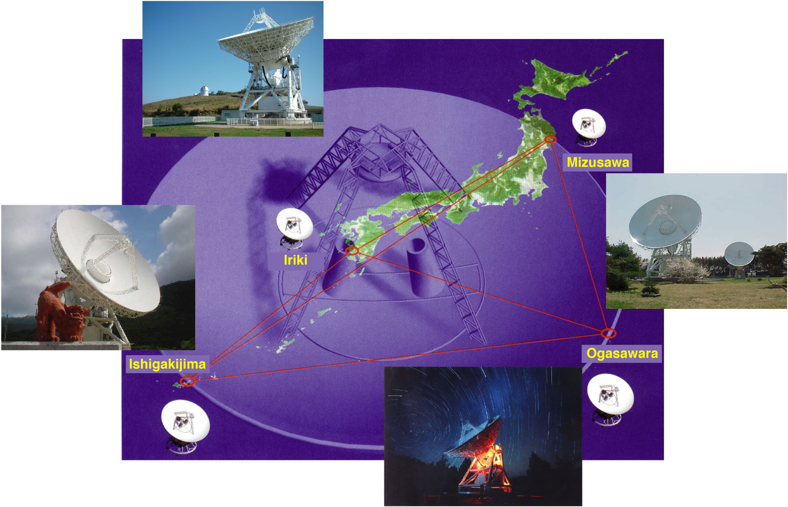
Cosmic masers
VERA radio interferometry array in Japan is dedicated to cosmic maser studies
plot from
Hunter et al. arXiv:1806.06981

Slide 23
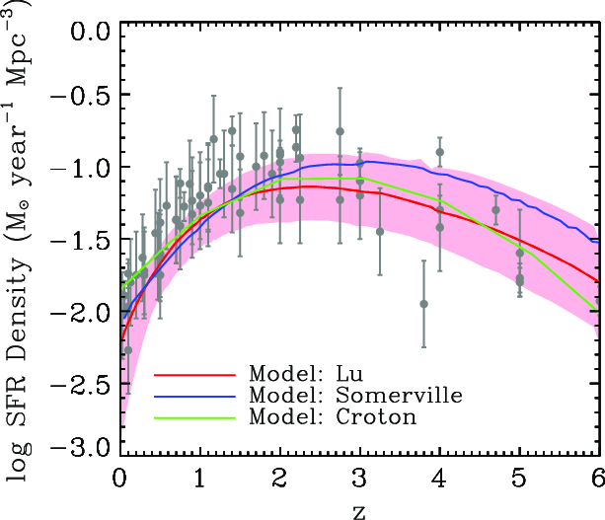
Cosmic noon
peak of star formation rate ~10 Gyr ago (z~2)
plot from Lu et al. 2014, ApJ, 795, 123

Slide 24
Summary
Stars we see today have different ages
Stars form in dense molecular clouds
Star formation continues today, but at lower rate than in early universe
Conservation of angular momentum makes stars spin and creates disks around young stars that may form planets

