Slide 1
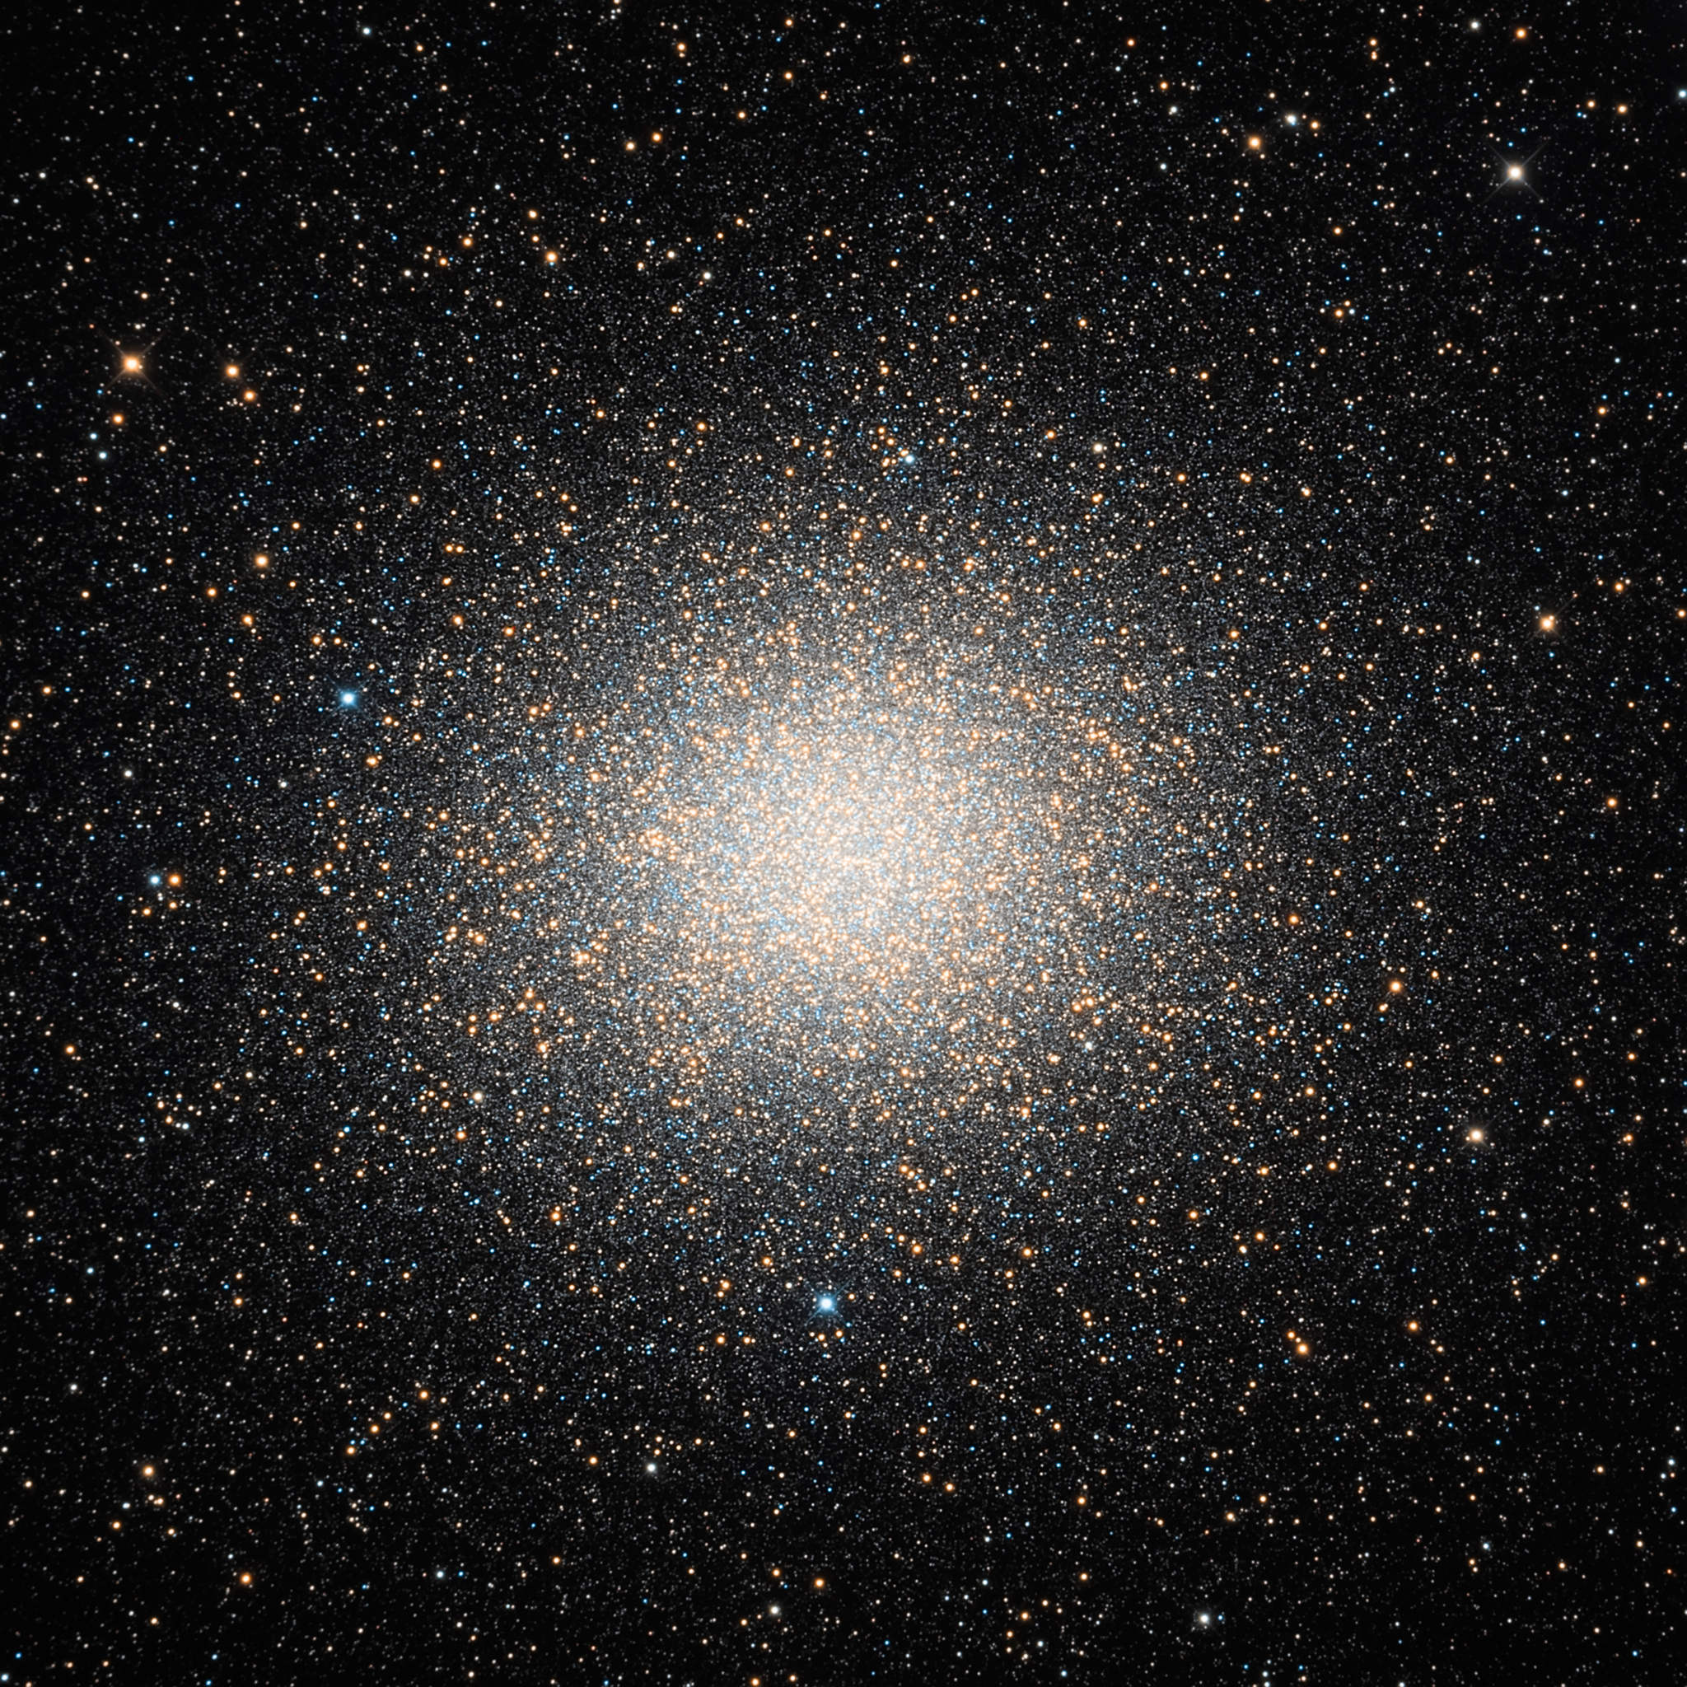

Slide 2
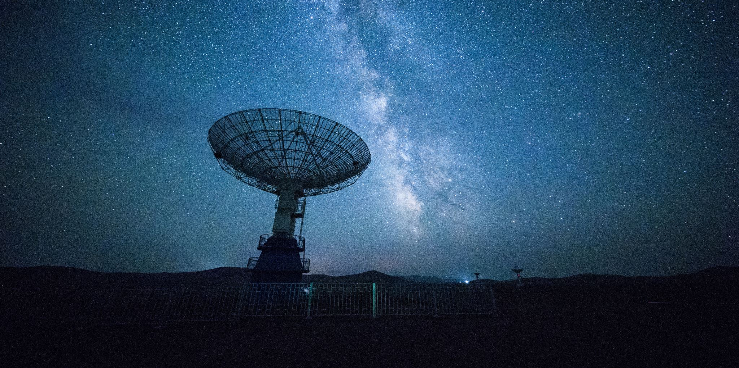
What is the life cycle of stars?

Slide 3
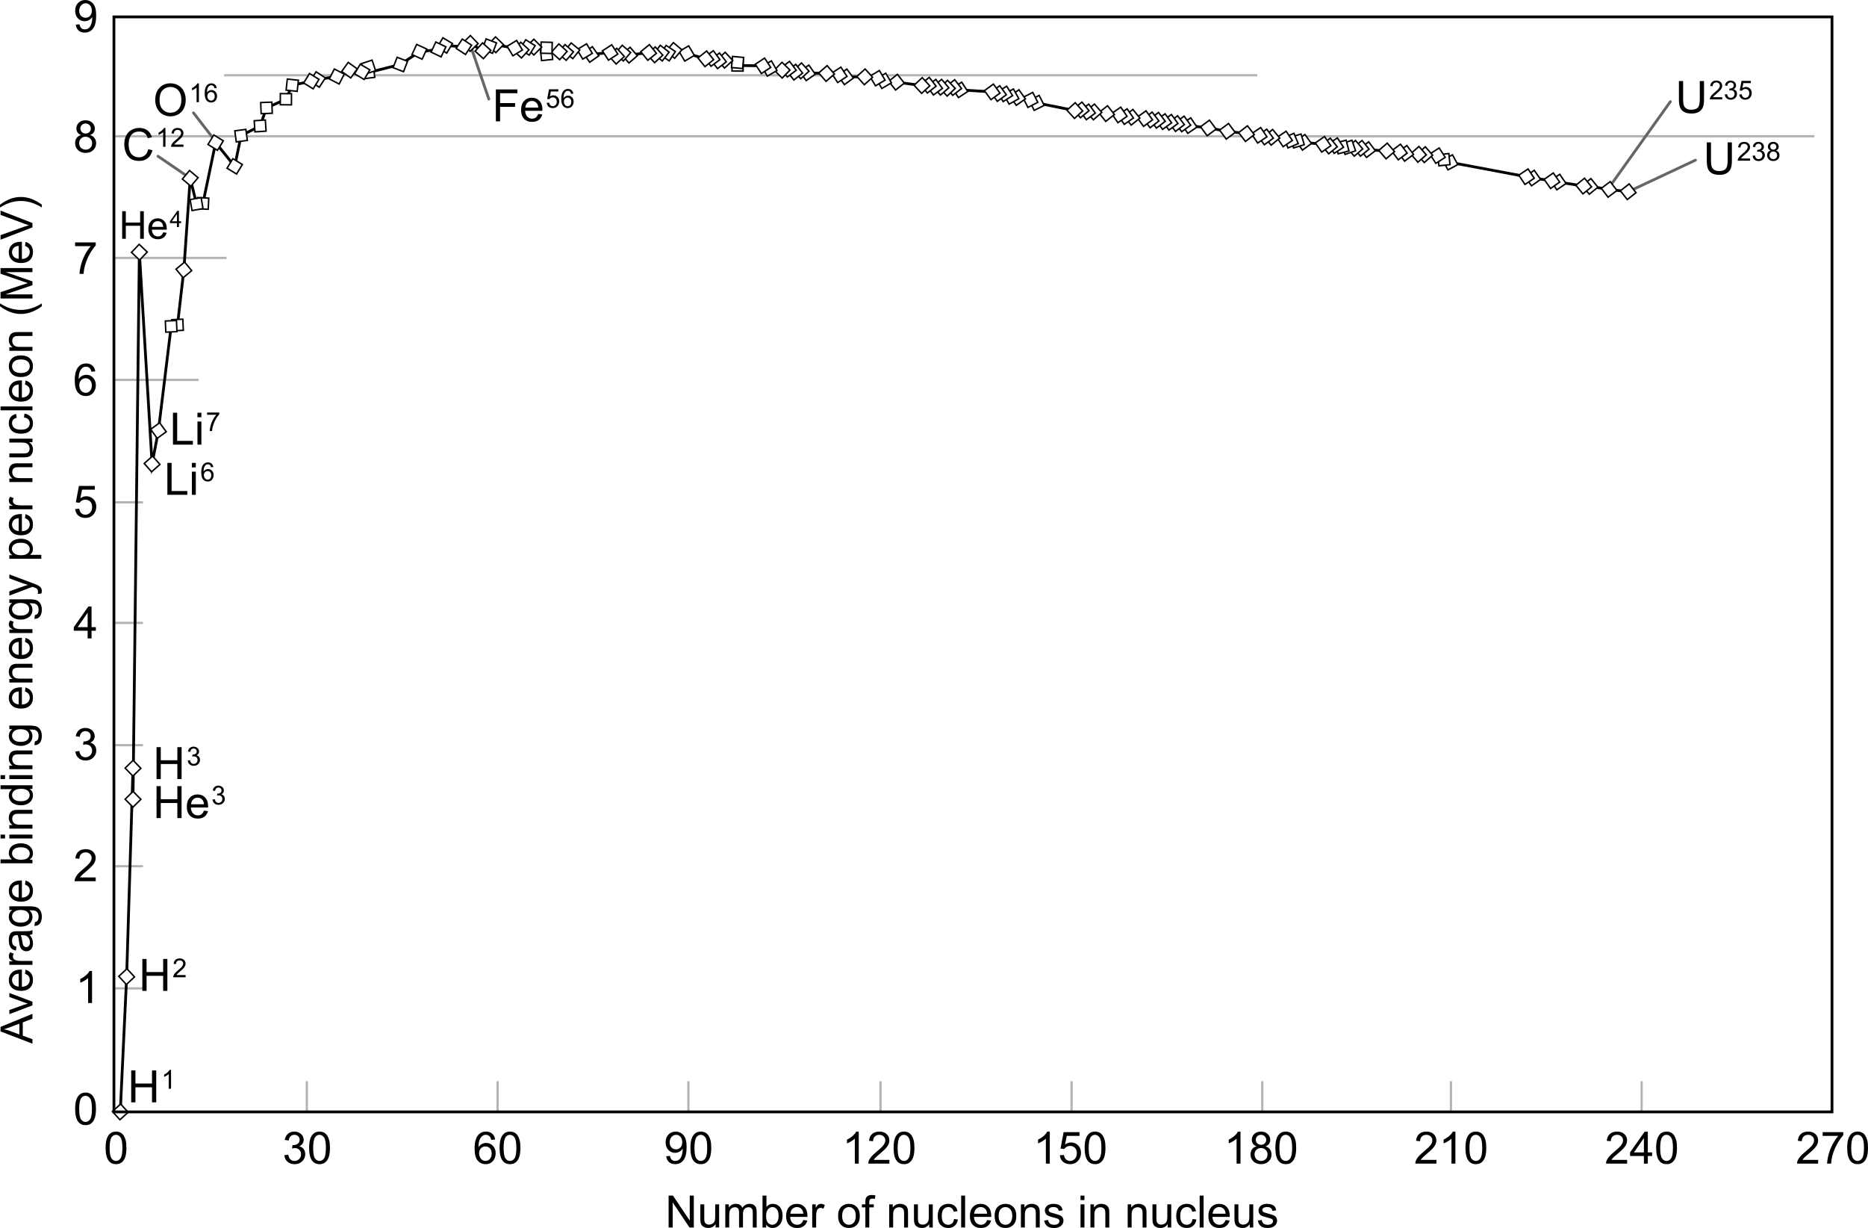
Stars are like nuclear reactors

Slide 4
Nuclear vs. EM forces
Iron
Helium
Hydrogen

Slide 5
Ways to get energy from nuclei
Fission
Fusion

Slide 6
Ways to get energy from nuclei
Fission:
A-bomb
Nuclear power plant
Fusion:
H-bomb
Tokamak
Inertial confinement

Slide 7
Quantum tunneling
Fusion:
In stars gravity confines the plasma enabling stable fusion

Slide 8
H->He Fusion
p-p reaction

Slide 9
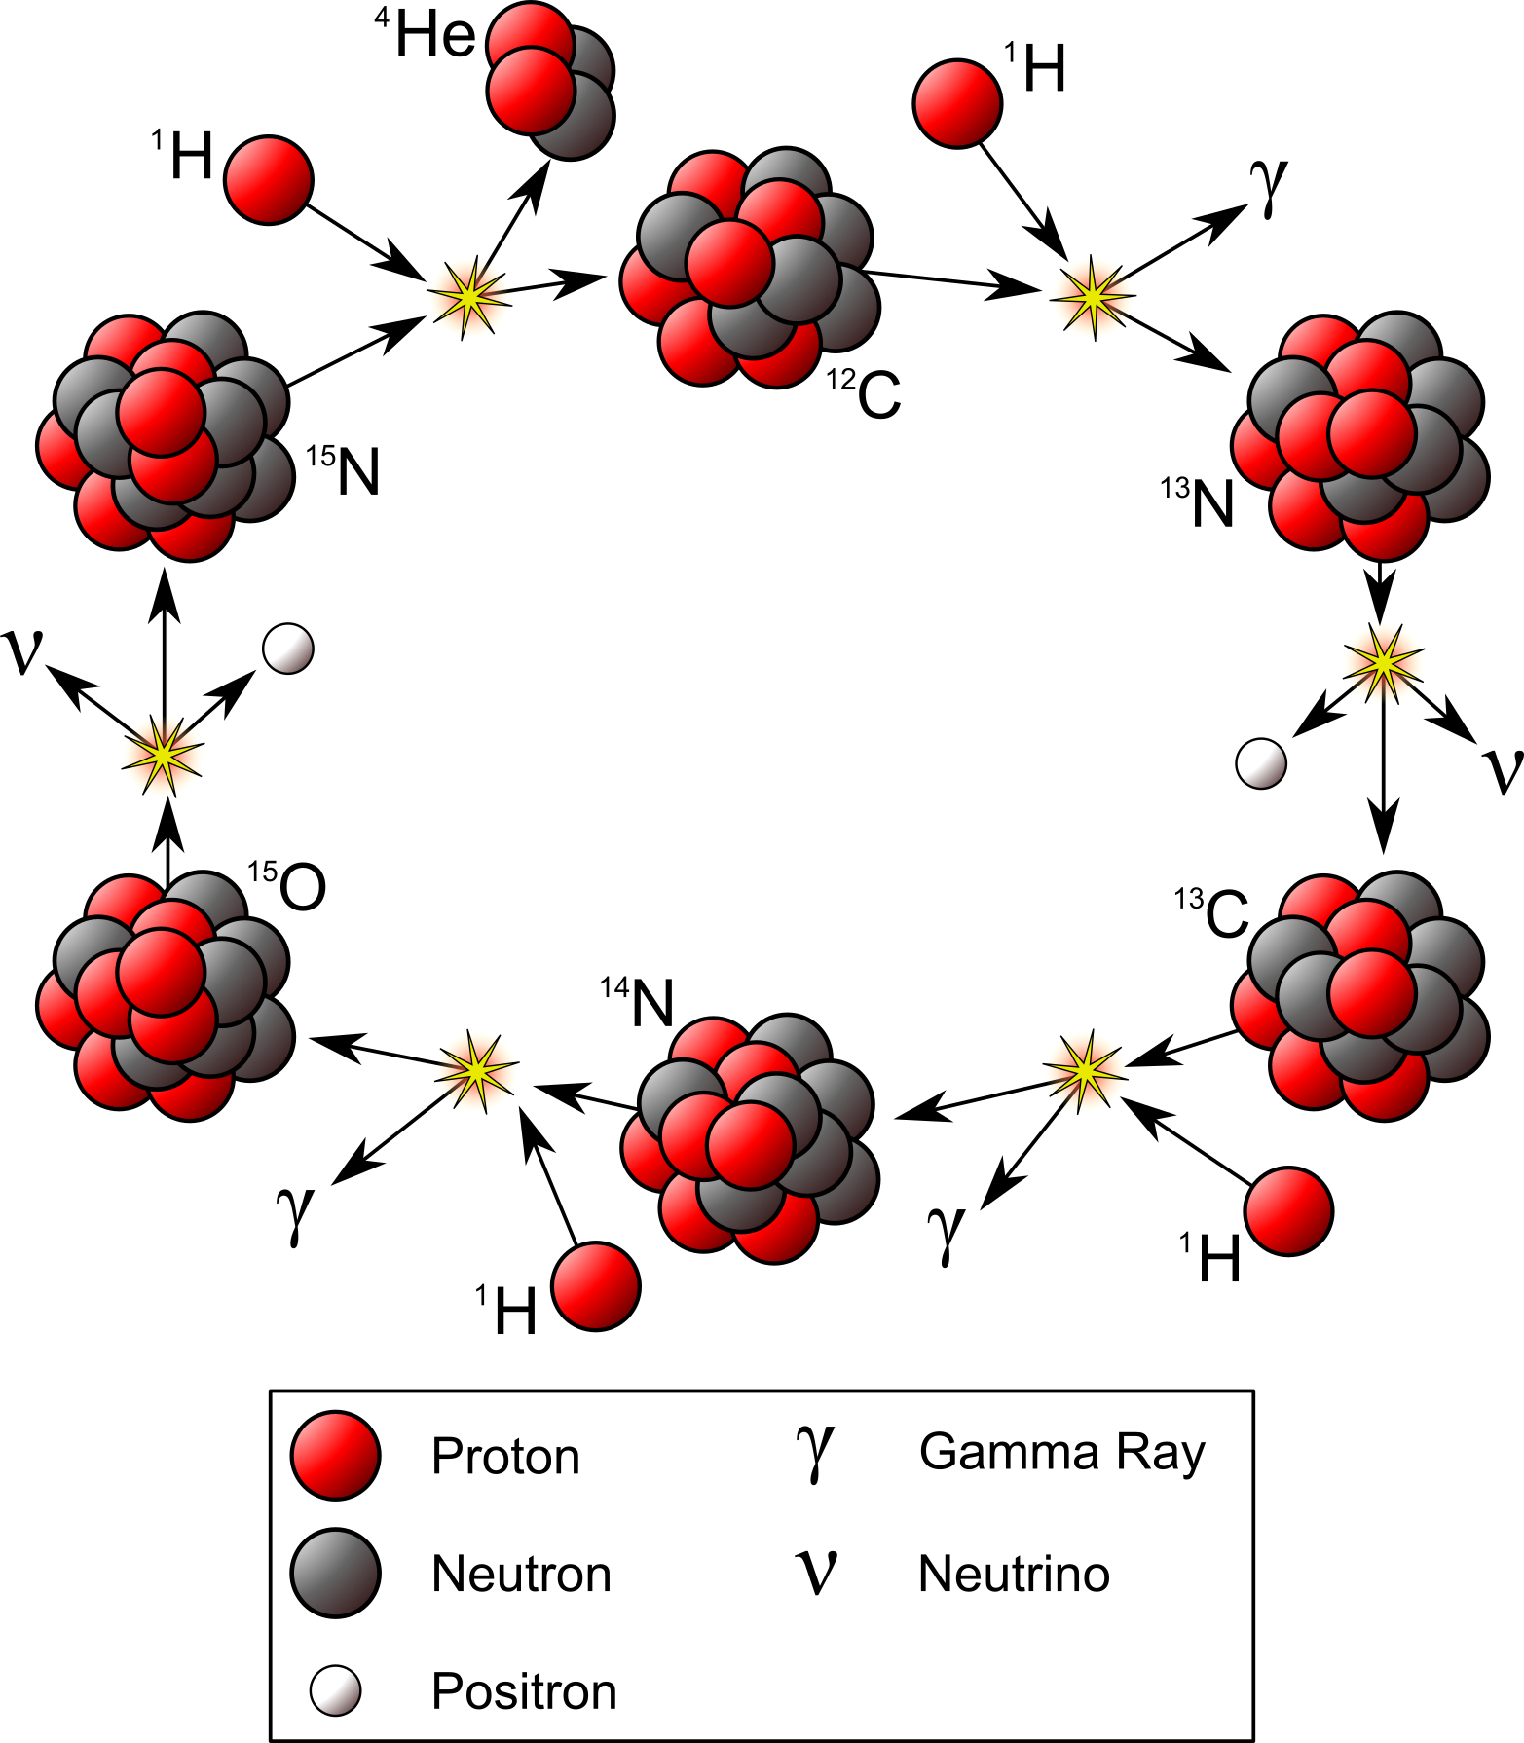
H->He Fusion
CNO cycle

Slide 10
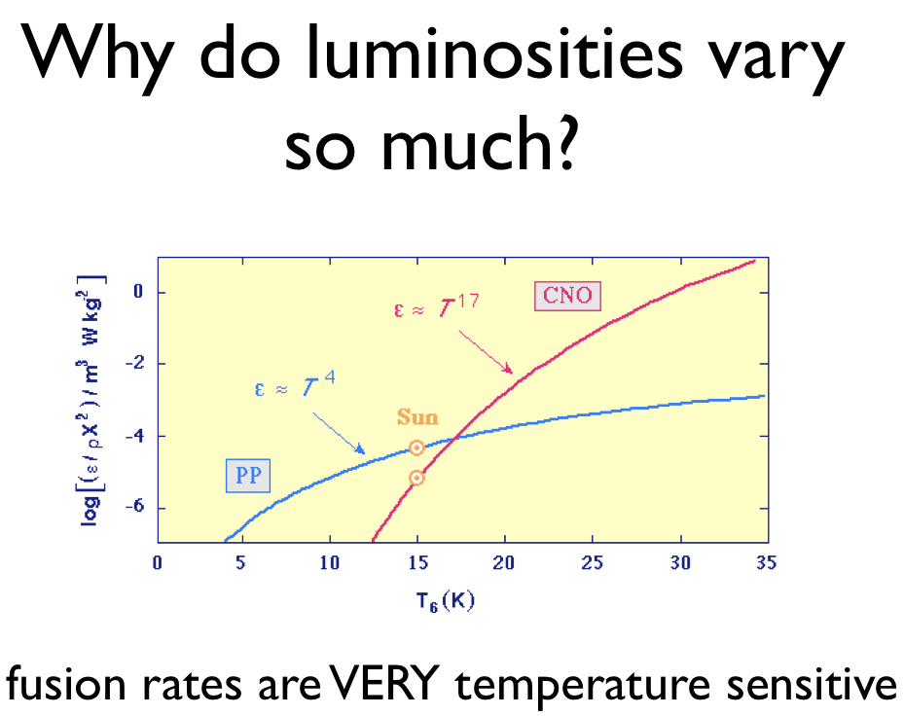

Slide 11
Hydrostatic Equilibrium:
Energy supplied by fusion pushes out against the inward crush of gravity

Slide 12
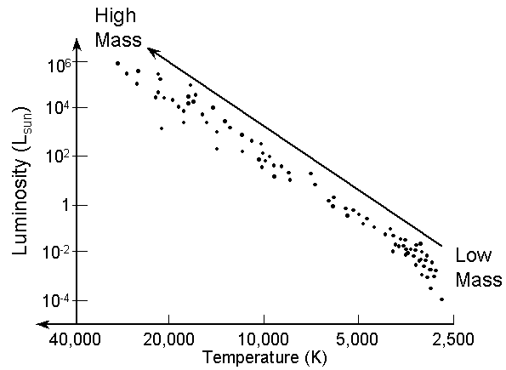
H->He fusing stars form
the Main Sequence!

Slide 13
How to put a star on HR diagram?

Slide 14

How to put a star on HR diagram?
We can guess temperature from the star's color

Slide 15

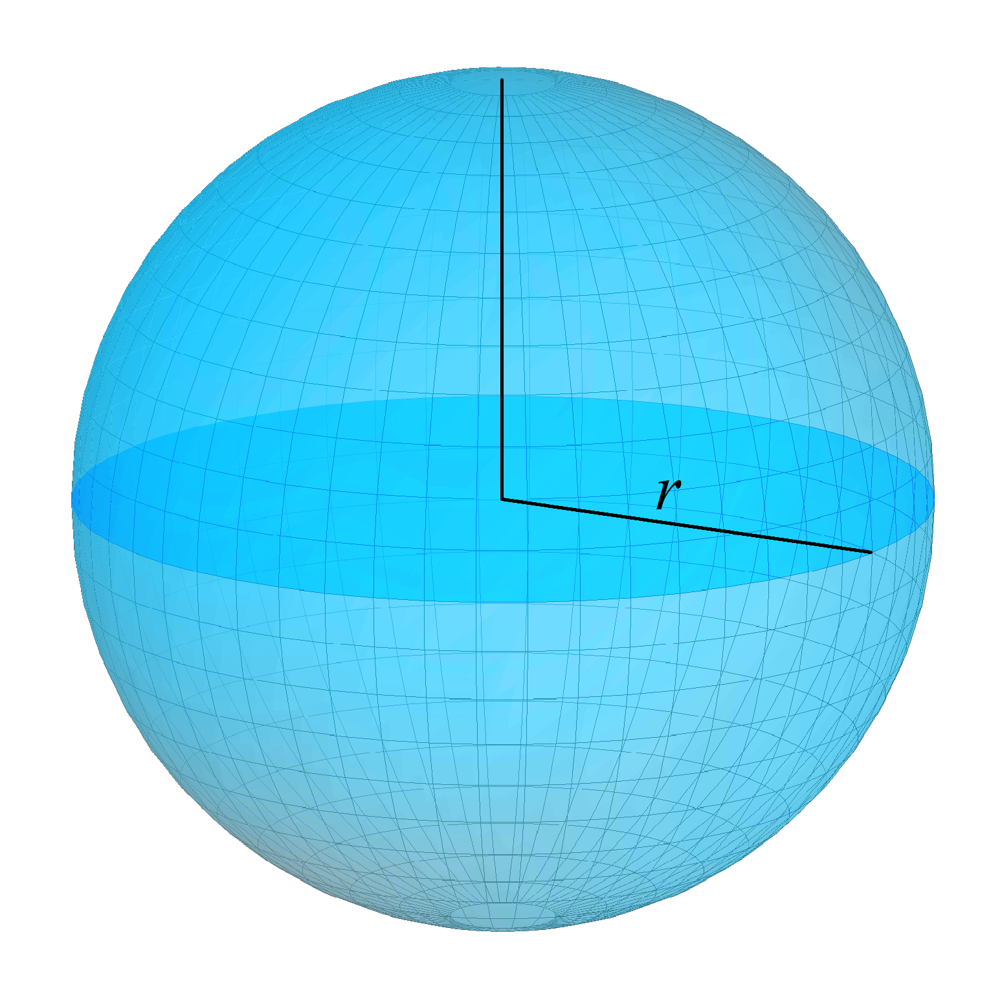
How to put a star on HR diagram?
We can see how bright the star is. Need to know distance to compute the star's Luminosity

Slide 16
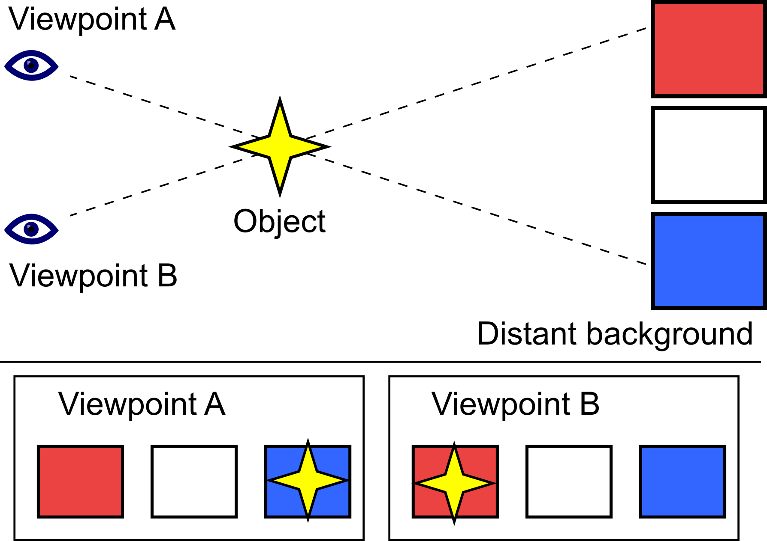
How to put a star on HR diagram?
We know distance from parallax

Slide 17
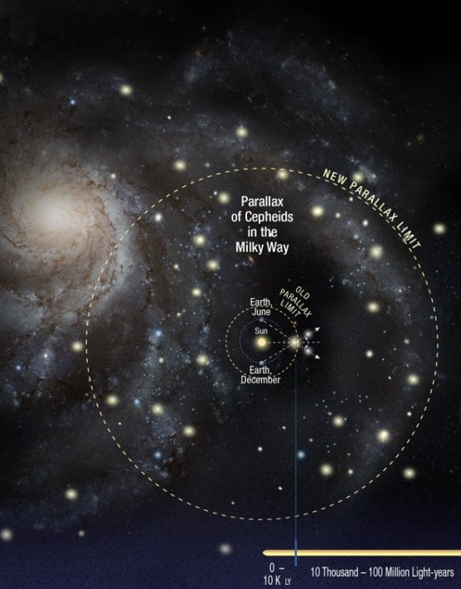
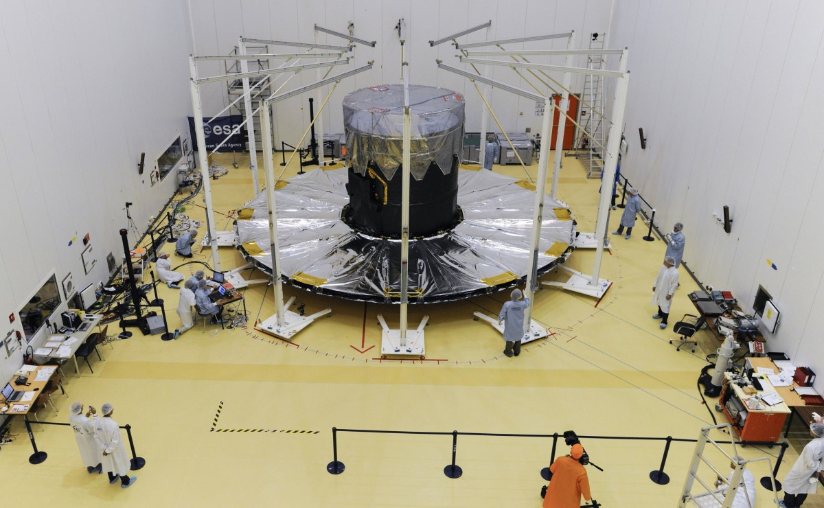
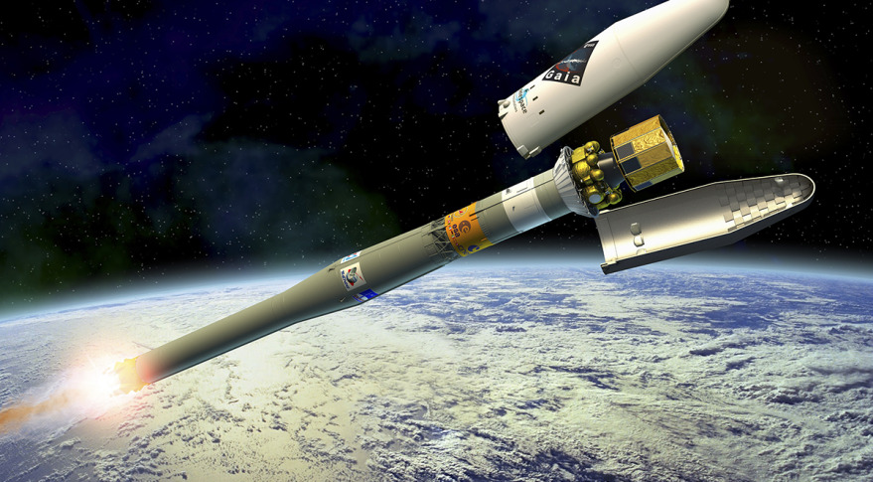
Gaia space probe measures parallaxes and colors of stars

Slide 18
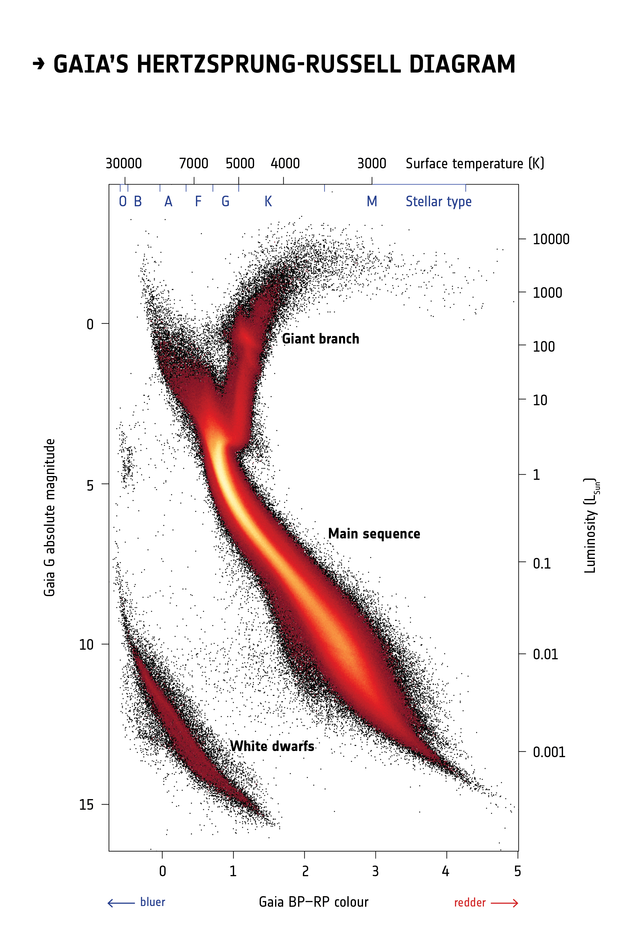
HR diagram from Gaia

Slide 19
HR diagram from Gaia
Stars that are out of Hydrogen fuel in their cores

Slide 20

How to put a star on HR diagram?
We can model life of a star on a computer
The following plots are made with the MESA/MIST stellar evolution code:http://waps.cfa.harvard.edu/MIST/

Slide 21
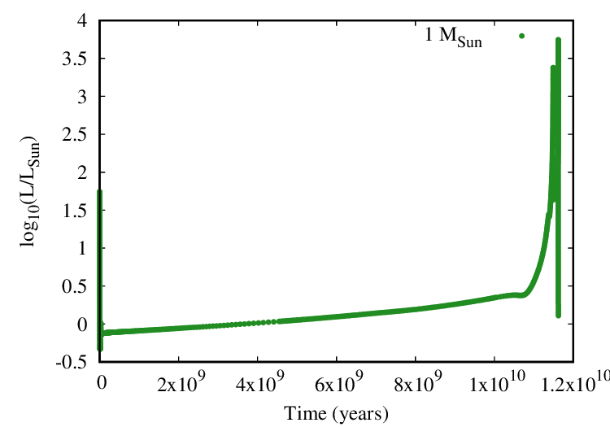
Luminosity as a function of time

Slide 22
Luminosity as a function of time
Sun settles on the main sequence

Slide 23
Luminosity as a function of time
Sun on main sequence
gets brighter by 1% every 100 Myr

Slide 24
What happens on Earth
Primitive life
starts here
Cambrian explosion
We are here
Oceans boil

Slide 25
Luminosity as a function of time
and Sun becomes red giant
Sun's core runs out of Hydrogen

Slide 26
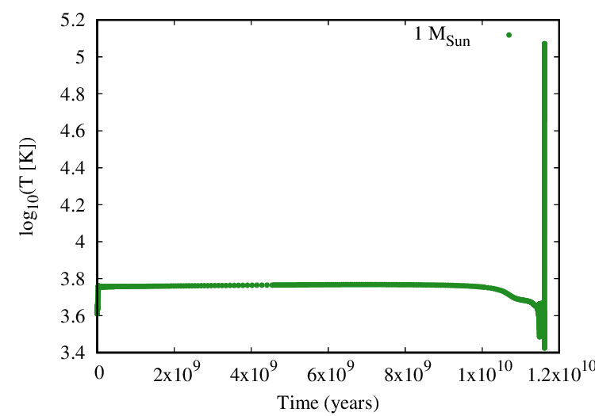
Temperature as a function of time
and Sun becomes red giant
Sun's core runs out of Hydrogen

Slide 27
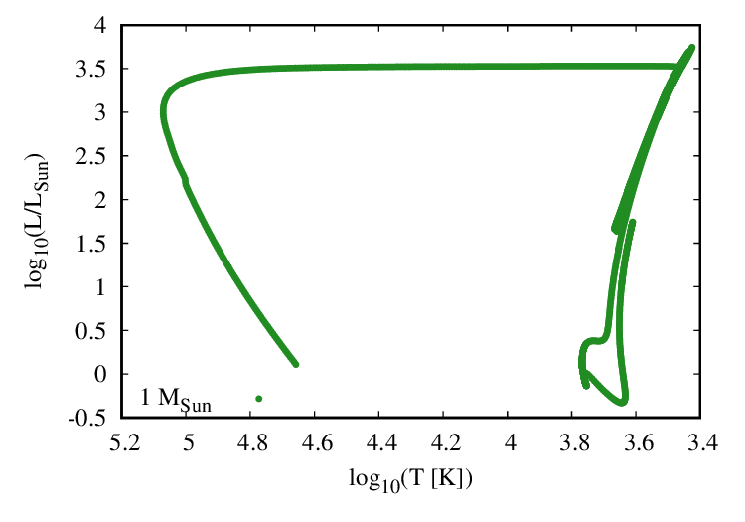
HR track of the Sun

Slide 28
HR track of the Sun
planetary nebula
red giant
white dwarf
main sequence

Slide 29
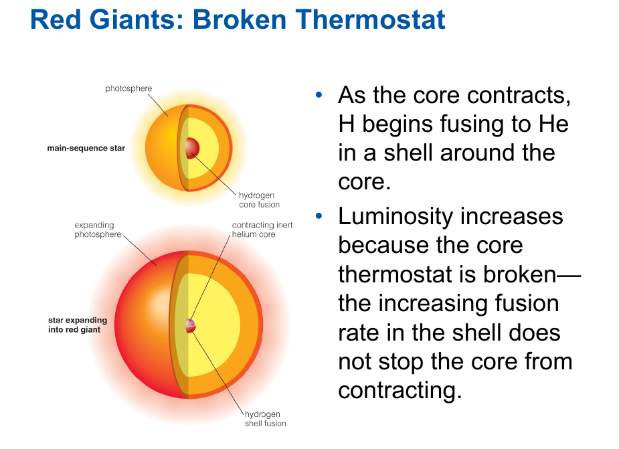

Slide 30
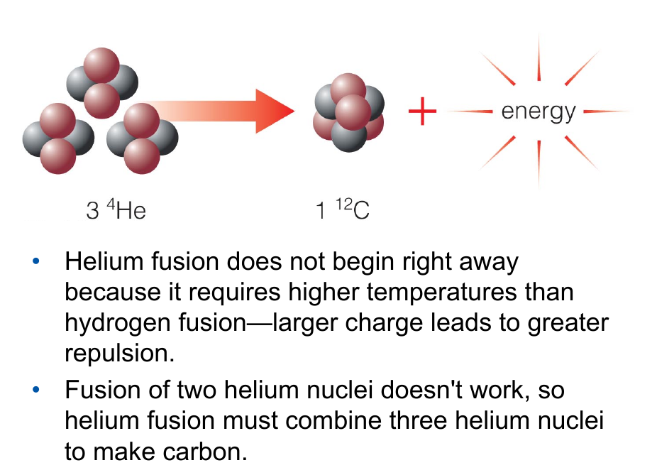

Slide 31
Nuclear vs. EM forces
Carbon
Helium
Hydrogen

Slide 32
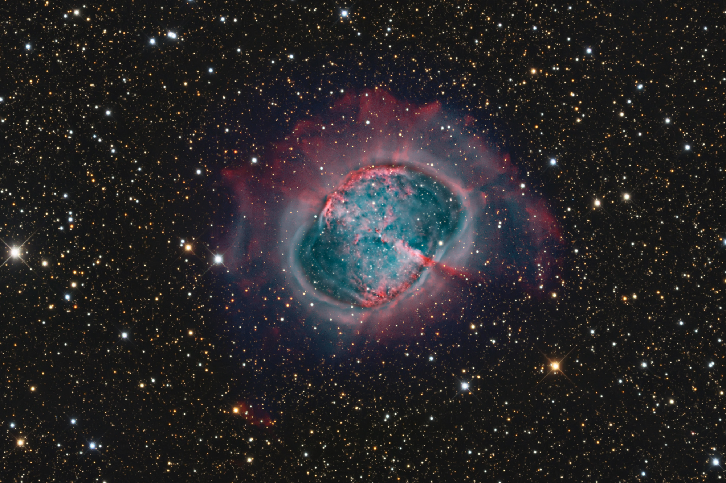
Ejected red giant atmosphere = planetary nebula

Slide 33
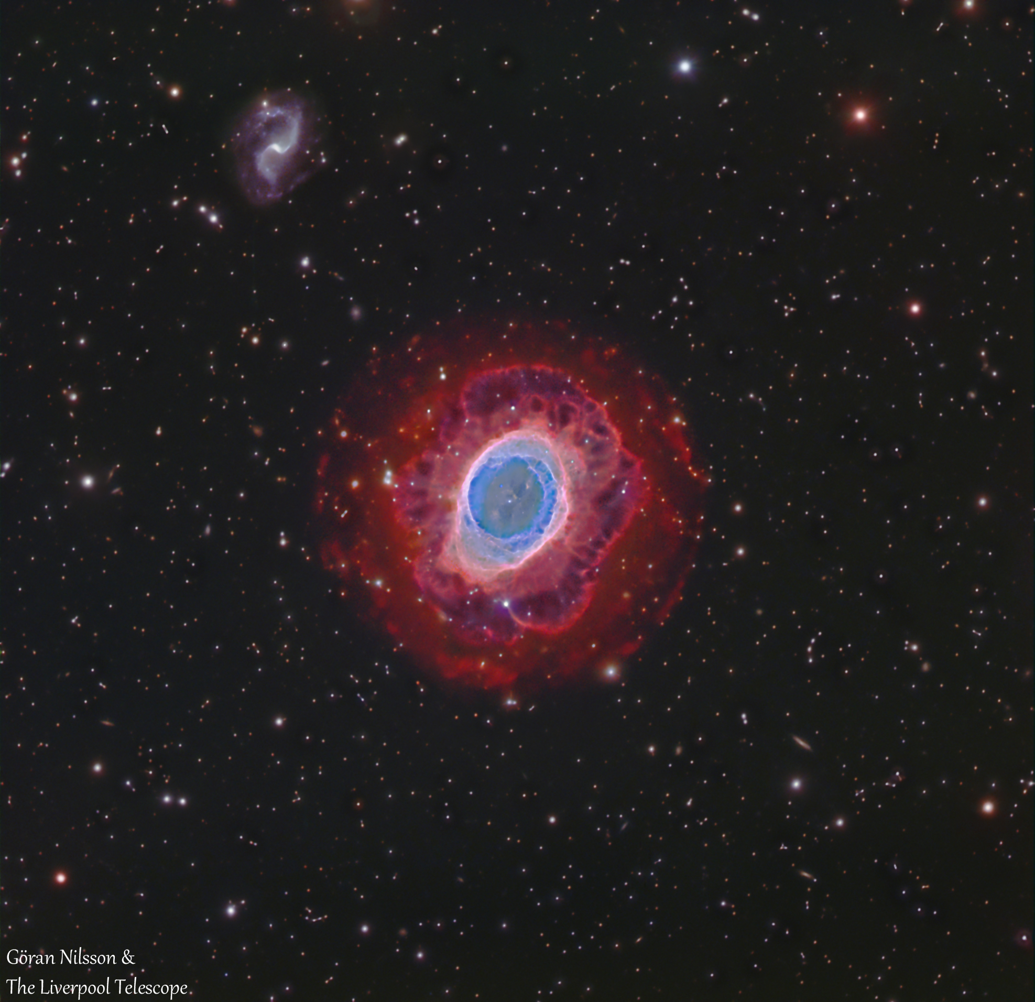
Ejected red giant atmosphere = planetary nebula

Slide 34
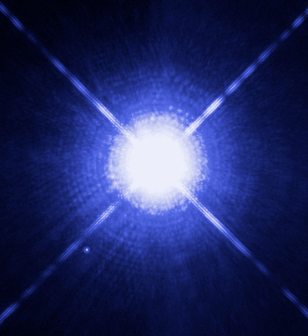
White Dwarf = exposed degenerate core of a solar-type star
Sirius A
Sirius B

Slide 35
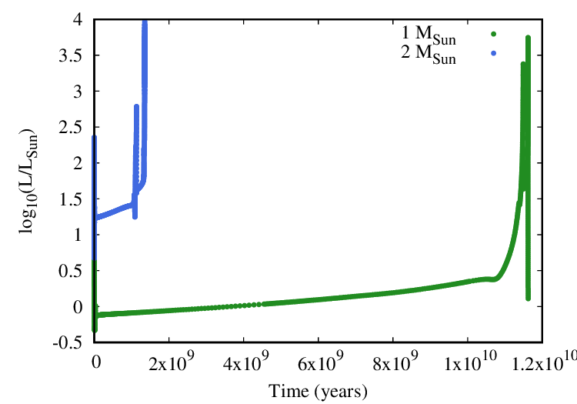
Luminosity as a function of time

Slide 36
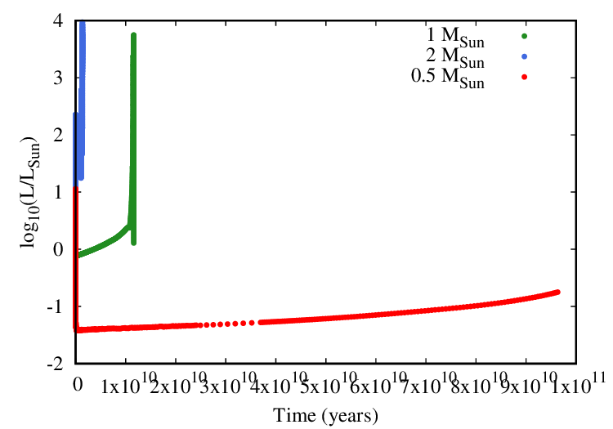
Luminosity as a function of time

Slide 37
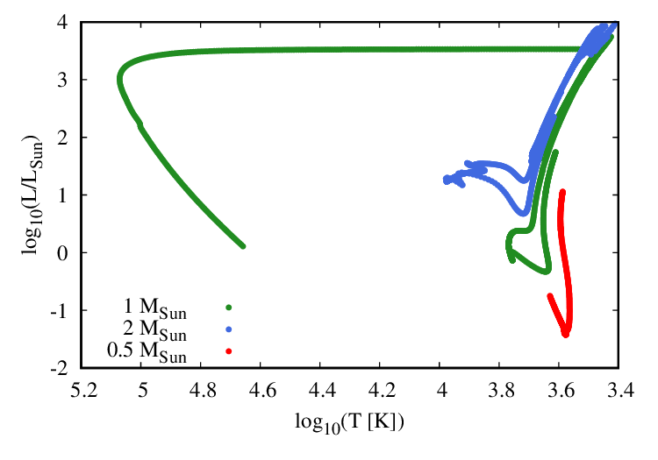
HR tracks
planetary nebula
red giant
main sequence
white dwarf

Slide 38
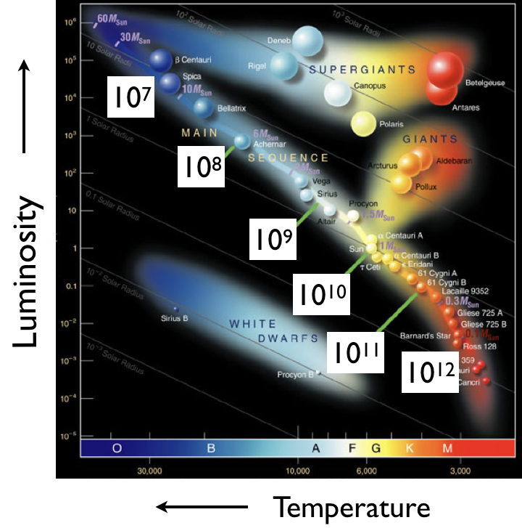

Slide 39
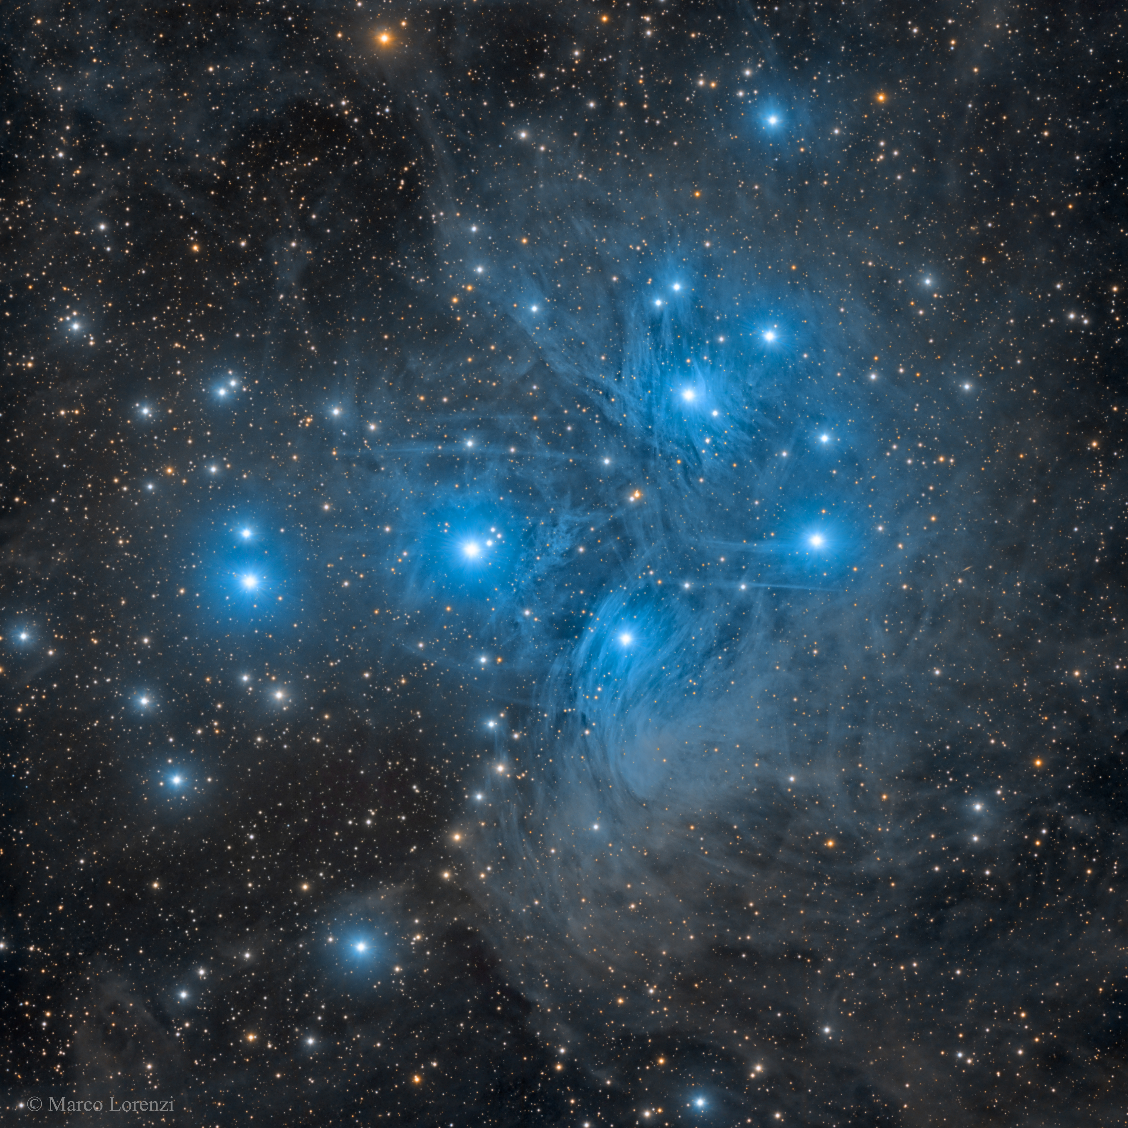
Stars often born in clusters
There are two types: Globular and Open
Omega Centauri Pleiades

Slide 40
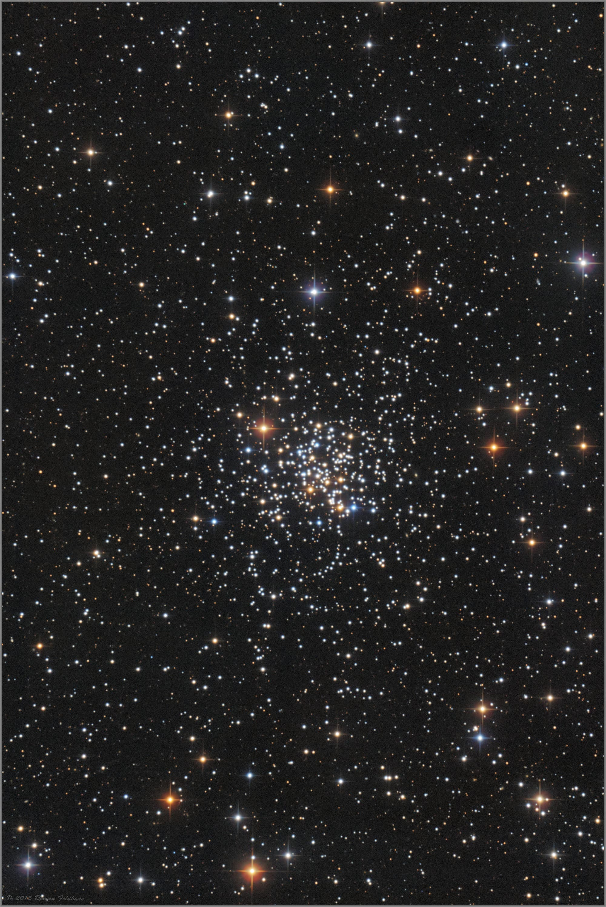
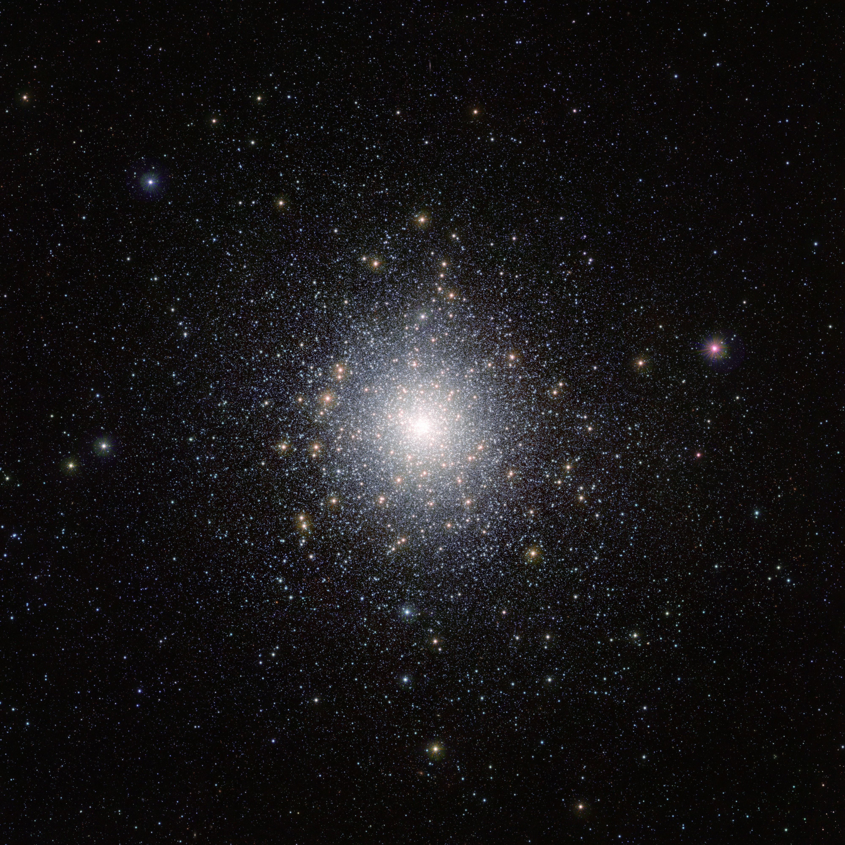
Two other examples of star clusters
There are two types: Globular and Open
47 Tucanae M67

Slide 41
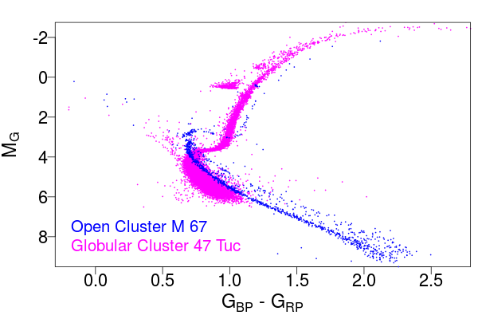
Gaia HR: old OC vs “young” GC

Slide 42
Two factors: age and metallicity

Slide 43
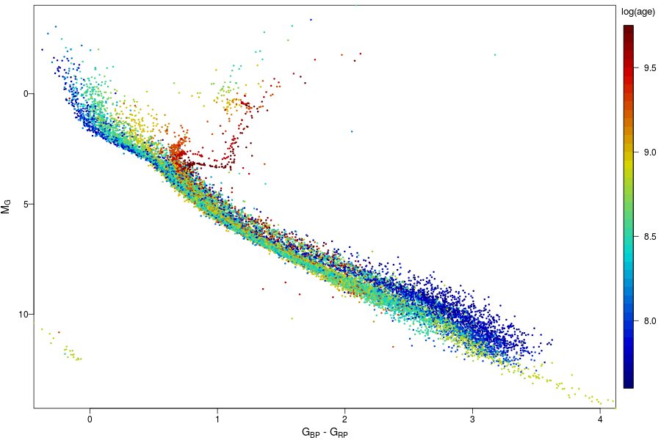
Gaia HR: open clusters
color is age

Slide 44
Gaia HR: open clusters
left main sequence
color is age
haven't reach main sequence

Slide 45
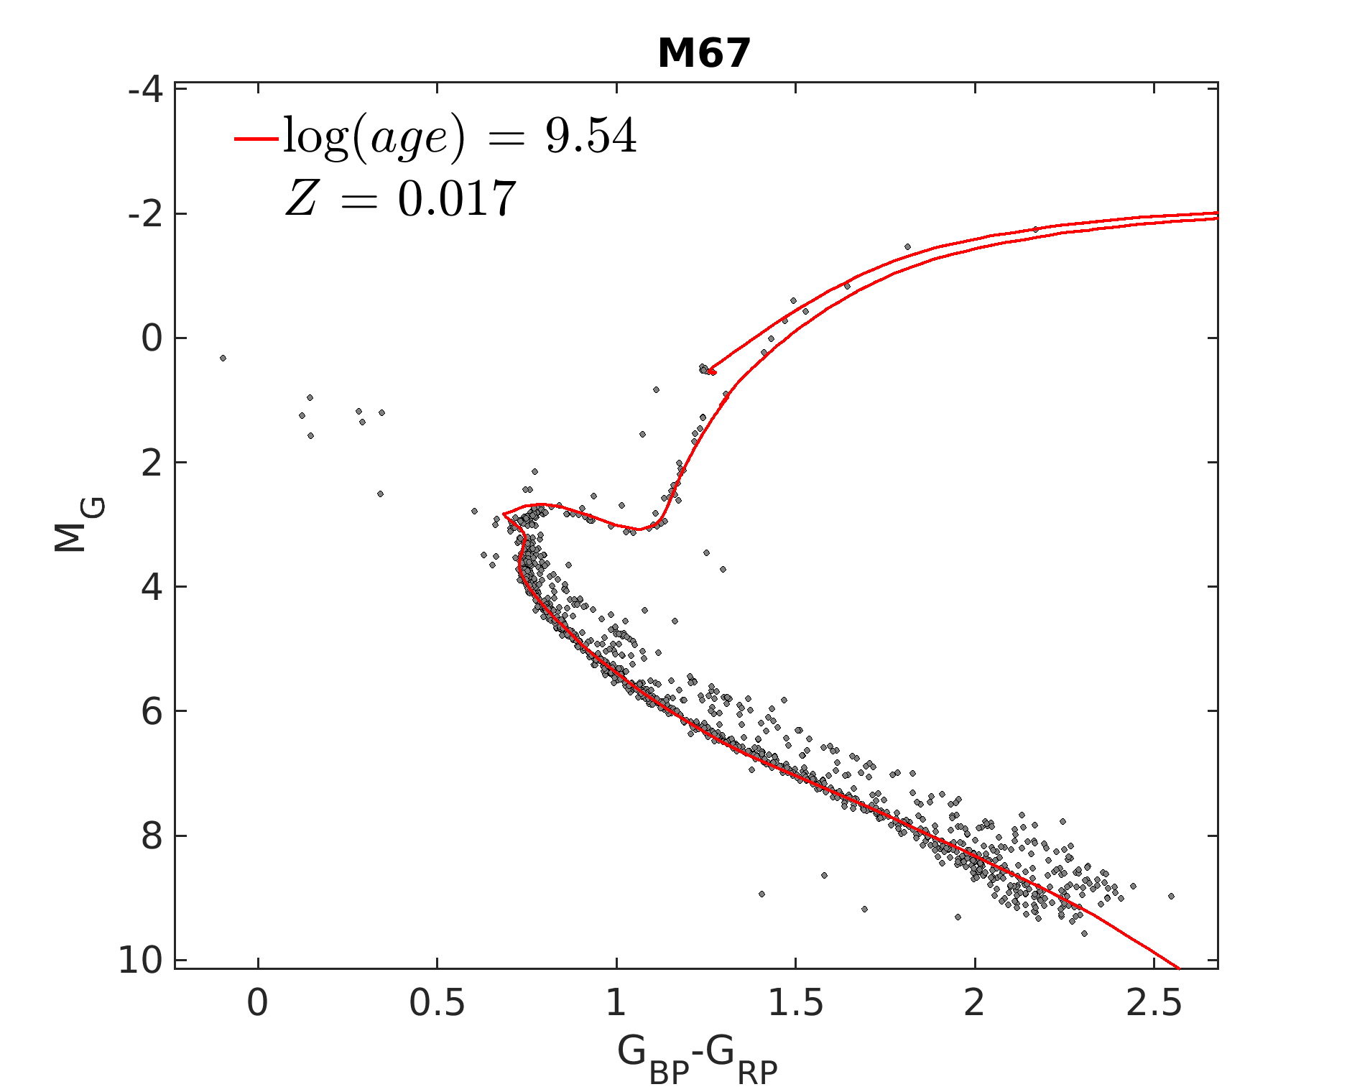
Isochrones: HR positions of same-age stars

Slide 46
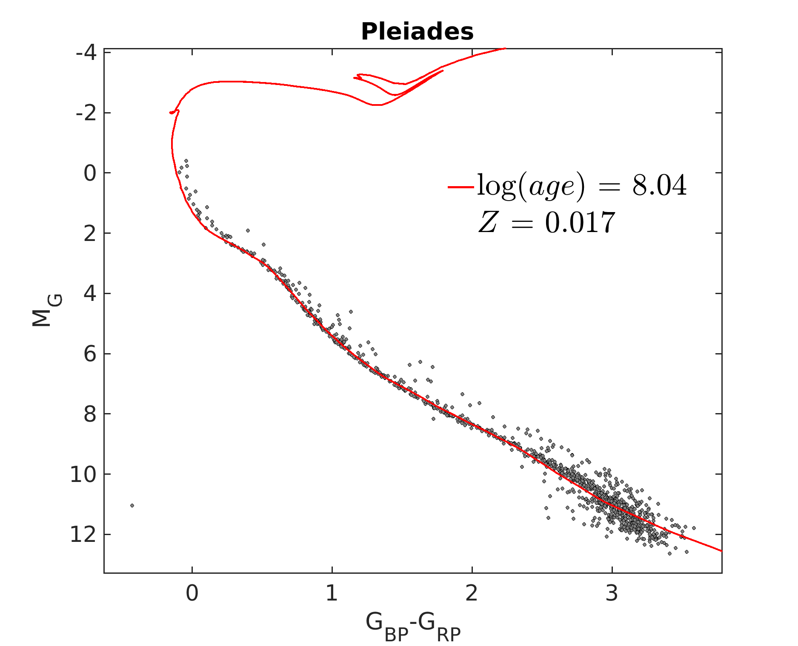
Isochrones: HR positions of same-age stars

Slide 47
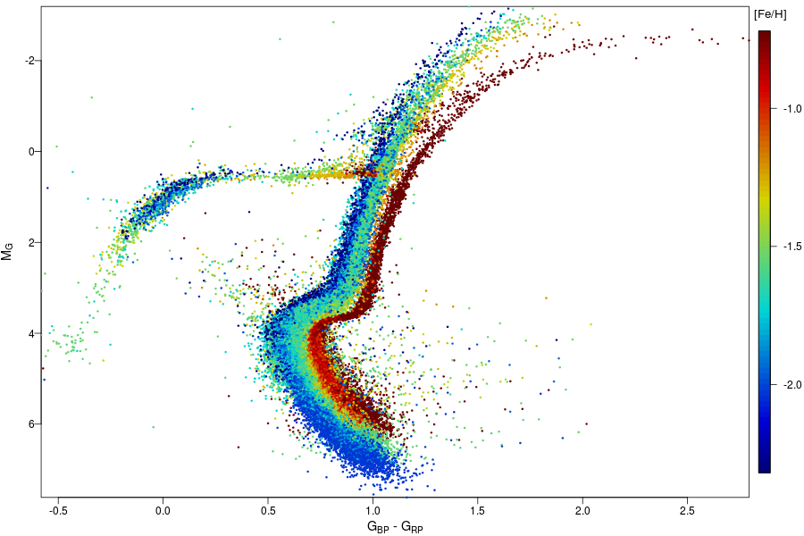
Gaia HR: globular clusters
color is metallicity
(their age is about the same)

Slide 48
Summary
Mass, age and metallicity determine luminosity and temperature of a star
Stars in clusters are born the same time and are at the same distance from us - useful for comparing with stellar evolution models
White Dwarf is the evolutionary end point of a solar-type star

