Slide 1
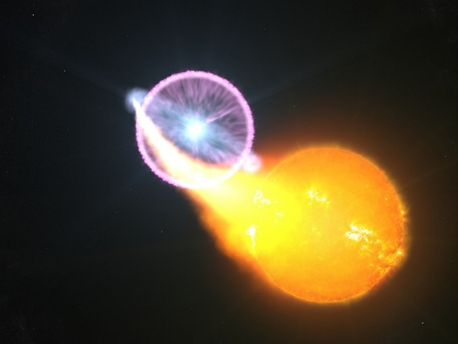
Exploring the formation of shocks in novae
Elias Aydi
NASA Hubble Fellow
Michigan State University
L. Chomiuk, K. V. Sokolovsky, L. Izzo, K. Mukai, B. Metzger, K. Shen, J. Monnier, G. Schaefer, M. Otulakowska-Hypka, K-L. Li, J. Sokoloski, J. Linford, D. A. H. Buckley, M. Orio, J. Mikolajewska, E. Steinberg, E. Harvey, J. Strader, and friends…
www.eliasaydi.com
AAS 244
June 2024

Slide 2
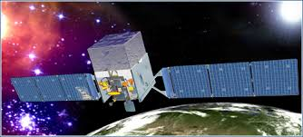
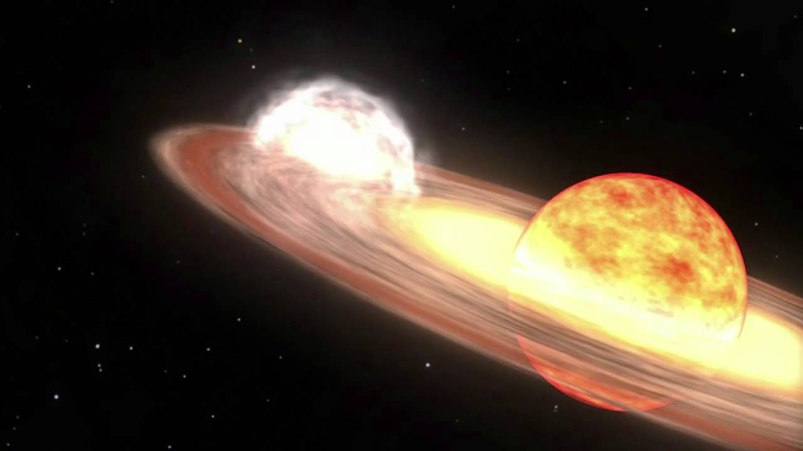
External shocks in symbiotic systems
Nova V407 Cyg
Abdo et al. (2010)
Fermi-LAT
Giant evolved secondary
Credits: http://svs.gsfc.nasa.gov/goto?10626
SMARTS
E. Aydi - MSU

Slide 3
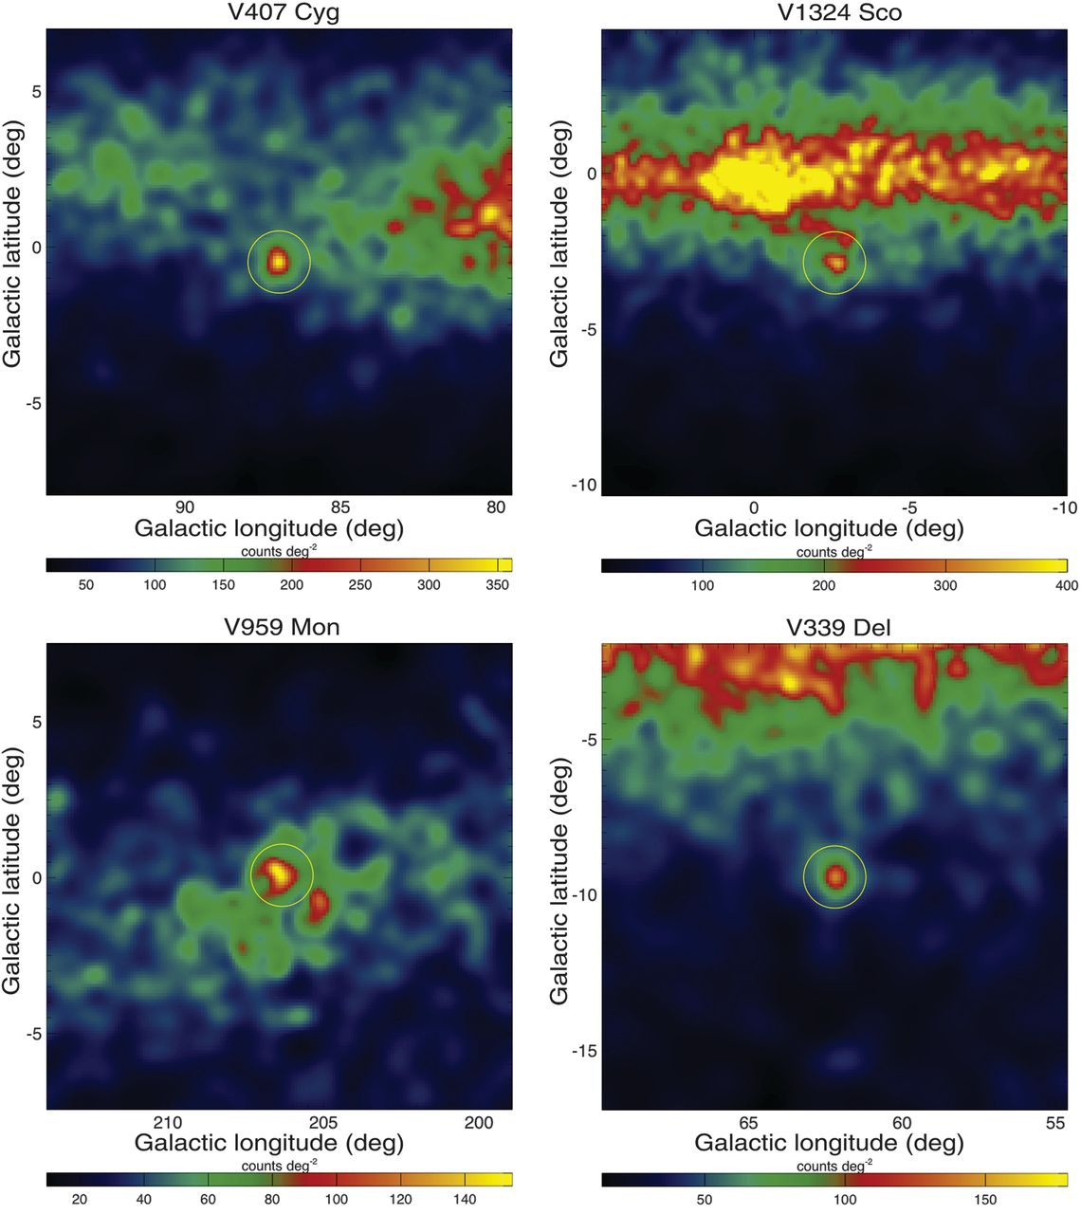
Gamma-ray from classical novae
GeV gamma-ray emission from novae
Fermi-LAT
SMARTS
E. Aydi - MSU
Ackerman et al. (2014)

Slide 4
Gamma-ray from classical novae
GeV gamma-ray emission from novae
Fermi-LAT
SMARTS
E. Aydi - MSU
Ackerman et al. (2014)

Slide 5
Radio imaging reveals two interacting outflows
Chomiuk et al. (2014)
V959 Mon
SMARTS
black: synchrotron from EVN
color: thermal from VLA
Symmetry axis “flips” by 90 degrees in 2 years following explosion.
E. Aydi - MSU

Slide 6
Radio imaging reveals two interacting outflows
Chomiuk et al. (2014)
V959 Mon
Bill Saxton / NRAO / AUI / NSF
SMARTS
E. Aydi - MSU

Slide 7
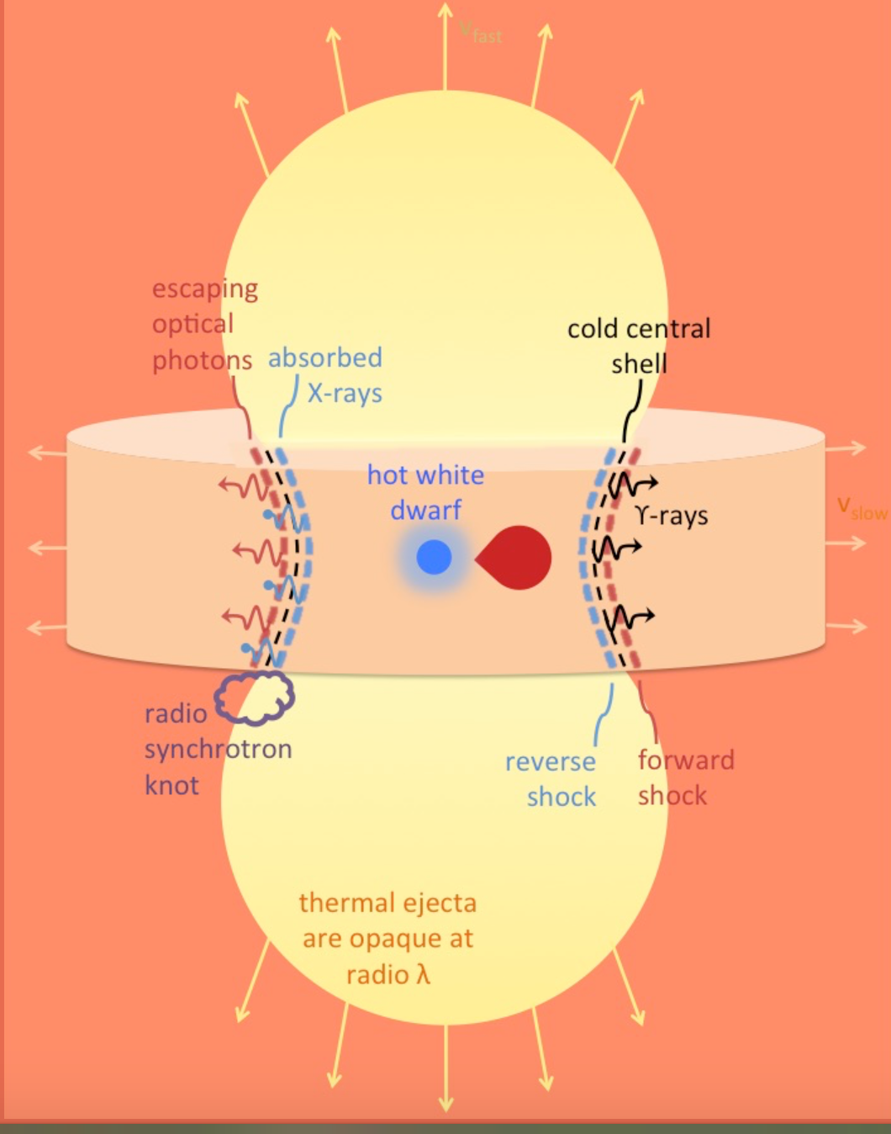
Shocks internal to the ejecta
Chomiuk et al. (2014)
Metzger et al. (2015)
Credits: NASA/GSF
SMARTS
E. Aydi - MSU

Slide 8
Shocks internal to the ejecta
Chomiuk et al. (2014)
Metzger et al. (2015)
Friedjung 1976: “The formation of the principal absorption system which appears to contain most of the mass ejected by a classical nova, can at least in some cases be explained by the collision of a high velocity wind responsible for the formation of spectrum line components belonging to the diffuse enhanced and Orion systems, with slower moving material associated with the pre-maximum system.”
SMARTS
E. Aydi - MSU

Slide 9
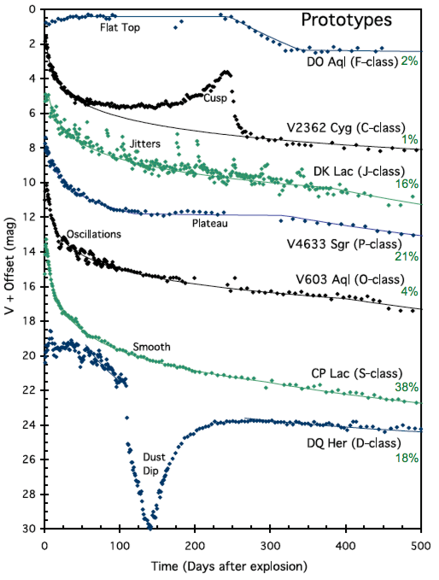
Novae do not behave
SMARTS
E. Aydi 2018 ©
E. Aydi - MSU
Strope et al. (2010)

Slide 10
Single vs multiple outflows?
Internal shocks
Shocks between clumps?
SMARTS
E. Aydi - MSU

Slide 11
External vs internal shocks?
External shocks
Internal shocks
Credits: http://svs.gsfc.nasa.gov/goto?10626
SMARTS
E. Aydi - MSU

Slide 12
Shocks internal to the ejecta
Chomiuk et al. (2014)
Metzger et al. (2015)
SMARTS
E. Aydi - MSU

Slide 13
Radio imaging reveals two interacting outflows
Chomiuk et al. (2014)
V959 Mon
SMARTS
black: synchrotron from EVN
color: thermal from VLA
Symmetry axis “flips” by 90 degrees in 2 years following explosion.
E. Aydi - MSU

Slide 14
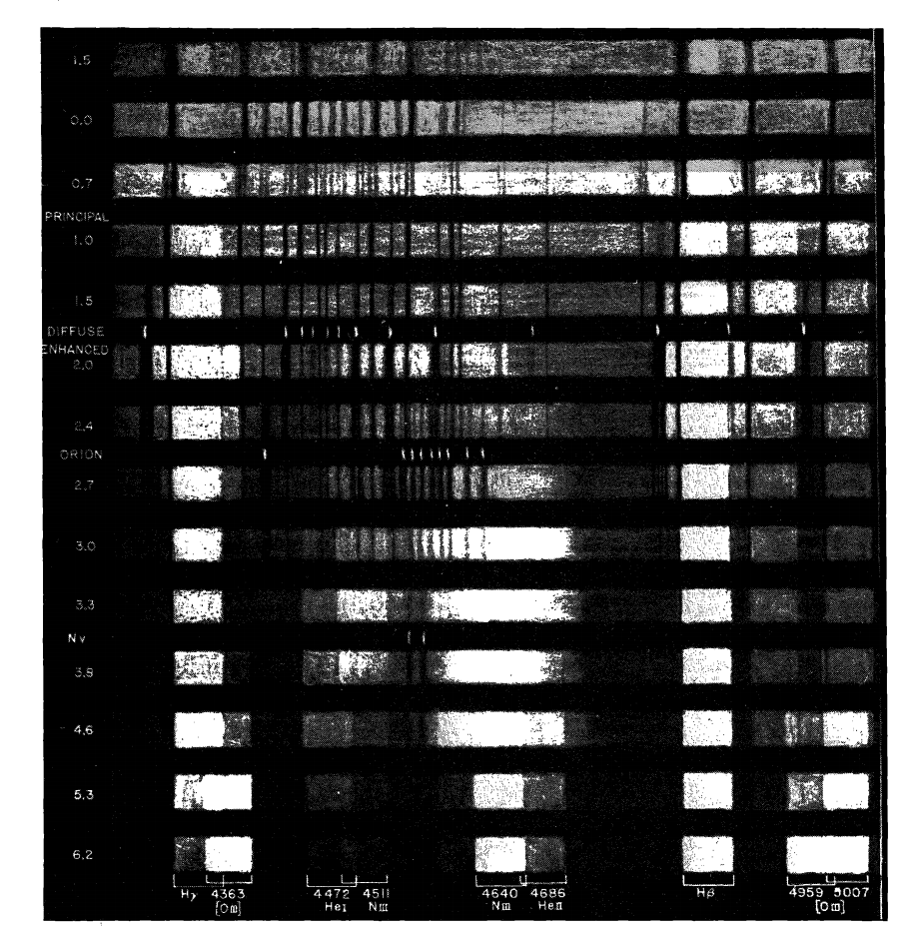
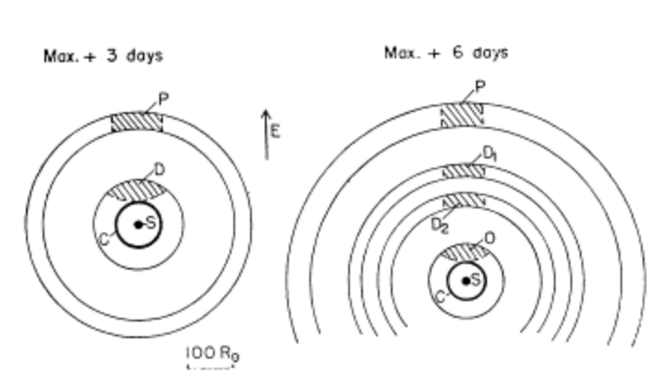
Early spectral evolution
McLaughlin (1944), Payne-Gaposchkin (1957), Friedjung (66,67, 76)
SMARTS
E. Aydi - MSU

Slide 15
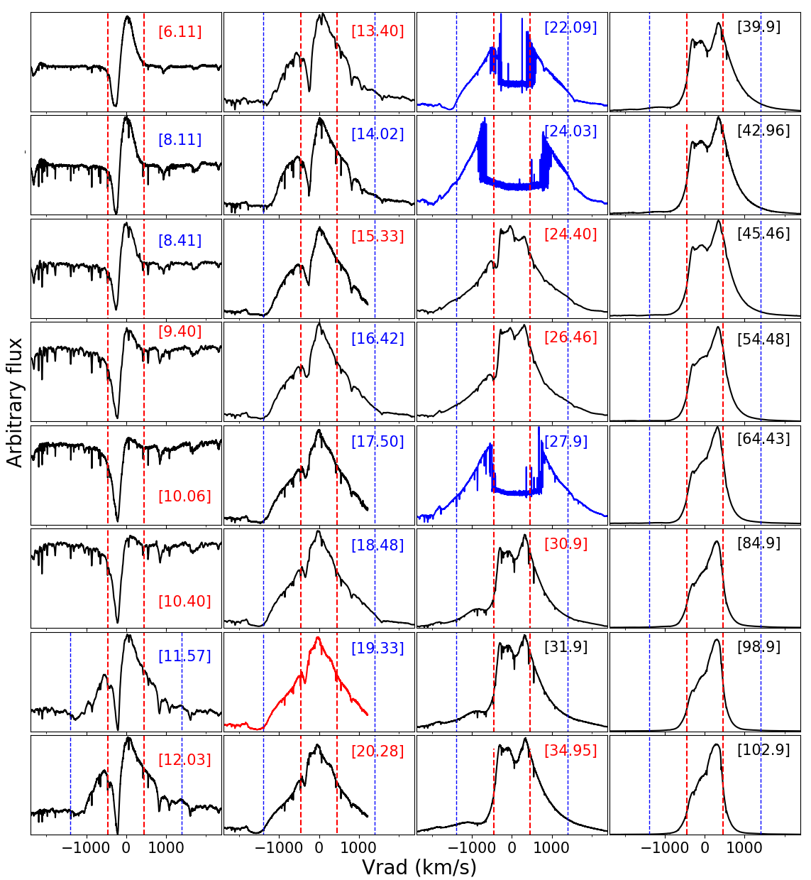
Spectra reveals two outflows
Halpha line profiles evolution
Aydi et al. 2020 (Nat Ast, 4, 776)
E. Aydi - MSU

Slide 16
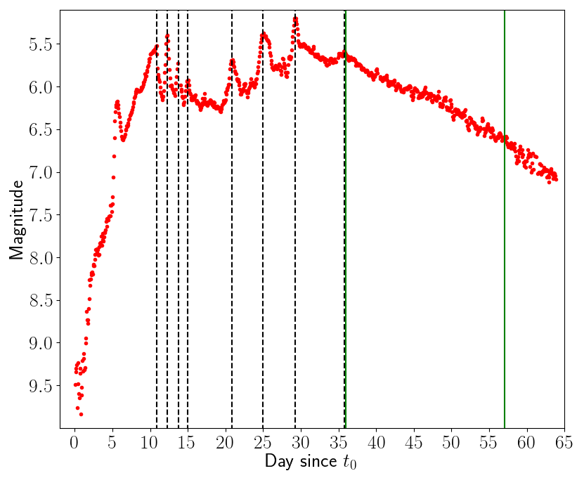
Spectra reveals two outflows
Halpha line profiles evolution
Aydi et al. 2020 (Nat Ast, 4, 776)
E. Aydi - MSU

Slide 17
Spectra reveals two outflows
Halpha line profiles evolution
Peak
Aydi et al. 2020 (Nat Ast, 4, 776)
E. Aydi - MSU

Slide 18
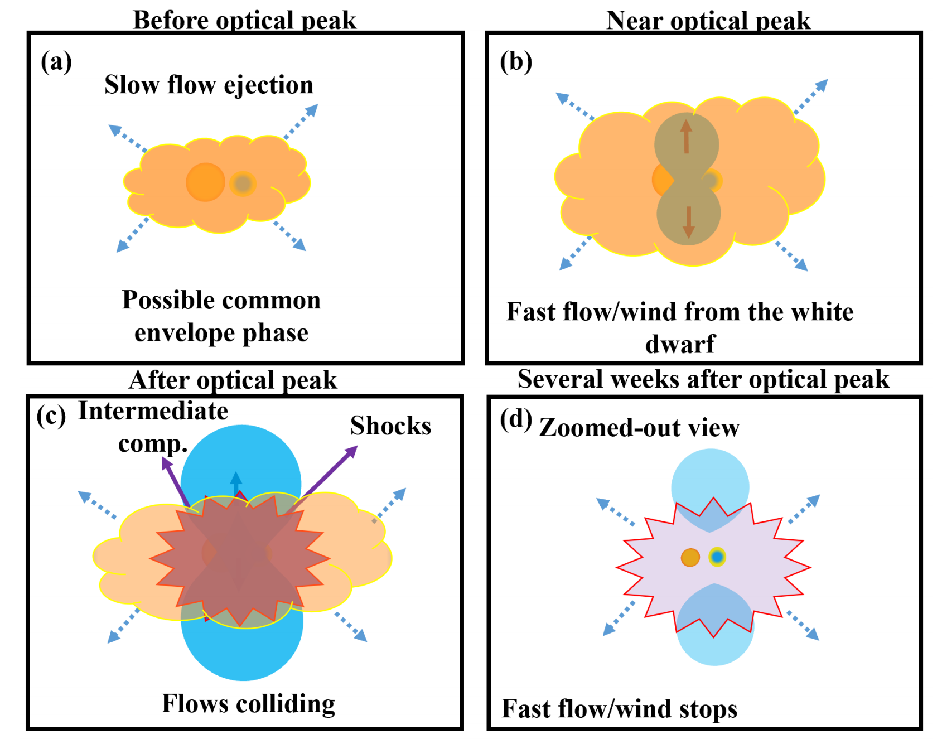
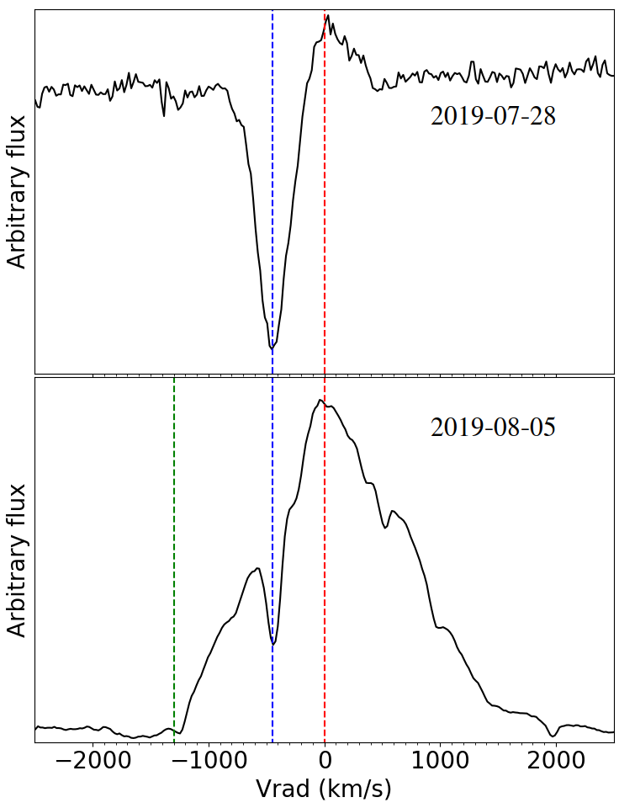
Spectra reveals two outflows
Nova LMC 2019
[-3]
SALT - SAAO
[+5]
SMARTS
E. Aydi - MSU
Aydi et al. 2020, ApJ, 905, 62

Slide 19
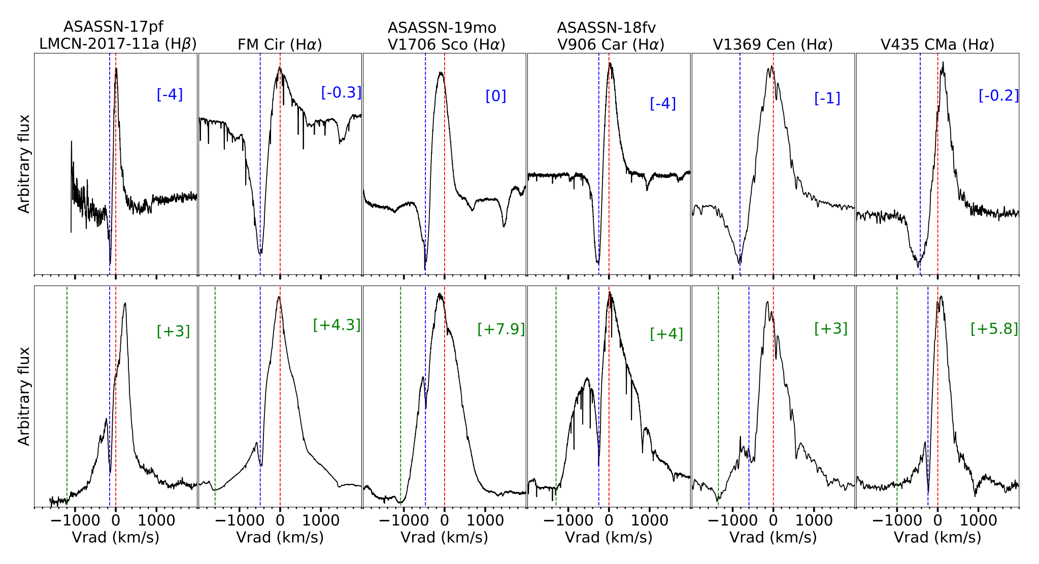
Spectra reveals two outflows
E. Aydi - MSU
Aydi et al. 2020, ApJ, 905, 62

Slide 20
Shocks internal to the ejecta
Chomiuk et al. (2014)
Metzger et al. (2015)
SMARTS
E. Aydi - MSU

Slide 21
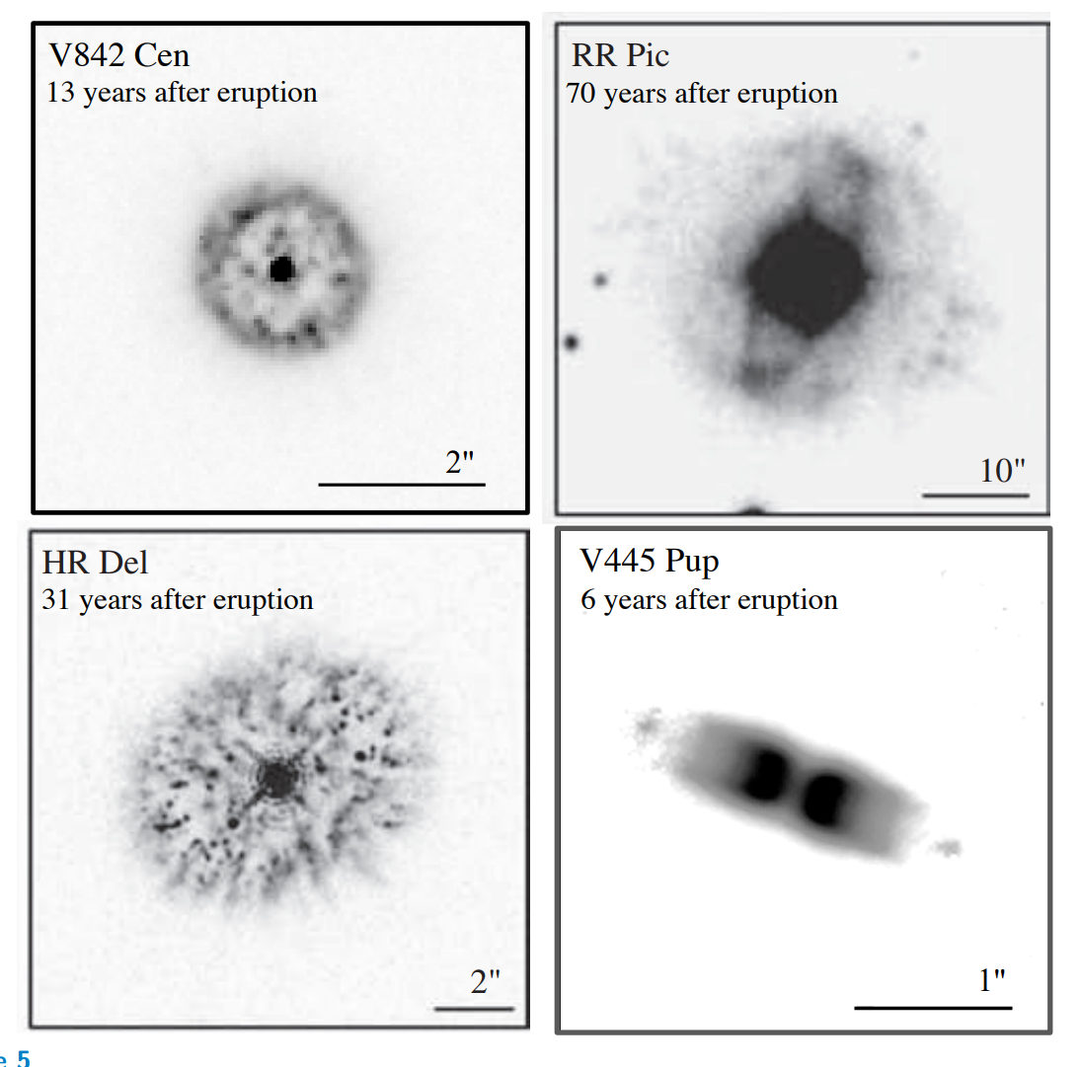
Imaging at late times
SALT - SAAO
SMARTS
E. Aydi - MSU

Slide 22
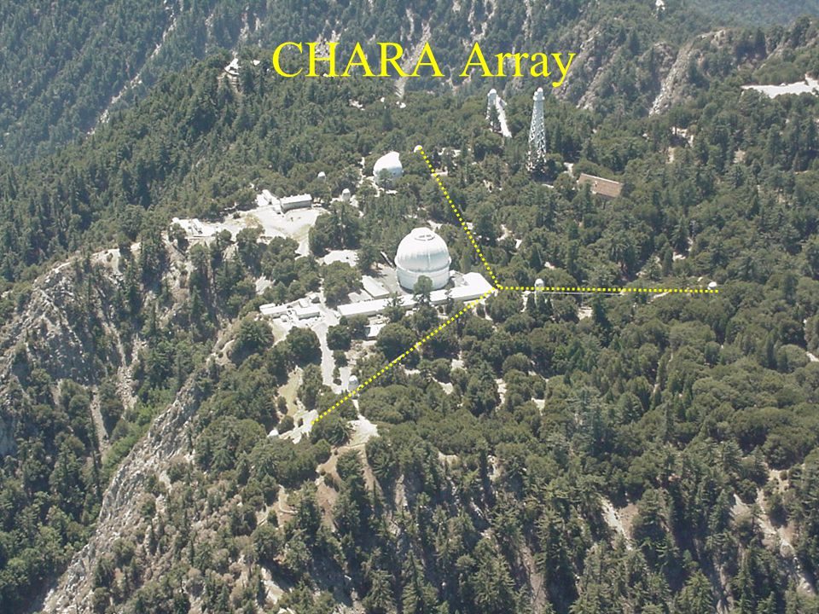
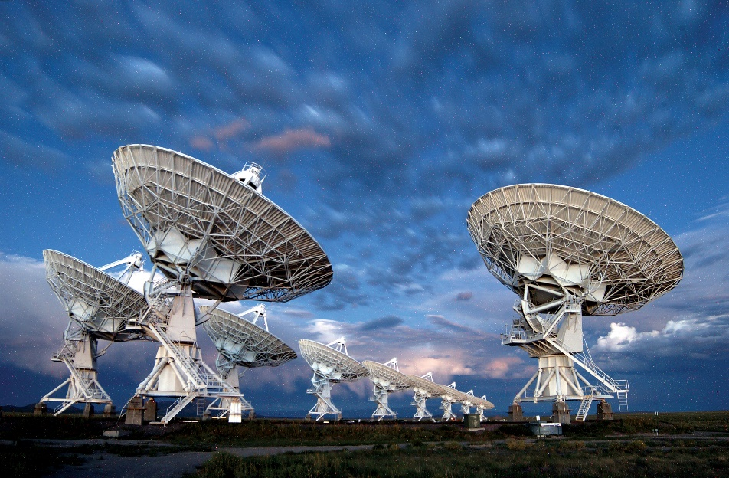
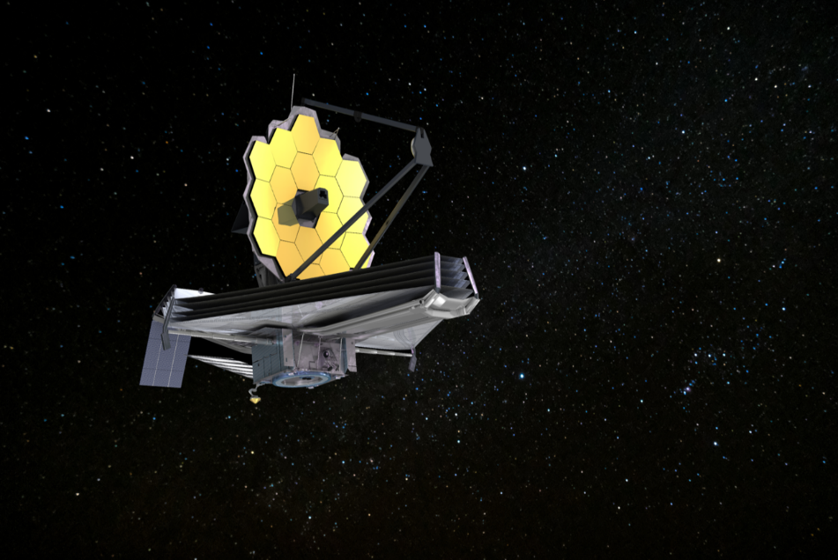
Imaging across an eruption
Early days/weeks
Months/year later
~ months/years later
VLA
JWST/HST
SALT - SAAO
SMARTS
E. Aydi - MSU

Slide 23
Imaging across an eruption
Early days/weeks
Months/year later
~ months/years later
VLA
JWST/HST
SALT - SAAO
SMARTS
E. Aydi - MSU

Slide 24
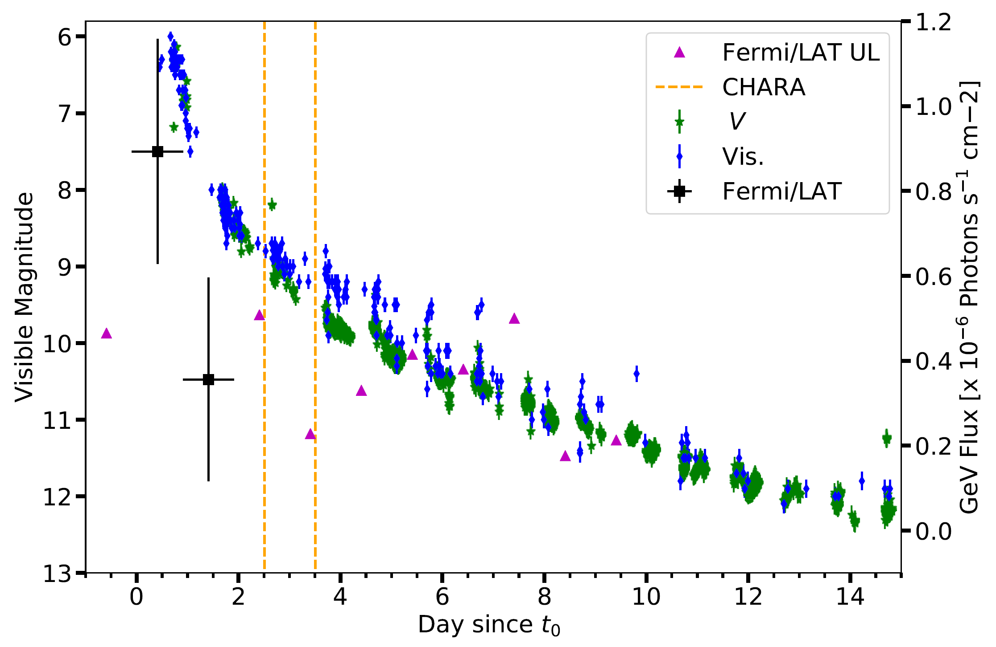
Imaging with CHARA
Nova V1674 Her - Discovered on June 12, 2021
Aydi et al. in perp.
SMARTS
E. Aydi - MSU

Slide 25
Imaging with CHARA
Aydi et al. in perp.
E. Aydi - MSU
Thanks to Gail Schaefer and John Monier

Slide 26
Imaging with CHARA
Aydi et al. in perp.
E. Aydi - MSU
Thanks to Gail Schaefer and John Monnier

Slide 27
Imaging with CHARA
Aydi et al. in perp.
E. Aydi - MSU
Thanks to Gail Schaefer and John Monnier

Slide 28
Imaging with CHARA
Nova V5852 Sgr Aydi et al. (2016)
E. Aydi - MSU

Slide 29
Imaging with CHARA
Aydi et al. in perp.
E. Aydi - MSU
Thanks to Gail Schaefer and John Monnier

Slide 30
Imaging with CHARA
Aydi et al. in perp.
3800 km/s
5000 km/s
SMARTS
E. Aydi - MSU

Slide 31
Imaging with CHARA
Aydi et al. in perp.
3800 km/s
5000 km/s
SMARTS
E. Aydi - MSU

Slide 32
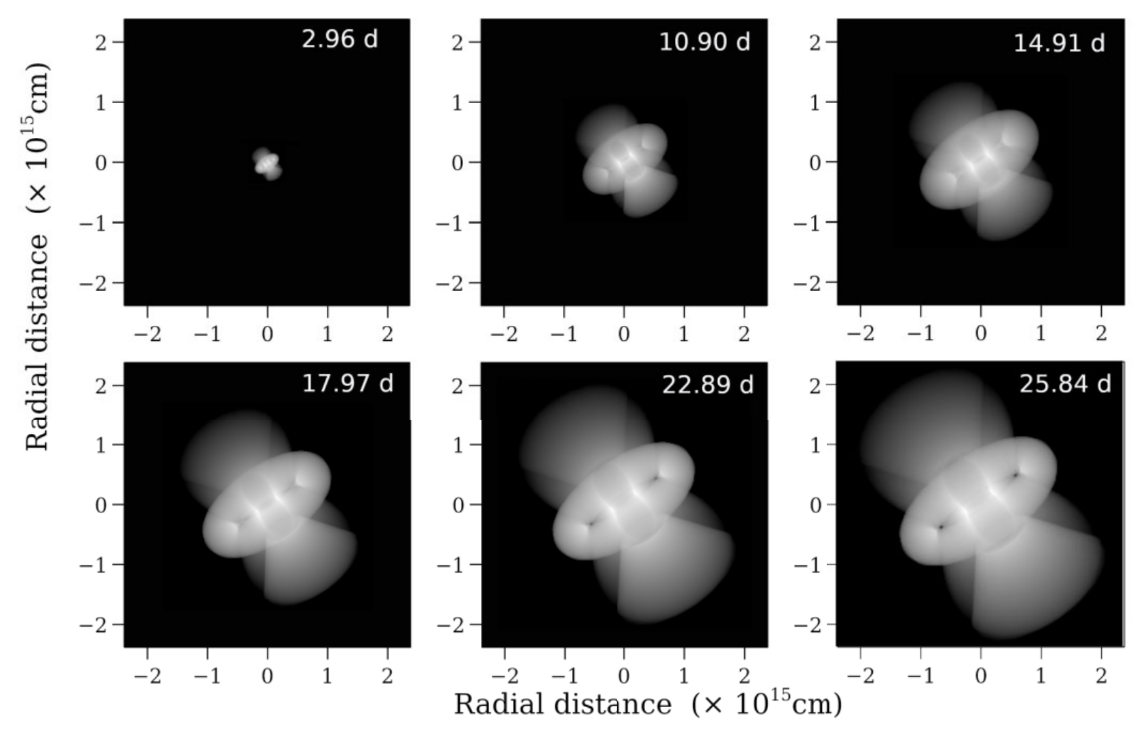
Imaging with CHARA
Habtie et al. (2024, MNRAS 527, 1405)
E. Aydi - MSU

Slide 33
Shocks internal to the ejecta
Chomiuk et al. (2014)
Metzger et al. (2015)
Credits: NASA/GSF
SMARTS
E. Aydi - MSU

Slide 34
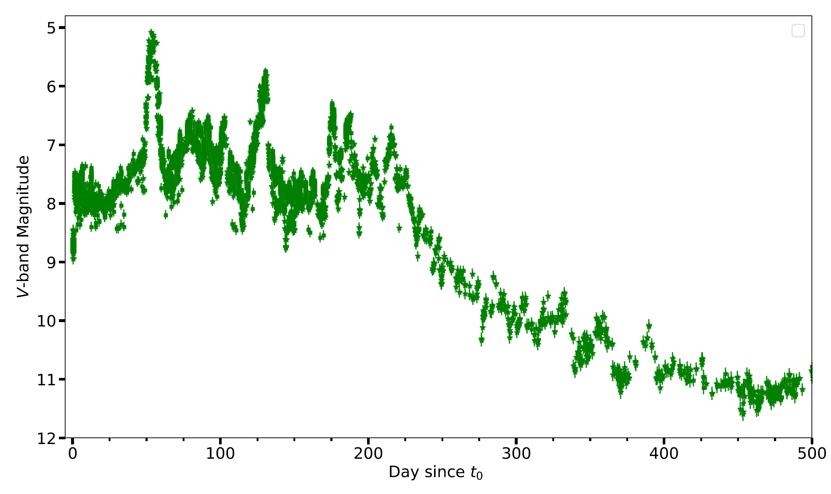
Imaging with CHARA
Nova V1405 Cas- Discovered on March 18, 2021
SMARTS
Aydi et al. in perp.
E. Aydi - MSU

Slide 35
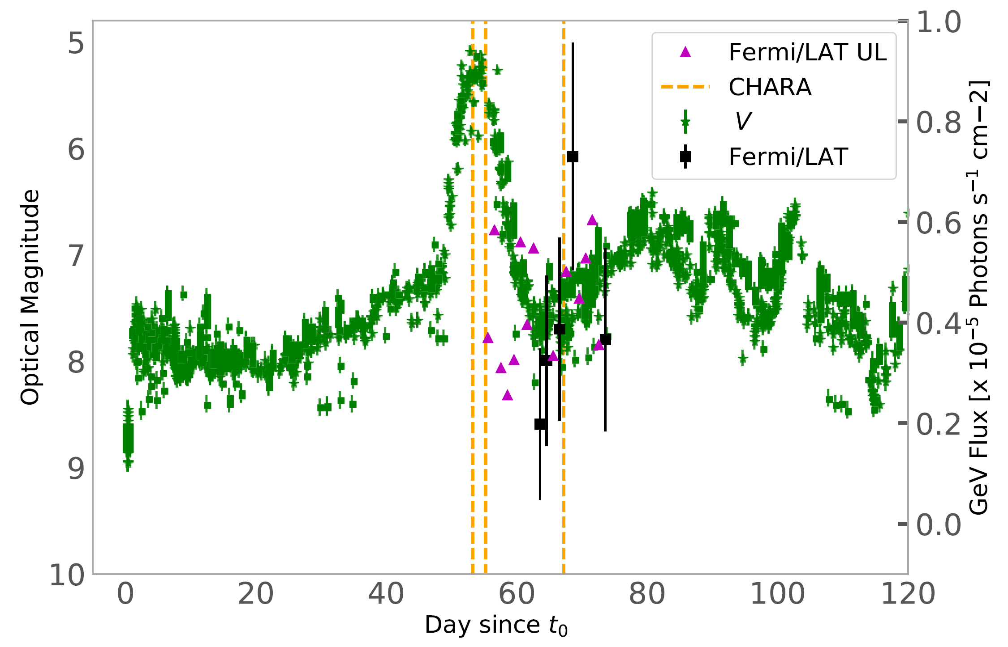
Imaging with CHARA
Nova V1405 Cas- Discovered on March 18, 2021
SMARTS
Aydi et al. in perp.
E. Aydi - MSU

Slide 36
Imaging with CHARA
Aydi et al. in perp.
E. Aydi - MSU
Thanks to Gail Schaefer and John Monnier

Slide 37
Imaging with CHARA
Nova V1405 Cas- Discovered on March 18, 2021
SMARTS
Aydi et al. in perp.
E. Aydi - MSU

Slide 38
Imaging with CHARA
Aydi et al. in perp.
E. Aydi - MSU
Thanks to Gail Schaefer and John Monnier

Slide 39
Imaging with CHARA
700 km/s
2100 km/s
SMARTS
Aydi et al. in perp.
E. Aydi - MSU

Slide 40
Imaging with CHARA
Nova V1405 Cas- Discovered on Marc 18, 2021
SMARTS
Aydi et al. in perp.
E. Aydi - MSU

Slide 41
How do novae expel their envelopes?
If the binary motion helps expel the envelope, novae could be miniature common envelope systems evolving in real time!!
SALT - SAAO
SMARTS
E. Aydi - MSU
Aydi et al. (2020, ApJ, 905, 62)

Slide 42
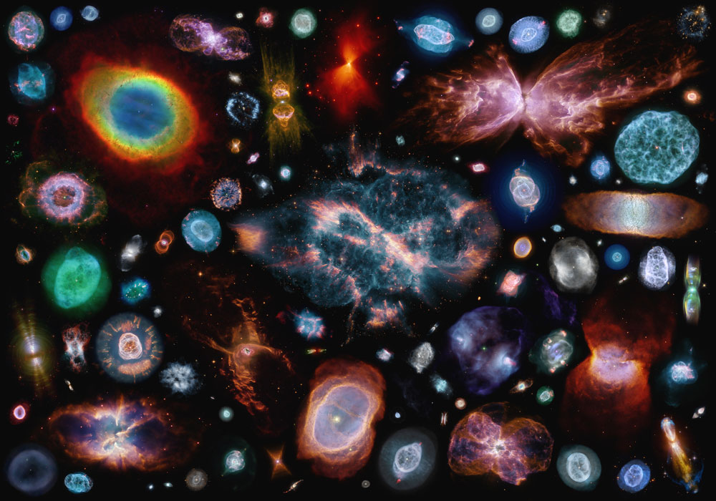
How do novae expel their envelopes?
E. Aydi - MSU

Slide 43
How novae expel their envelopes?
Early days
Months/year later
~year later
ng-VLA?
JWST
SALT - SAAO
Common envelope laboratory evolving on days/weeks timescale in our Galactic backyard
SMARTS
E. Aydi - MSU

Slide 44
Single vs multiple outflows?
Internal shocks
Shocks between clumps?
SMARTS
E. Aydi - MSU

Slide 45
What do we need?
Internal shocks
Shocks between clumps?
SMARTS
E. Aydi - MSU

Slide 46
What do we need?
Understanding the role of binary and common envelope.
More observations (across the spectrum).
Modelling (ideally in 3D)
Some undergoing efforts in 1D (Shen and Quataert 2022).
Any volunteers?
SMARTS
E. Aydi - MSU

Slide 47
External vs internal shocks?
External shocks
Internal shocks
Credits: http://svs.gsfc.nasa.gov/goto?10626
SMARTS
E. Aydi - MSU

Slide 48
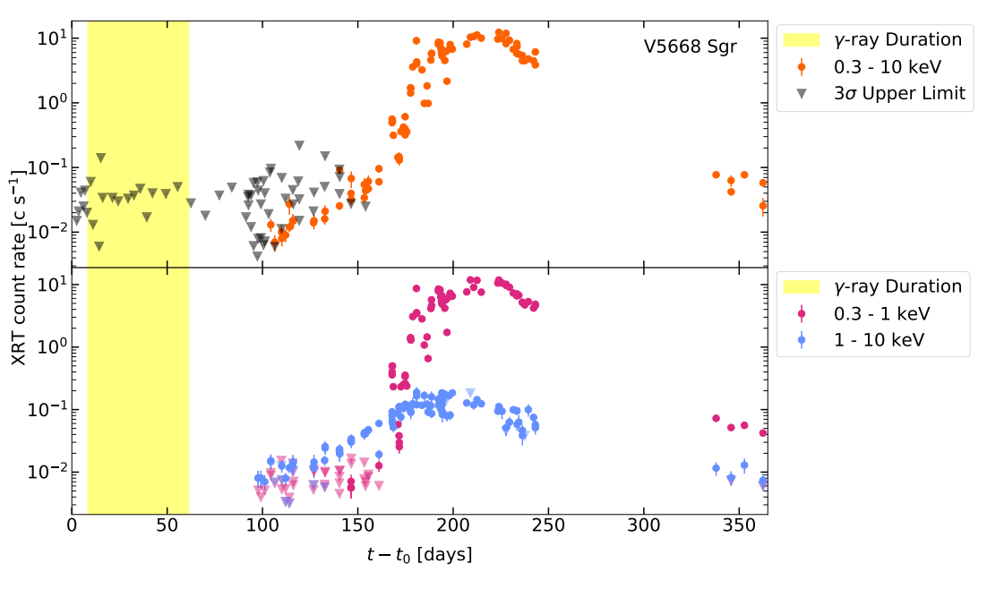
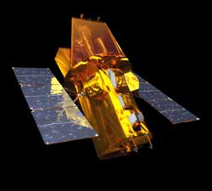
Surveying the X-ray Behavior of novae
Gordon et al. (2021, ApJ, 910, 134)
Alexa C. Gordon
SALT - SAAO
SMARTS
E. Aydi - MSU

Slide 49
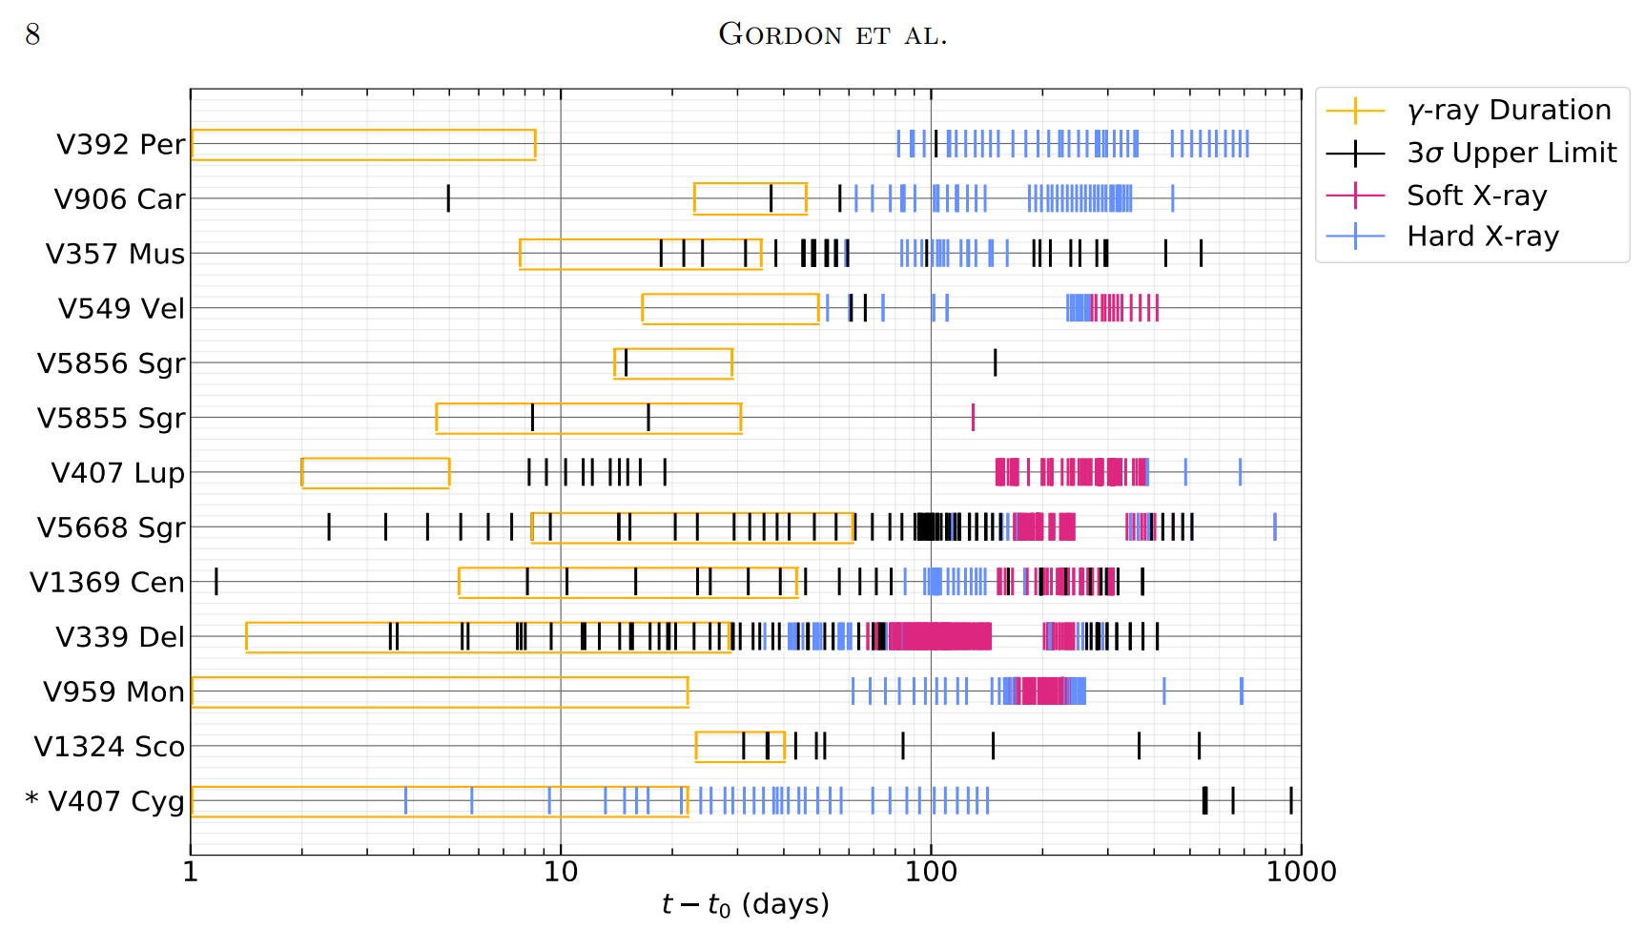
Surveying the X-ray Behavior of novae
Gordon et al. (2021, ApJ, 910, 134)
Alexa C. Gordon
SALT - SAAO
Recurrent novae
V3890 Sgr and RS Oph
SMARTS
E. Aydi - MSU

Slide 50
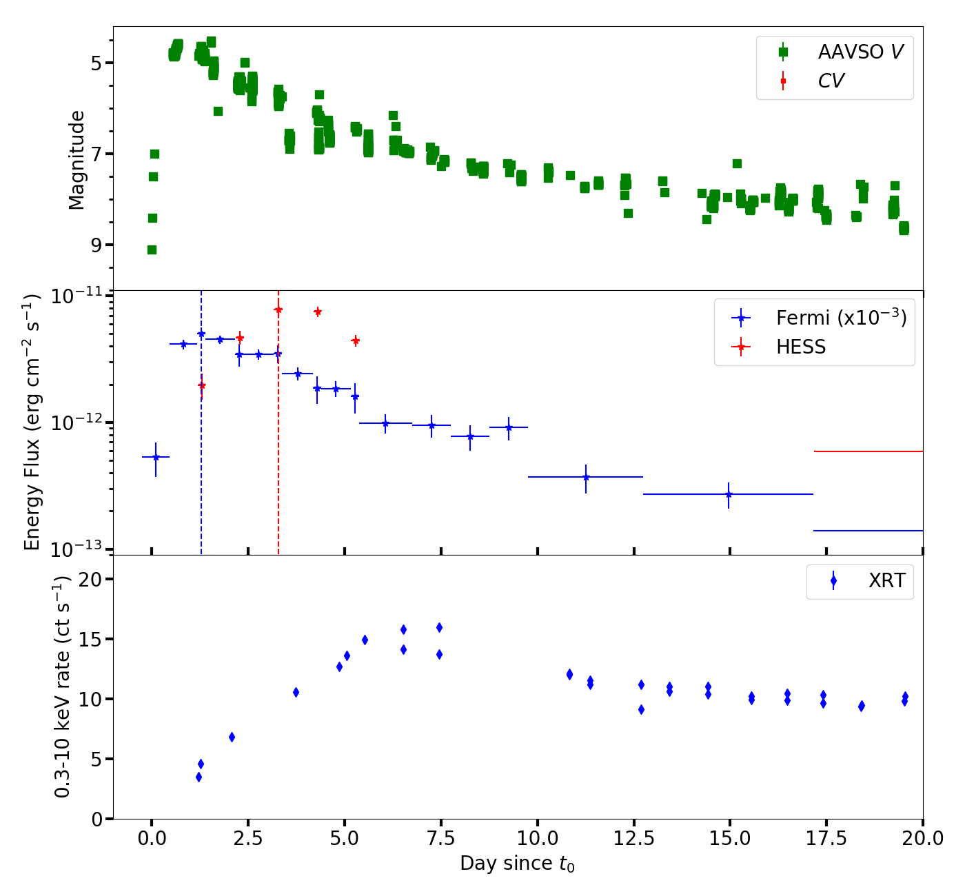
Novae as TeV sources
E. Aydi
E. Aydi - MSU

Slide 51
External vs internal shocks?
External shocks
Internal shocks
Credits: http://svs.gsfc.nasa.gov/goto?10626
SMARTS
E. Aydi - MSU

Slide 52
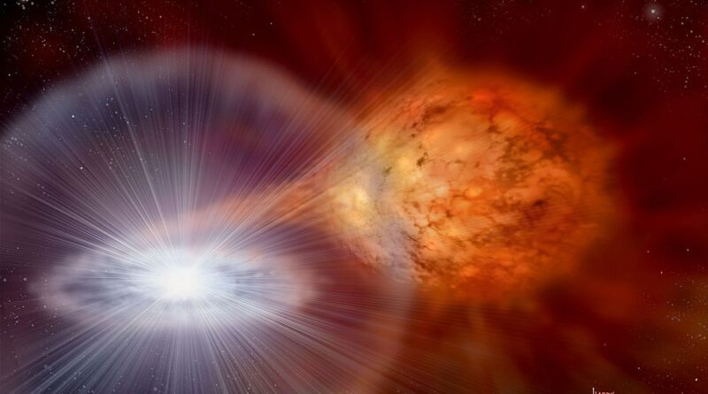
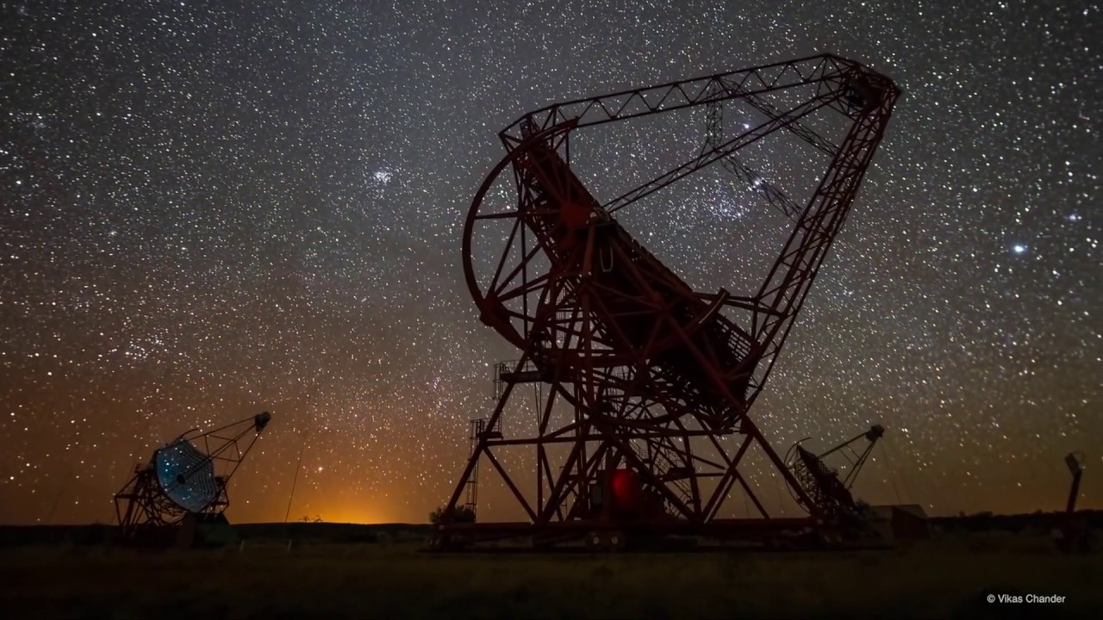
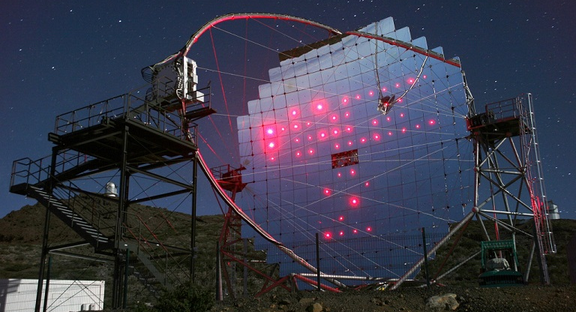
Novae as TeV sources
SMARTS
High Energy Stereoscopic System
(HESS)
Major Atmospheric Gamma-ray Imaging Cherenkov Telescope
(MAGIC)
E. Aydi - MSU

Slide 53
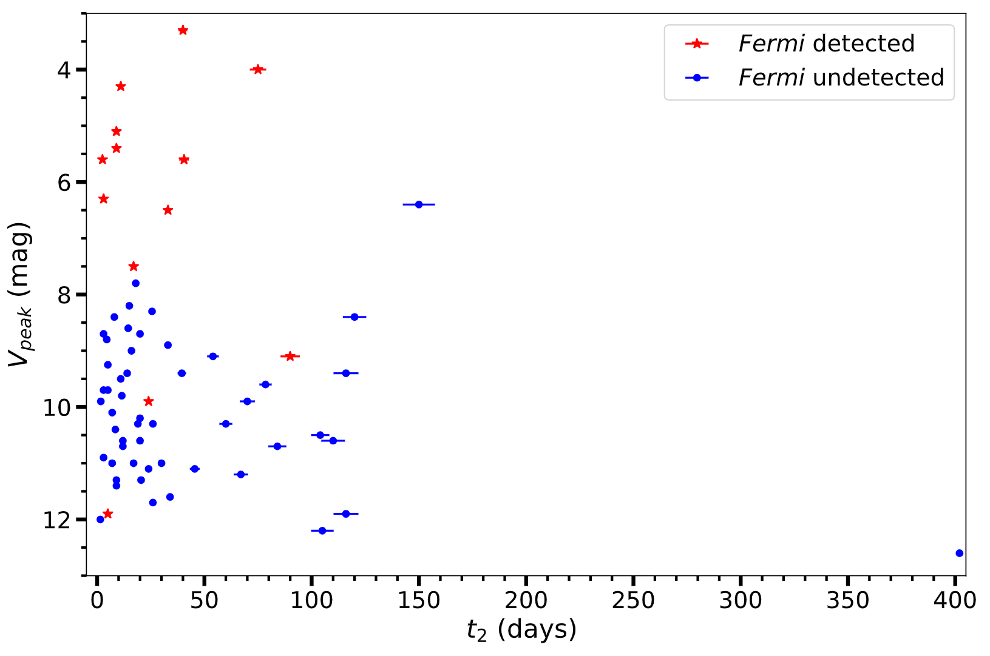
What determines the shock power in novae?
SALT - SAAO
Ashley Stone
SMARTS
Stone et al in prep.
E. Aydi - MSU

Slide 54
Luminosity of the shocks??
L_{sh} ρv²
∝
SMARTS
E. Aydi - MSU
Aydi et al. 2020, ApJ, 905, 62

Slide 55
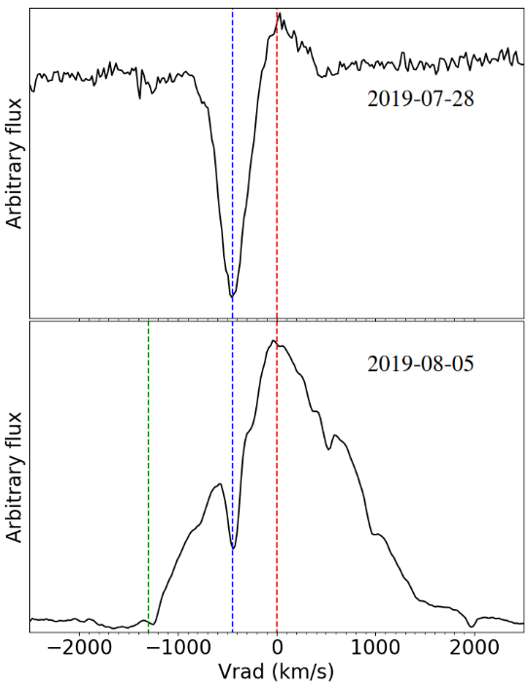
Parameter space to determine Lɤ
Stone et al in prep.
Ashley Stone
SALT - SAAO
SMARTS
E. Aydi - MSU

Slide 56
External vs internal shocks?
External shocks
Internal shocks
Credits: http://svs.gsfc.nasa.gov/goto?10626
SMARTS
E. Aydi - MSU

Slide 57
Novae as TeV sources
SMARTS
High Energy Stereoscopic System
(HESS)
Major Atmospheric Gamma-ray Imaging Cherenkov Telescope
(MAGIC)
E. Aydi - MSU

Slide 58
External vs internal shocks?
External + internal shocks?
Internal shocks
Credits: http://svs.gsfc.nasa.gov/goto?10626
SMARTS
See Deising et al. (2023)
E. Aydi - MSU

Slide 59
Novae as TeV sources
See Deising et al. (2023)
E. Aydi
E. Aydi - MSU

Slide 60
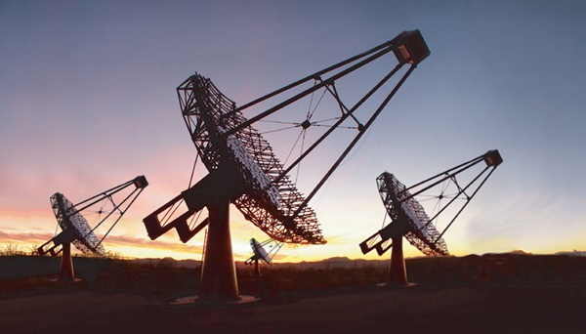
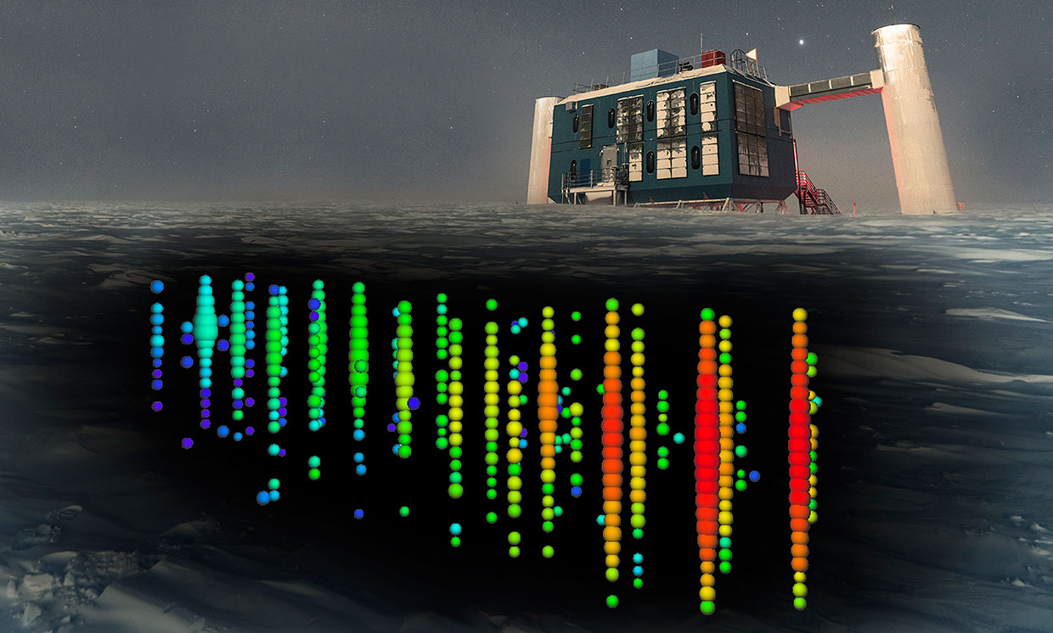
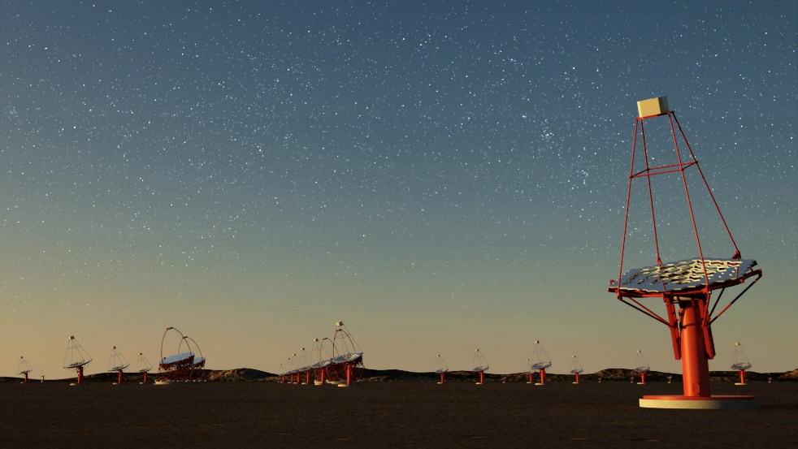
Neutrino from symbiotic systems
VERITAS
IceCube
CTA
Recurrent Nova T CrB at < 1 kpc and is due soon!
SMARTS
E. Aydi - MSU

Slide 61
Summary
Nova ejection is more complex than a single ballistic ejection. Shocks in classical novae are different than shocks in symbiotics.
Early common envelope interaction might be playing an important role in ejecting the envelope of novae.
Early interferometry in the optical/IR could be very powerful for us to constrain the ejection scenario/formation of shocks in novae. Modelling is also needed, especially in 3D.
The power of shocks might be correlated with the speeds of the interacting ejecta.
Shocks in symbiotics might be more complex than nova ejecta shocking CSM. Also, these systems might be our best chance to detect neutrino?
SALT - SAAO
SMARTS
E. Aydi - MSU

Slide 62
Nova V906 Car is lit
Aydi et al. 2020 (Nat Ast, 4, 776)
E. Aydi - MSU

Slide 63
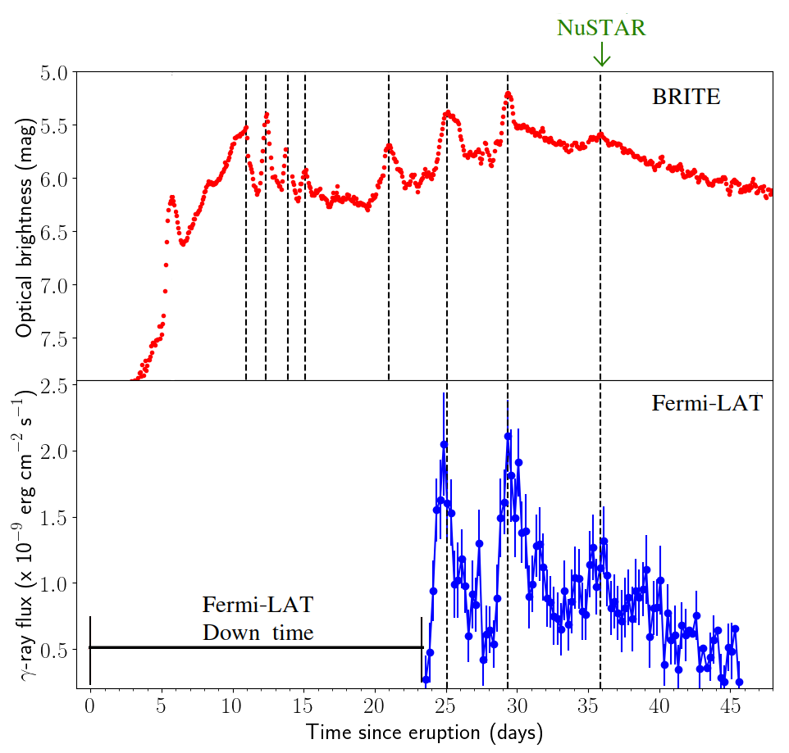
Nova V906 Car is lit
Aydi et al. 2020 (Nat Ast, 4, 776)
E. Aydi - MSU

Slide 64
Nova V906 Car is lit
Aydi et al. 2020 (Nat Ast, 4, 776)
Simultaneous flares → same origin (shocks)
E. Aydi - MSU

Slide 65
Nova V906 Car is lit
Aydi et al. 2020 (Nat Ast, 4, 776)
Simultaneous flares → same origin (shocks)
Luminosity doubled→ shocks radiate a large fraction of nova luminosity
E. Aydi - MSU

