Slide 1
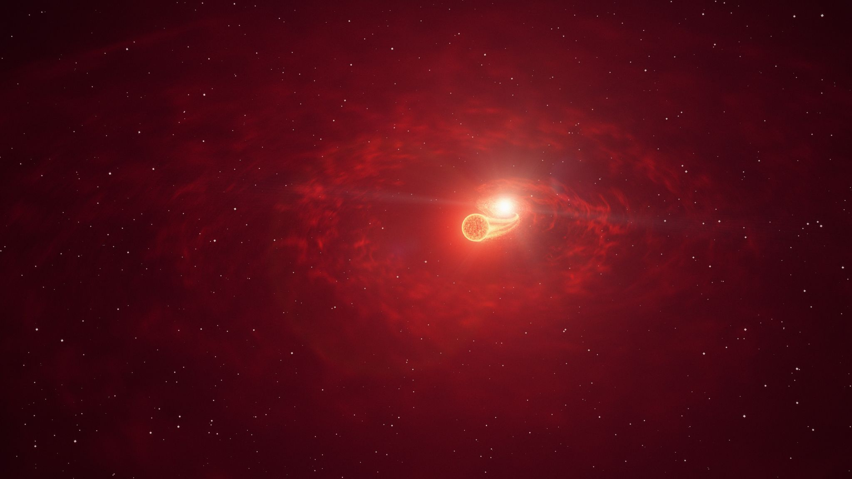
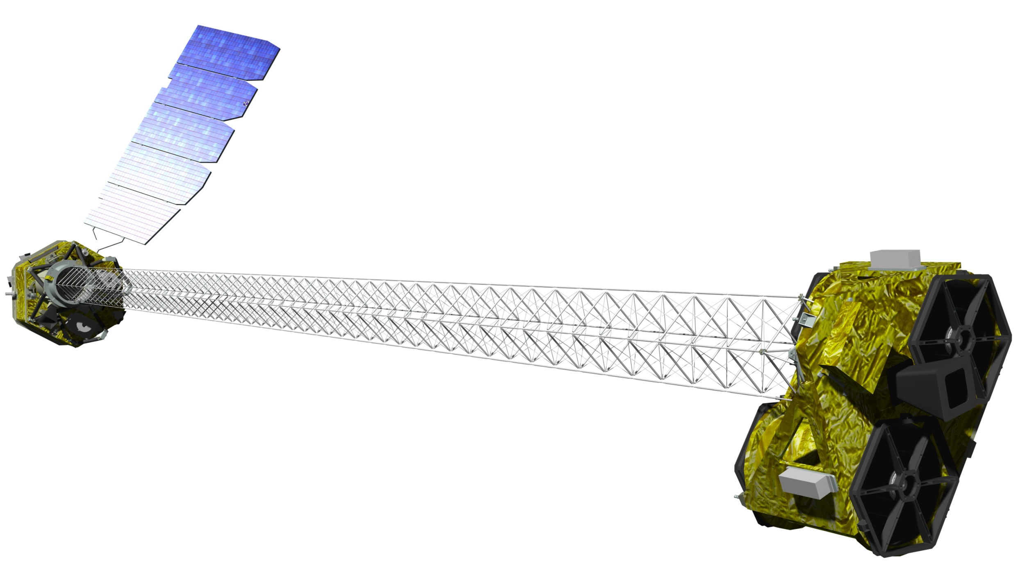
Exploring the Shock-Driven High-Energy Emission of Classical Novae with NuSTAR
Kirill Sokolovsky
U. Illinois Urbana-Champaign
in collaboration with Elias Aydi, Laura Chomiuk, Peter Craig,
Isabella Molina (Michigan State),
Koji Mukai (NASA/GSFC),
Justin Linford, Montana Williams (NRAO),
Brian Metzger, Jennifer Sokoloski (Columbia),
Elad Steinberg (Hebrew U.), Indrek Vurm (Tartu),
Manel Errando, Tekeba Olbemo (Washington U. St. Louis),
Marco Ajello, Scott Joffre (Clemson), C. C. Cheung (NRL),
Pierre Jean (Toulouse), Tyrel Johnson (GMU),
Konstantin Malanchev (Carnegie Mellon)
Images:
NASA/NuSTAR and
artist’s impression of RS Oph
(DESY/H.E.S.S., Sci. Comm. Lab)

Slide 2
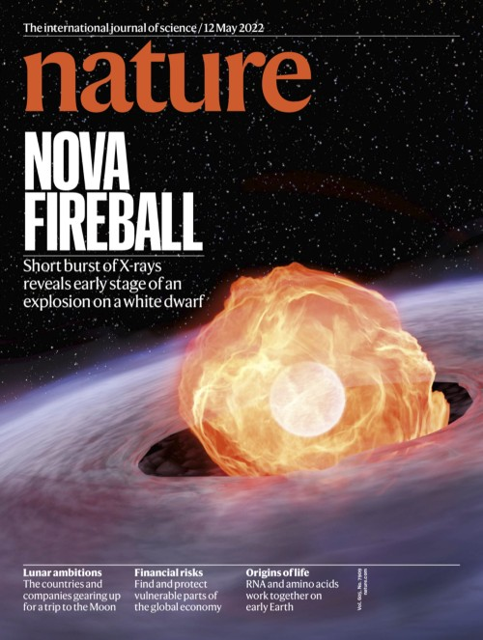
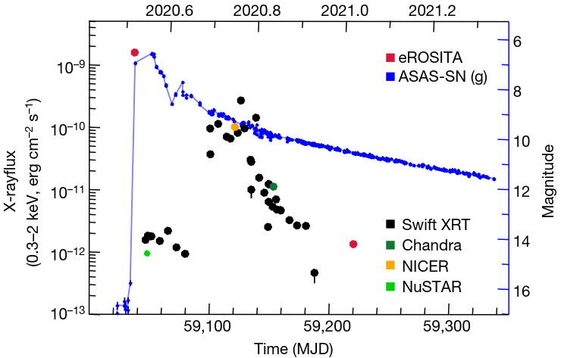
X-ray lightcurve of a nova
X-ray and optical lightcurve of nova YZ Ret
(Konig et al. 2022, Nature, V.605, I.7909, p.248)
Fireball
Shocks
Super-Soft Source
Accretion

Slide 3
NuSTAR - best for nova shocks
Focusing X-rays in 3-78 keV range
Sensitive (compared to coded mask)
Can penetrate through a lot of absorption
No optical loading (good for nova at peak)
Image:
artist's concept of NuSTAR in orbit.
NASA/JPL-Caltech via Wikipedia

Slide 4
Classical novae with NuSTAR
9 observed, 7 detected (4 while being GeV-bright*)
Nova name | T_0 + | Exp. | Detected | Reference
V339 Del | 9 d | 24 ks | No | Vurm & Metzger (2018, ApJ, 852, 62)
V5668 Sgr | 13 d | 52 ks | No | Vurm & Metzger (2018, ApJ, 852, 62)
V5855 Sgr* | 13 d | 51 ks | Yes | Nelson et al. (2019, ApJ, 872, 86)
V906 Car* | 36 d + 57 d | 50 ks + 50 ks | Yes + Yes | Sokolovsky et al. (2020, MNRAS, 497, 2569)
YZ Ret* | 10 d | 65 ks | Yes | Sokolovsky et al. (2022, MNRAS, 514, 2239)
V1405 Cas | 3 d | 40 ks | Yes | ATel #14530 (publication in prep.)
V1674 Her | 12 d | 39 ks | Yes | Sokolovsky et al. (2023, MNRAS, 521, 5453)
V1716 Sco* | 2 d | 70 ks | Yes | ATel #16018 Sokolovsky et al. (in prep.)
V1723 Sco? | 2 d + 47 d | 63 ks + 22 ks | No + Yes | ATel #16444 Fauverge et al. (in prep.)

Slide 5
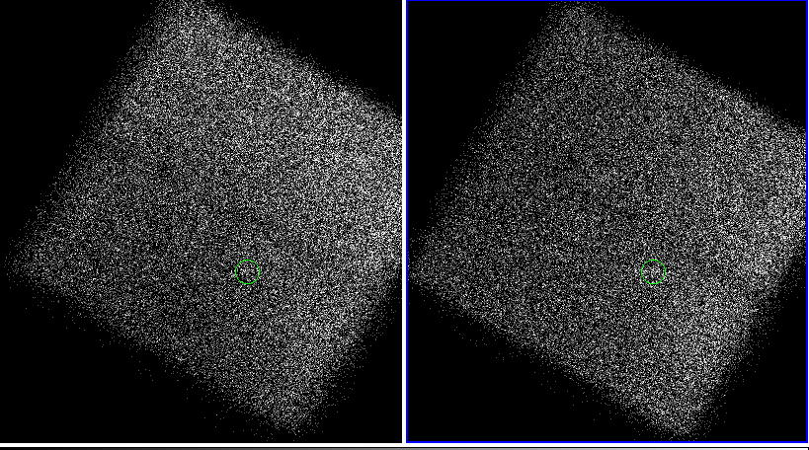
V1723 Sco (2024) eruption + 2 days
63 ks, non-detection <0.002 cts/s (2 focal plane modules)

Slide 6
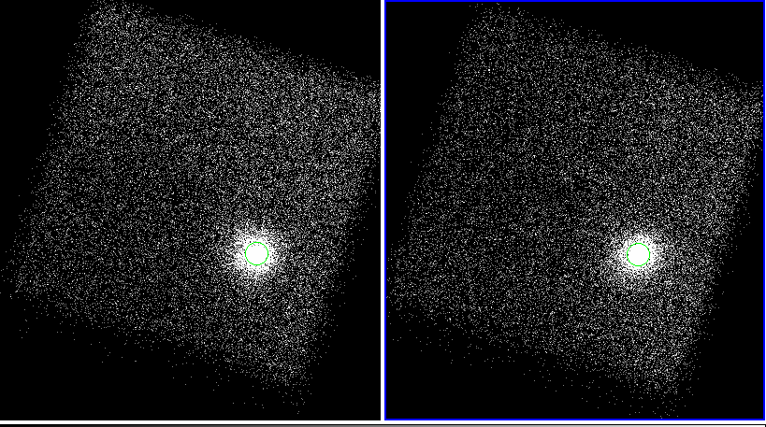
V1723 Sco (2024) eruption + 47 days
22 ks, clear detection 1.0 cts/s (2 focal plane modules)

Slide 7
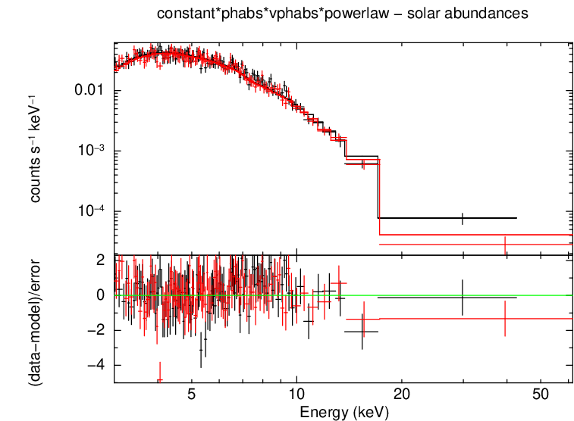
V1723 Sco (2024) NuSTAR spectrum
Concave and mostly featureless
Power law fit:
γ= 3.74+/-0.06
N_{H} = 1.57 +/-0.01 x10²³ cm⁻²
χ²_{red}= 236/235

Slide 8
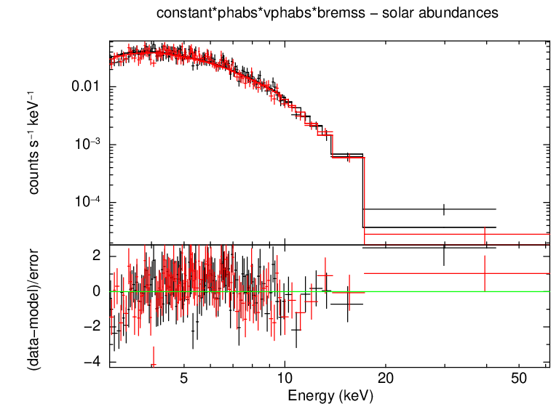
V1723 Sco (2024) NuSTAR spectrum
Concave and mostly featureless
Thermal bremsstrahlung fit:
kT = 4.43+/-0.09 keV
N_{H} = 0 cm⁻² (no excess over the assumed Galactic value)
χ²_{red}= 254/235

Slide 9
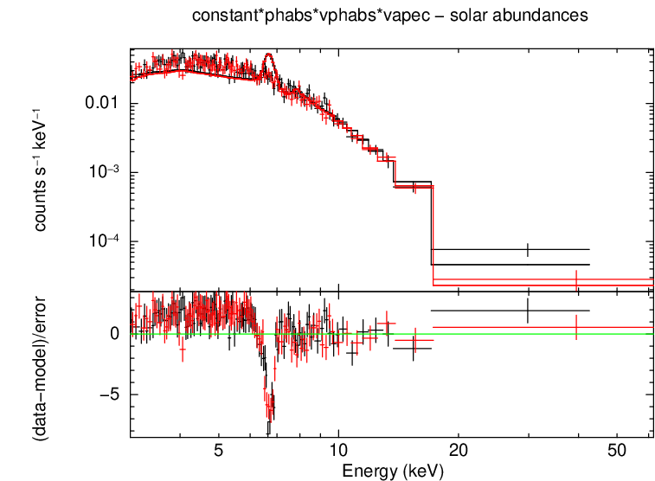
V1723 Sco (2024) NuSTAR spectrum
Concave and mostly featureless
Thermal plasma fit:
kT = 4.97 keV
N_{H} = 0 cm⁻² (no excess over the assumed Galactic value)
χ²_{red}= 853/235 (bad)

Slide 10
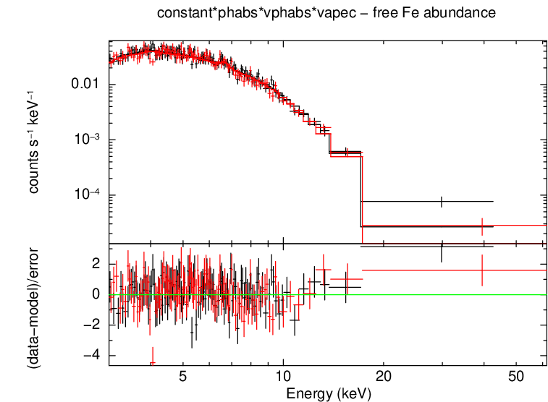
V1723 Sco (2024) NuSTAR spectrum
Concave and mostly featureless
Thermal plasma fit:
kT = 3.84+/-0.12 keV
N_{H} = 4.48 +/-0.98 x10²² cm⁻²
χ²_{red}= 227/234
n(Fe) = 0.07 n(Fe☉)

Slide 11
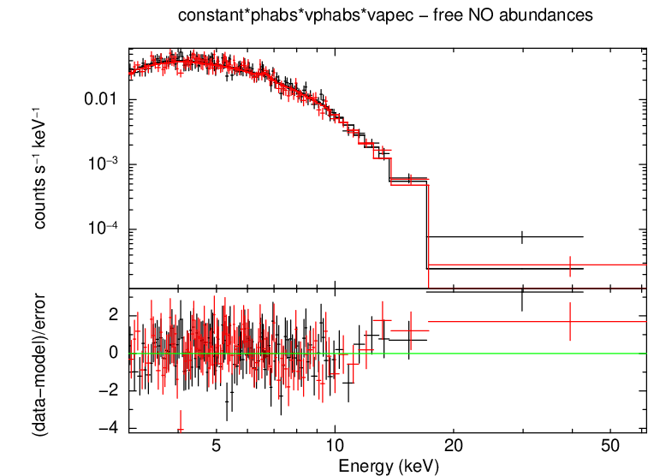
V1723 Sco (2024) NuSTAR spectrum
Concave and mostly featureless
Thermal plasma fit:
kT = 3.62+/-0.11 keV
N_{H} = 3 +/-1
x10²⁰ cm⁻²
χ²_{red}= 225/234
n(NO) = 300 n(NO☉)

Slide 12
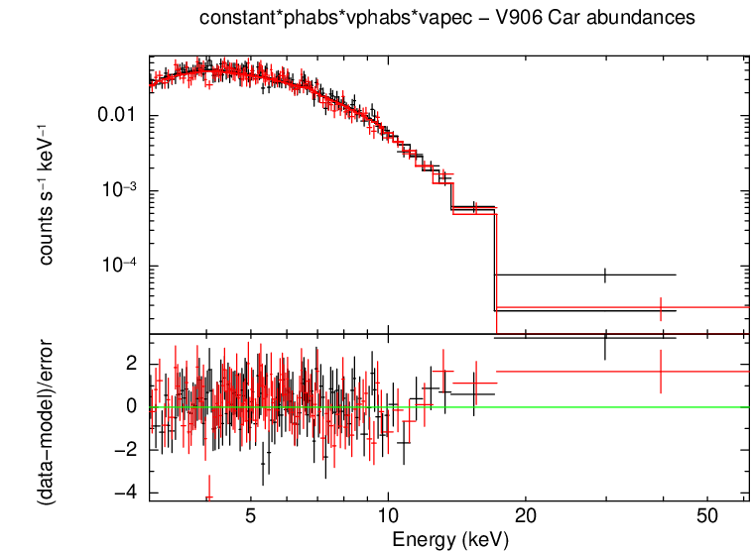
V1723 Sco (2024) NuSTAR spectrum
abundances from a totally different nova V906 Car
Thermal plasma fit:
kT = 3.67+/-0.10 keV
N_{H} = 2.1 +/-0.1
x10²¹ cm⁻²
χ²_{red}= 227/235
n(NO) = 345 n(NO☉)
n(Fe) = 0.1 n(Fe☉)

Slide 13
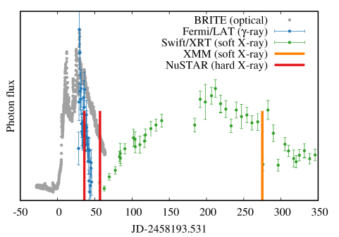
Optical/GeV/X-ray lightcurve of V906 Car

Slide 14
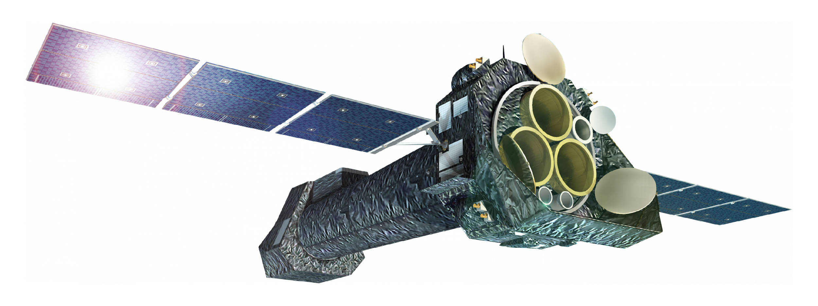
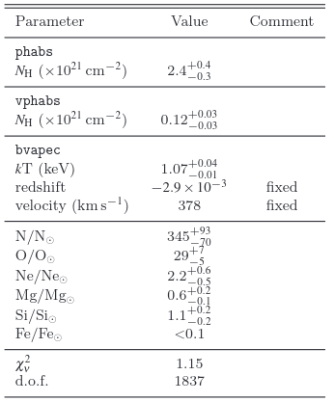
V906 Car: X-ray grating spectroscopy XMM/RGS
275 days after eruption, still shock-dominated
Image: artist's impression
of XMM-Newton
ESA/NASA via Wikipedia
Sokolovsky et al. (2020, MNRAS, 497, 2569)

Slide 15
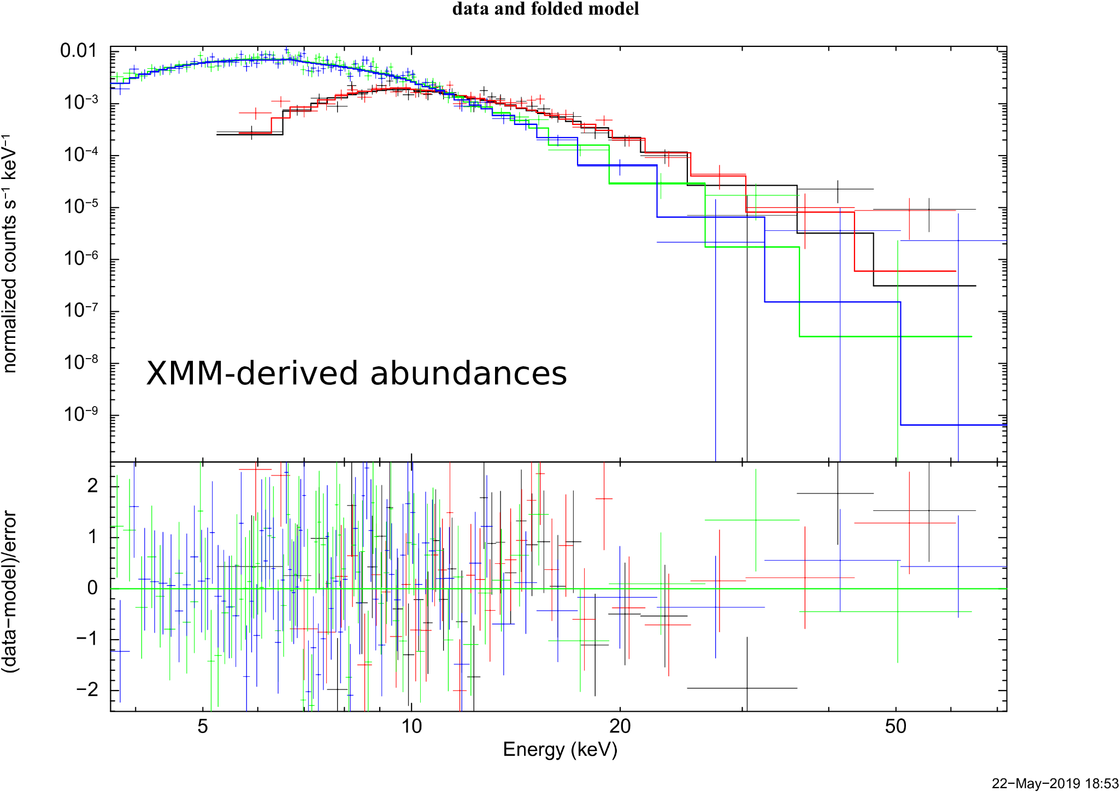
V906 Car: NuSTAR spectra at 36 and 57 days
kT₁ = 8.6+/-0.8 keV N_{H1} = 1.9 +/-0.1
x10²³ cm⁻²
kT₂ = 4.3+/-0.2 keV N_{H2} = 2.6 +/-0.2
x10²² cm⁻²
χ²_{red}= 211/200
Sokolovsky et al. (2020, MNRAS, 497, 2569)

Slide 16
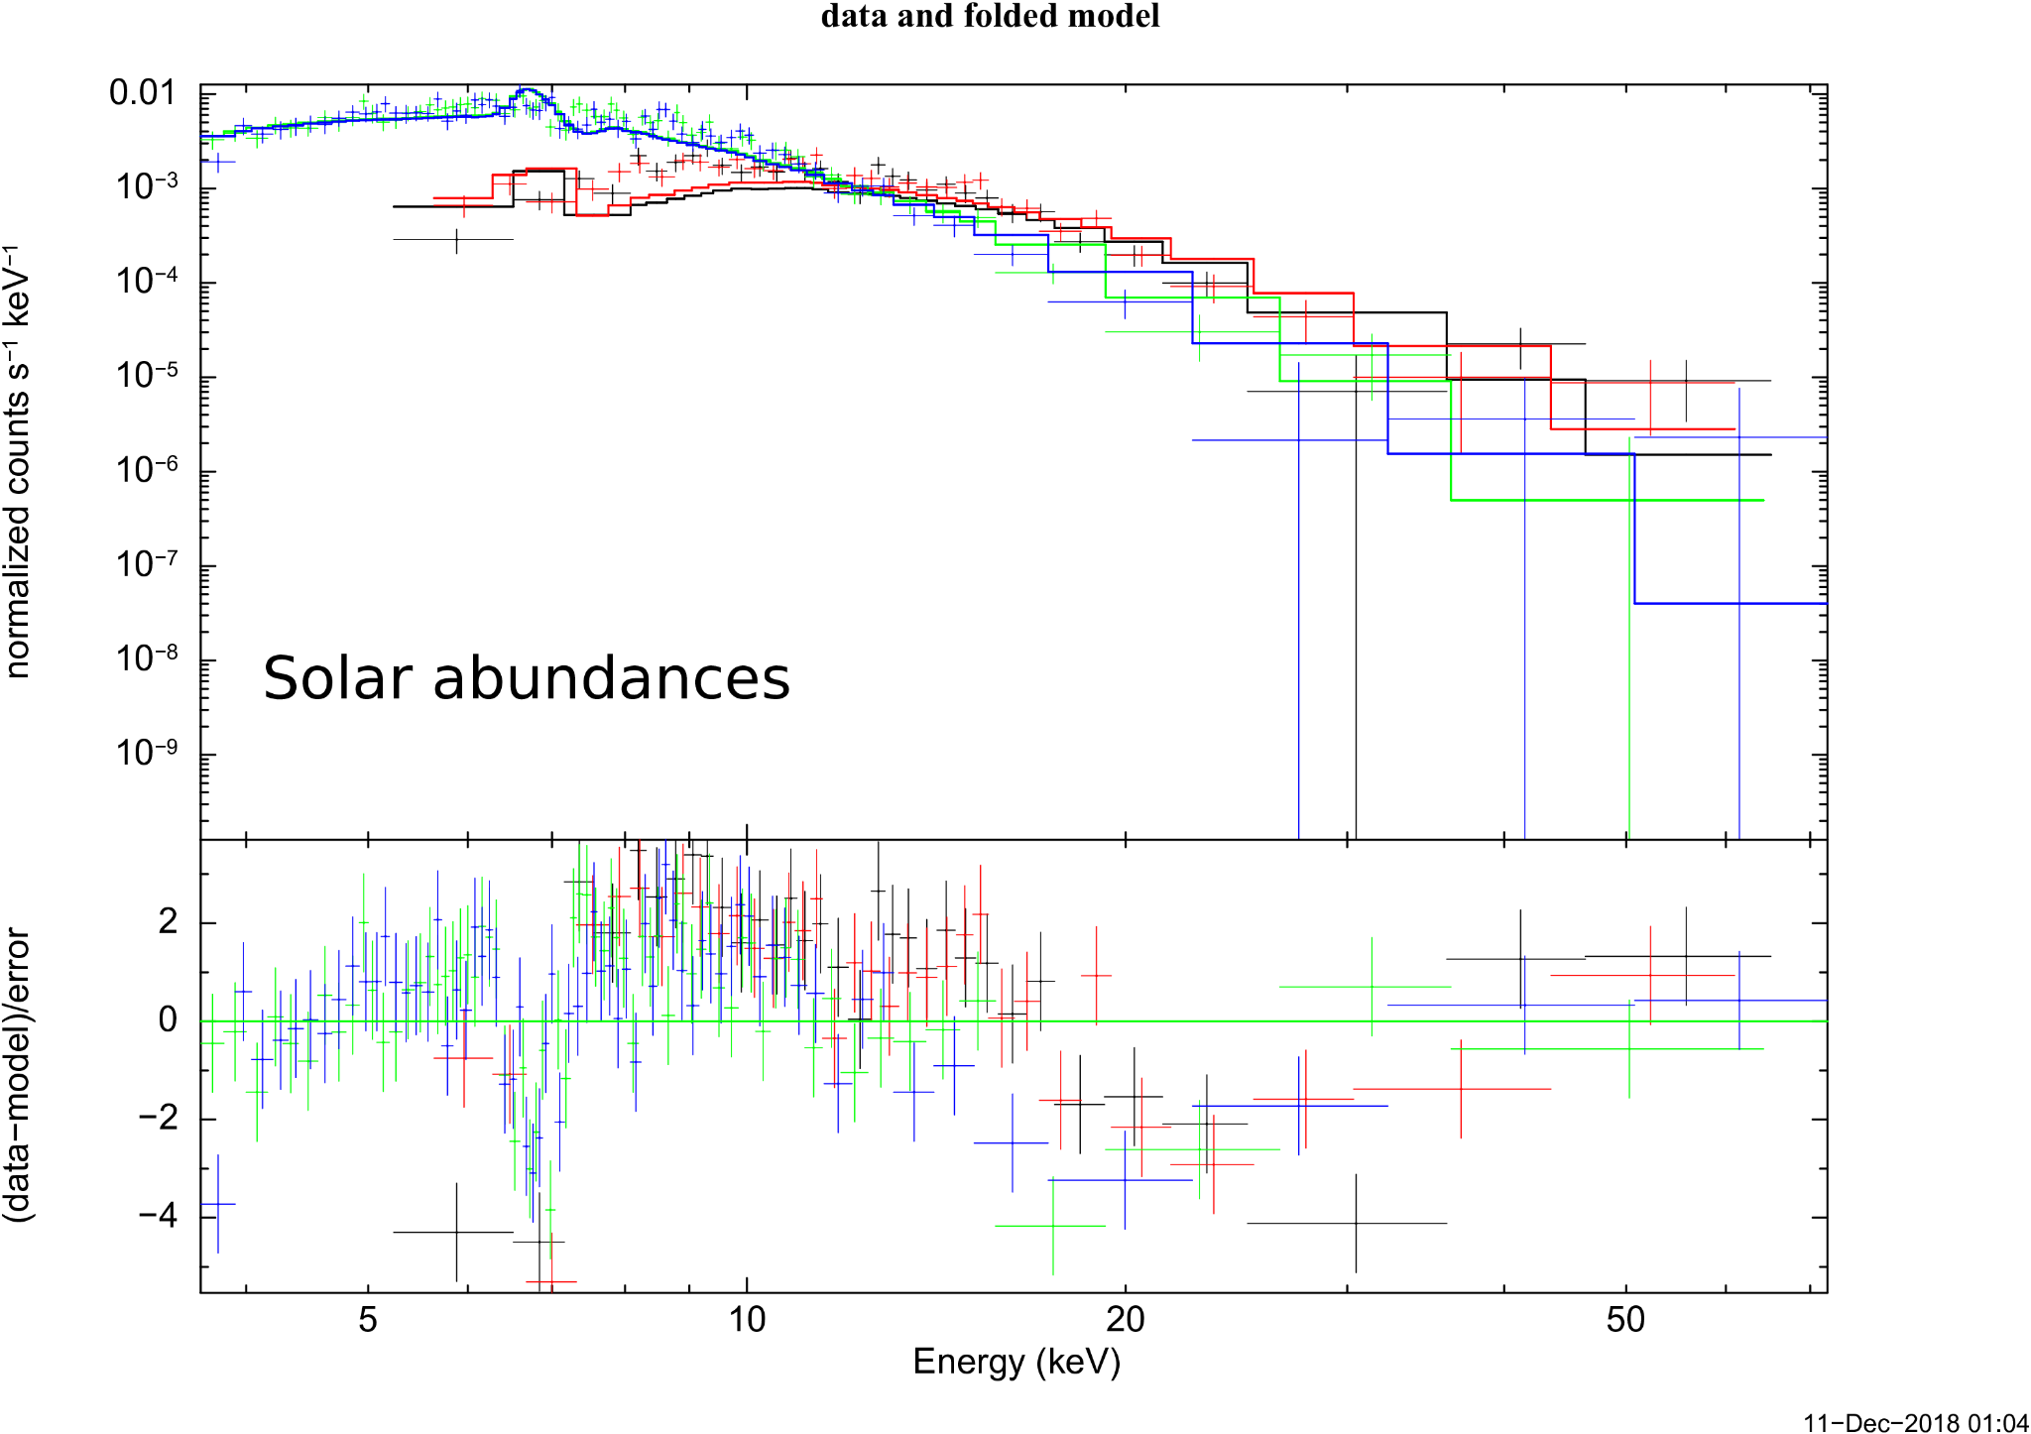
V906 Car: NuSTAR spectra at 36 and 57 days
kT₁ = 13.7 keV N_{H1} = 1.6
x10²⁴ cm⁻²
kT₂ = 4.3+/-0.2 keV N_{H2} = 1.6
x10²³ cm⁻²
χ²_{red}= 621/200
Sokolovsky et al. (2020, MNRAS, 497, 2569)
(bad)

Slide 17
NuSTAR spectra summary
Single-temperature thermal
kT > 1 keV suggests shock heating
No power law component (no MeV line comptonization/GeV emission tail in NuSTAR band)
Non-solar abundances imply WD ablation
kT and N_{H} decrease over time

Slide 18
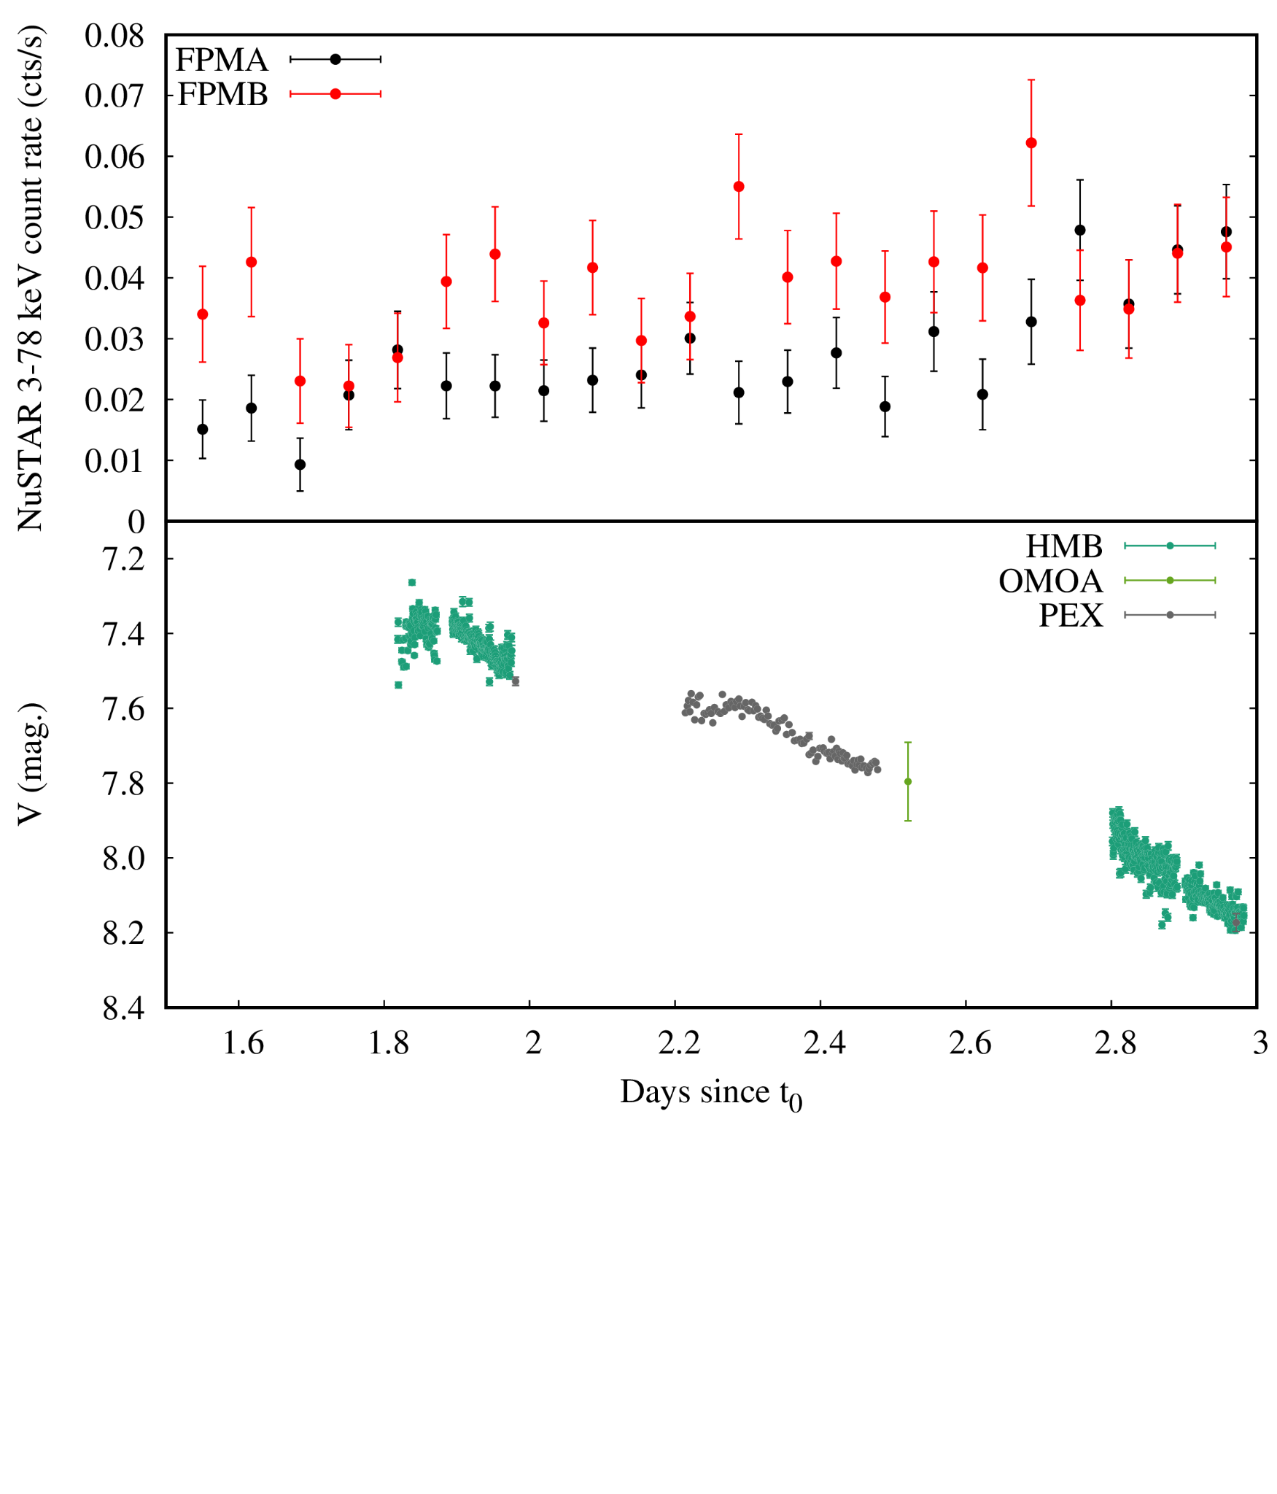
NuSTAR
AAVSO
X-ray 3-30 keV
V1716 Sco
(2023)
optical V filter

Slide 19
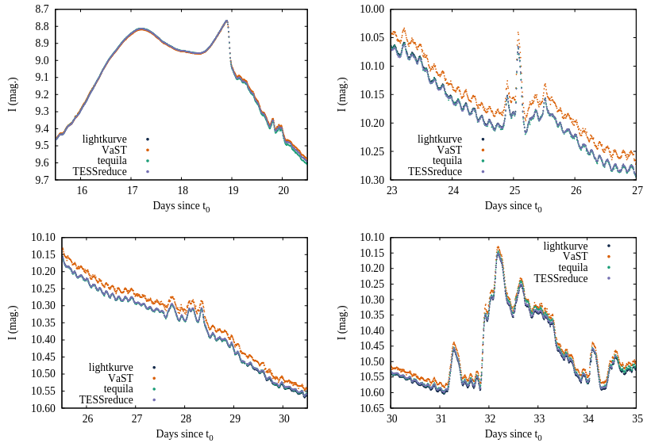
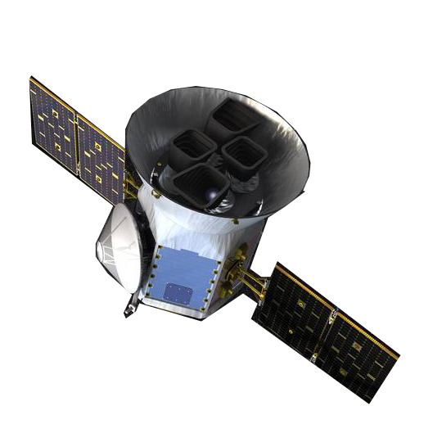
TESS mini-flares in V606 Vul
Searching for vast variability in novae is not crazy!
Sokolovsky et al. (2023, arXiv:2311.04903)

Slide 20
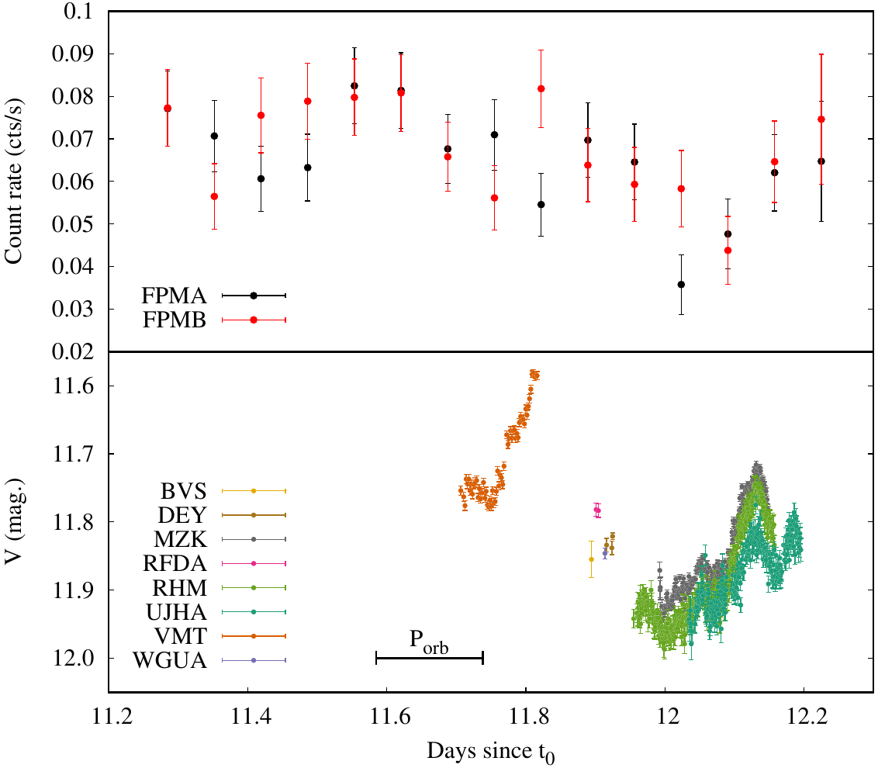
NuSTAR
AAVSO
X-ray 3-30 keV
V1674 Her
Sokolovsky et al. (2023, MNRAS, 521, 5453)
optical V filter

Slide 21
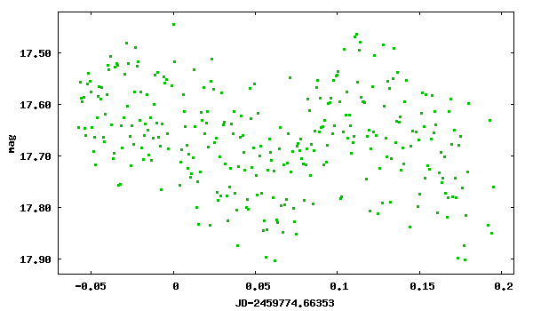
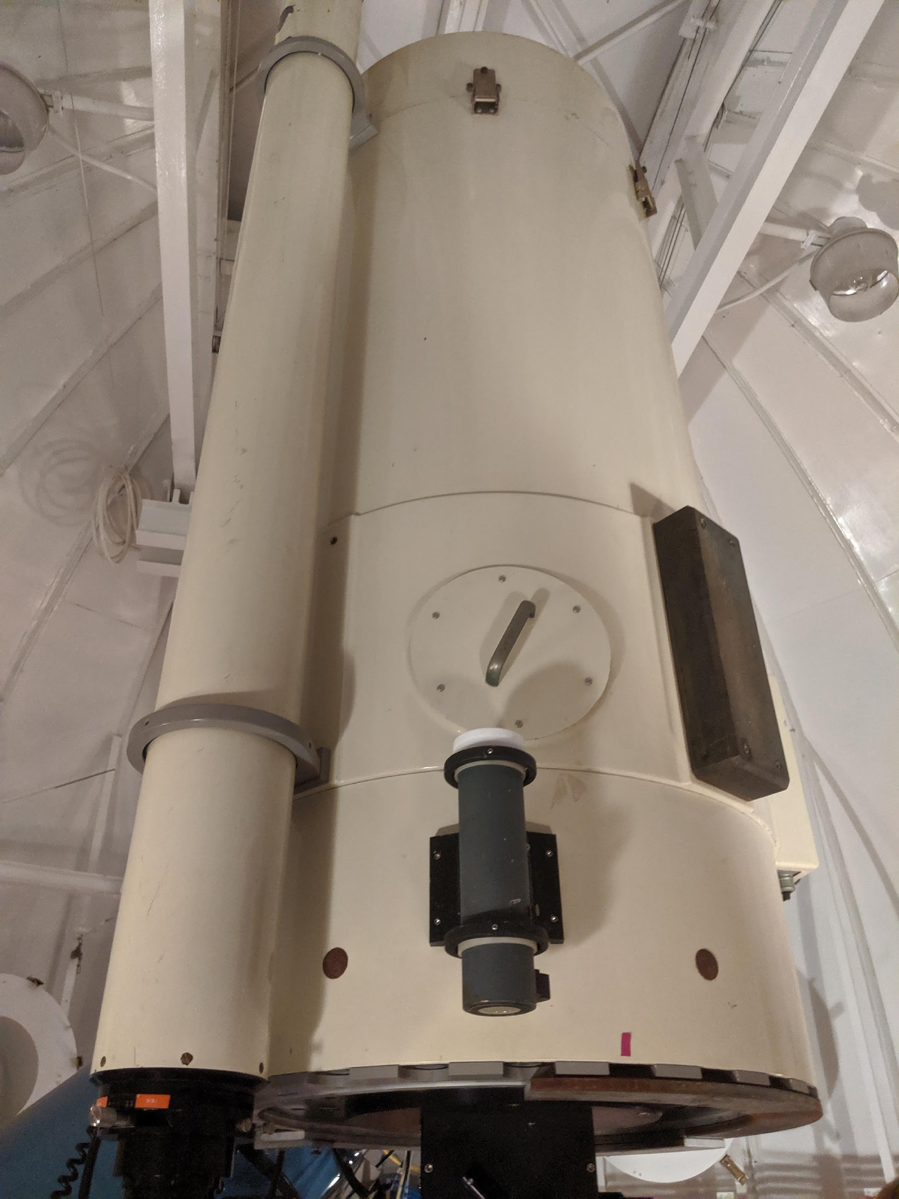
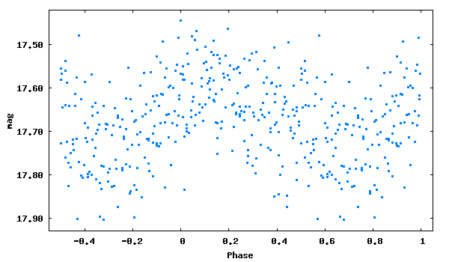
V1674 Her - optical photometry at MSU
V1674 Her host is an IP
P_{orb} = 3.67^{h}
P_{rot} = 8.36^{min}
Patterson et al. (2022, ApJ, 940, L56)

Slide 22
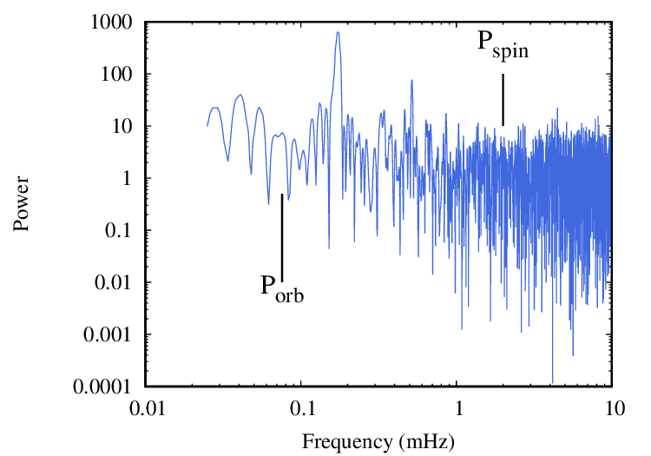
NuSTAR 3-78 keV photon arrival times
Periodogram constructed with patpc code has no peaks close to orbital and spin period (known from optical obs.)
NuSTAR orbital period
3x NuSTAR orbital period
Sokolovsky et al. (2023, MNRAS, 521, 5453)

Slide 23
NuSTAR lightcurves and shock location
Some variability on ~10 hour timescale
No periodic modulation (orbital/WD rotation)
No obvious correlation with optical
Shocked region is large compared to the binary?
Not directly related to optical - below the photosphere?

Slide 24
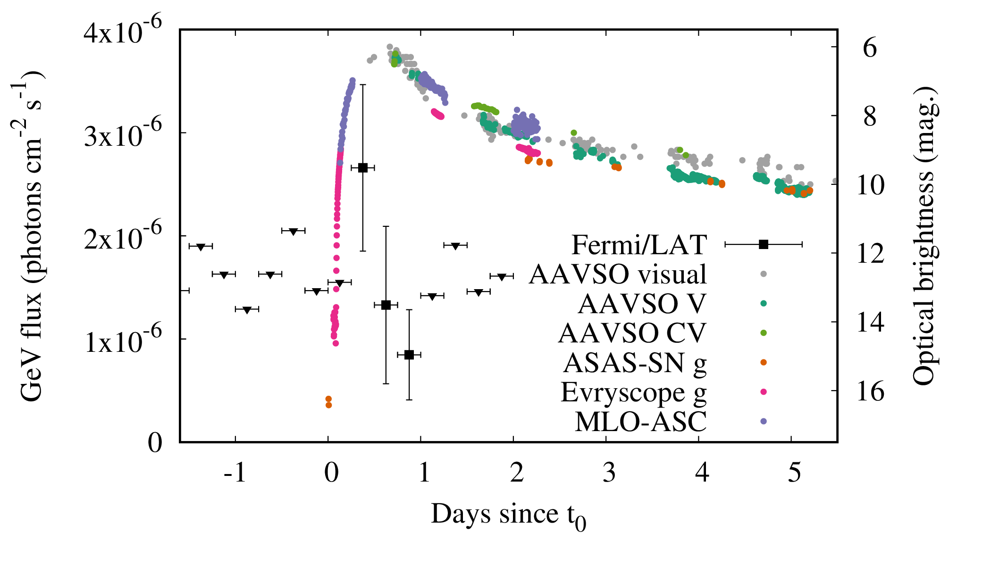
6h (~2 P_{orb}) GeV-optical lag in V1674 Her

Slide 25
L_{X}(NuSTAR) / L_{γ}(Fermi-LAT) ratio
Metzger et al. (2015, MNRAS, 450, 2739) suggested nova shocks should be radiative and shine in hard X-rays, spending fraction of their energy on particle acceleration, so L_{X}(NuSTAR) / L_{γ}(Fermi-LAT) >> 1
But this is not what we observe…

Slide 26
L_{X}(20 keV) / L_{γ}(100 MeV) << 1
4/6 novae detected simultaneously by NuSTAR and Fermi-LAT
Nova name | T_0 + | L_{X} / L_{γ} | Detected | Reference
V339 Del | 9 d | < 0.004 | No | Vurm & Metzger (2018, ApJ, 852, 62)
V5668 Sgr | 13 d | < 0.017 | No | Vurm & Metzger (2018, ApJ, 852, 62)
V5855 Sgr | 13 d | 0.017 | Yes | Nelson et al. (2019, ApJ, 872, 86)
V906 Car | 36 d + 57 d | 0.020 | Yes + Yes | Sokolovsky et al. (2020, MNRAS, 497, 2569)
YZ Ret | 10 d | 0.007 | Yes | Sokolovsky et al. (2022, MNRAS, 514, 2239)
V1405 Cas | 3 d |  | Yes | ATel #14530 (publication in prep.)
V1674 Her | 12 d |  | Yes | Sokolovsky et al. (2023, MNRAS, 521, 5453)
V1716 Sco | 2 d | 0.014 | Yes | ATel #16018 Sokolovsky et al. (in prep.)
V1723 Sco? | 2 d + 47 d |  | No + Yes | ATel #16444 Fauverge et al. (in prep.)

Slide 27
L_{X}(NuSTAR) / L_{γ}(Fermi-LAT) ratio
Possible explanations:
The shock is non–radiative (spends in energy mostly on adiabatic expansion, particle acceleration)
Multiple shocks: the shock responsible for GeV emission is distinct from the one heating X-ray plasma (forward-reverse? del Valle et al., 2022, A&A, 660, A104). The GeV shock’s X-rays are so soft/absorbed that remain hidden for NuSTAR?
Corrugated shock front suppressing X-ray emission (Steinberg & Metzger, 2018, MNRAS, 479, 687)

Slide 28
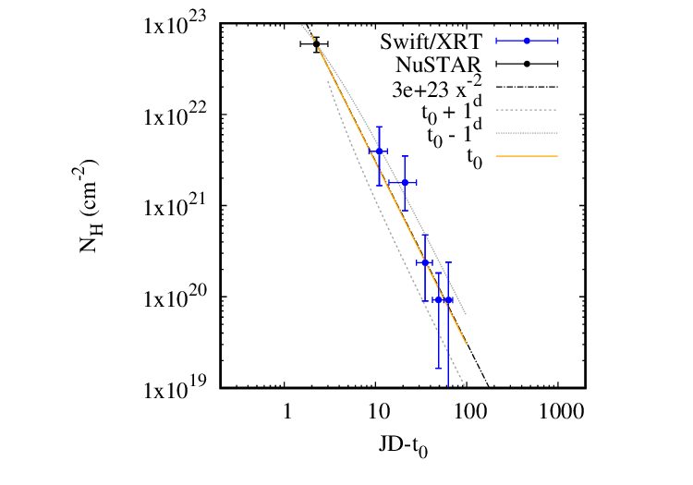
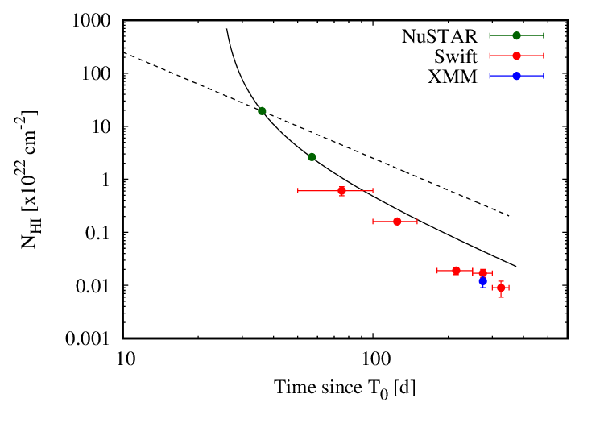
Ejecta mass and ejection time from N_{H}
V1716 Sco, ejection at t₀
M_{ej} = 8x10⁻⁸ M☉
V906 Car, ejection at t₀+ 24^{d}
M_{ej} = 3x10⁻⁵ M☉
Sokolovsky et al. (2020, MNRAS, 497, 2569)

Slide 29
Summary
NuSTAR spectra of all detected novae look alike
Consistent with single-temperature CNO-enriched plasma
Heavily absorbed - shocks are deep within ejecta
But no fast variability, so not too close to the WD
L_{X} / L_{γ} << 1, defying explanation

Slide 30
Thanks!

Slide 31
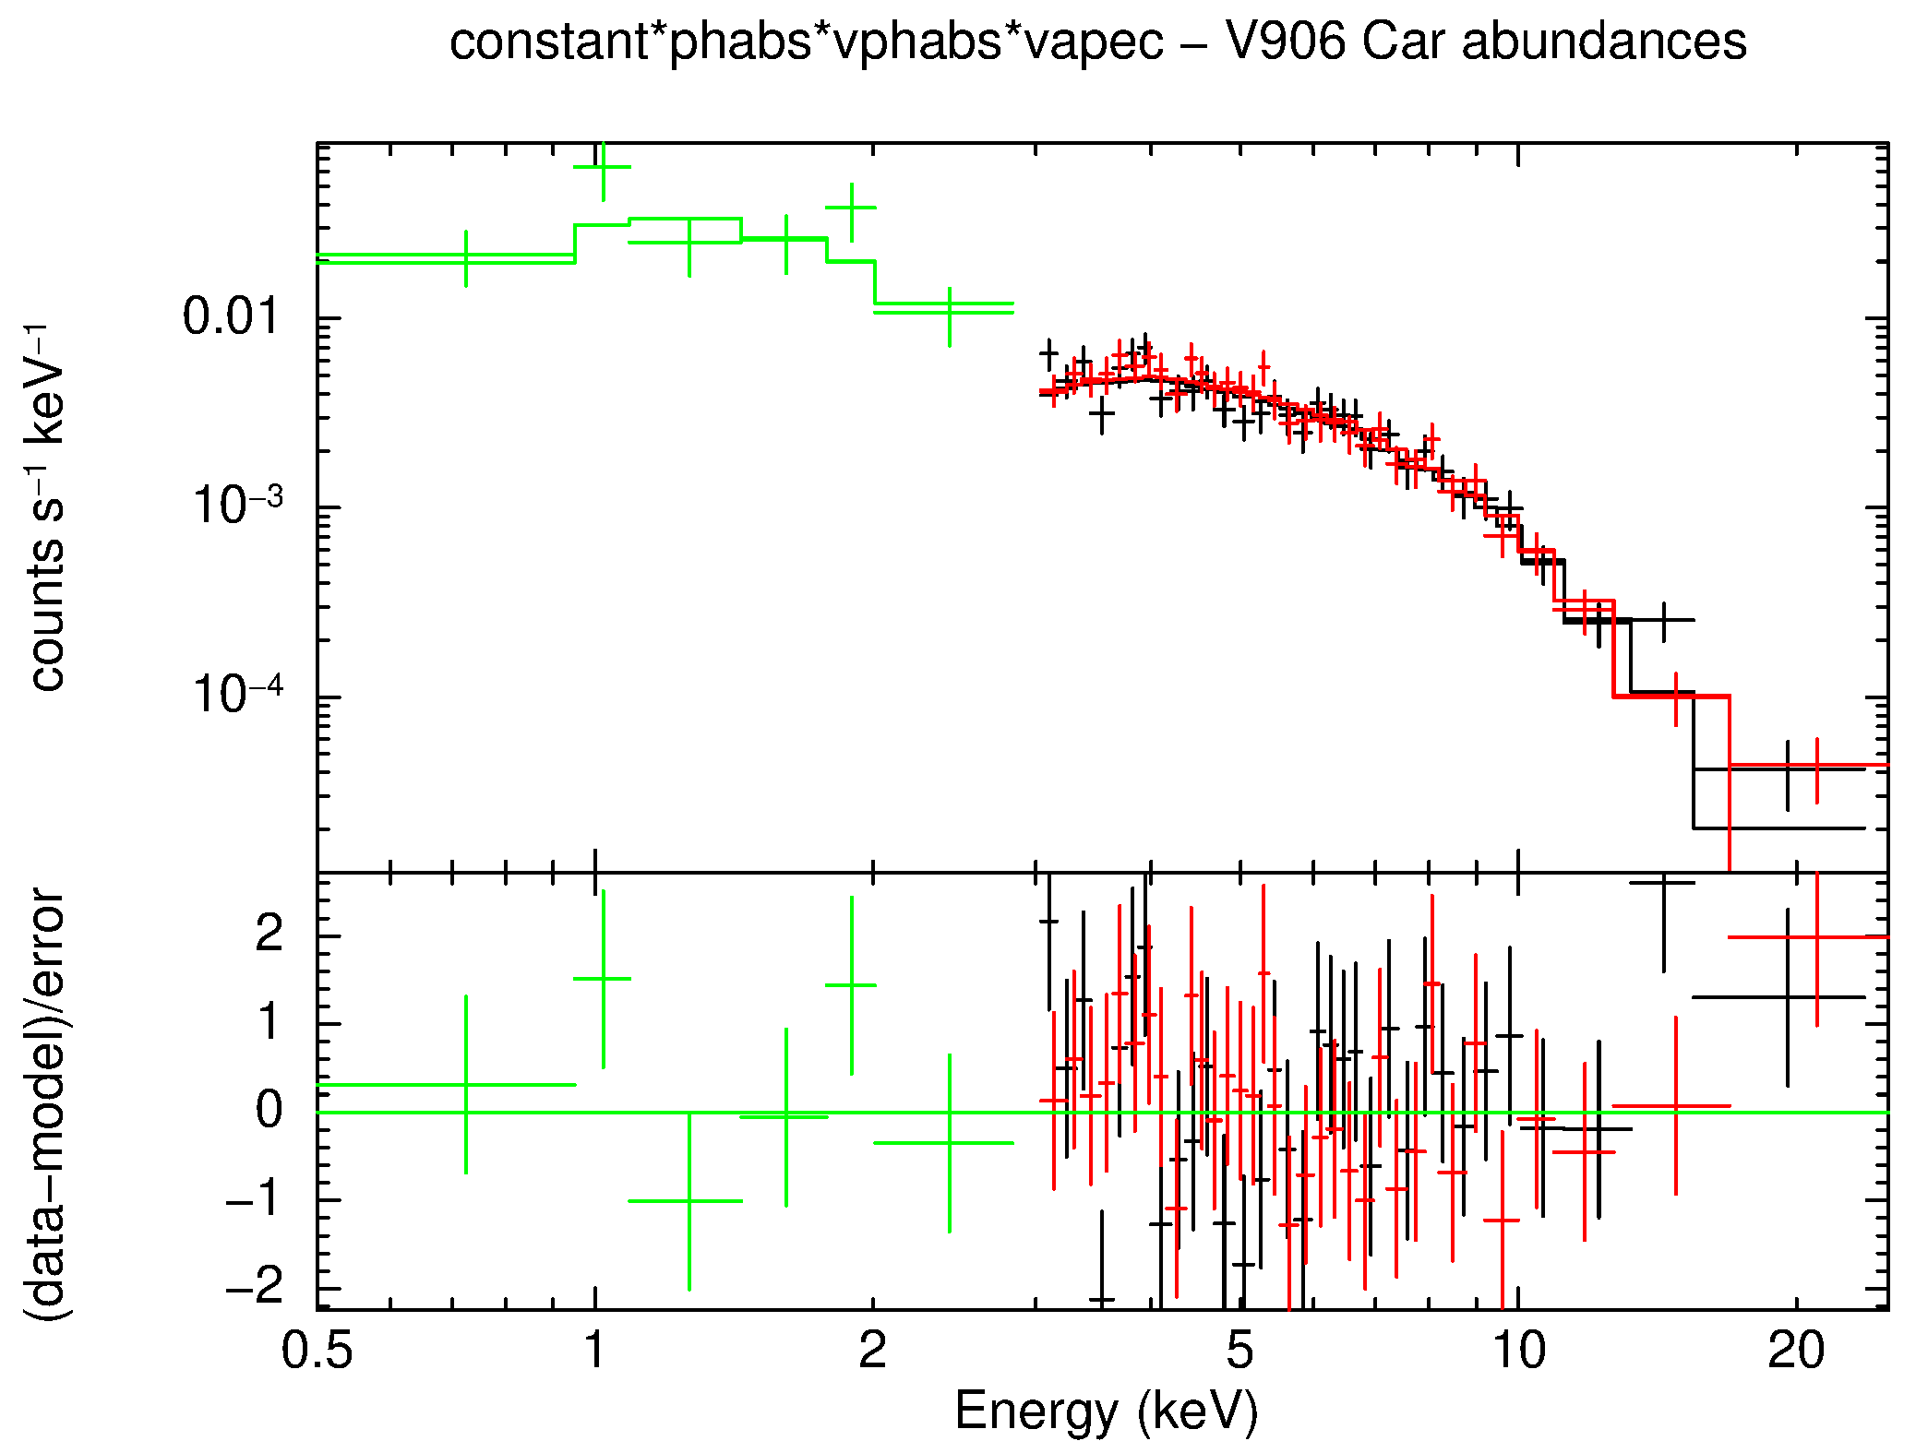
X-ray spectrum of V1674 Her (NuSTAR+Swift)
t₀ + 12 days
Thermal kT = 4 keV
No intrinsic absorption
Non-solar abundances

Slide 32
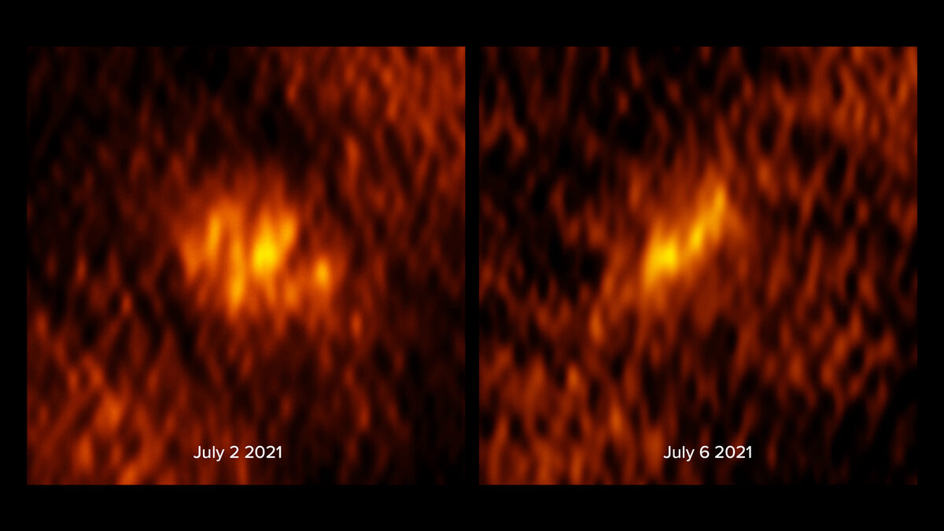
V1674 Her - VLBA synchrotron emission images
5 GHz
Williams et al. (2023, AAS 242, 109.6)
t0 + 20 days t0 + 24 days

Slide 33
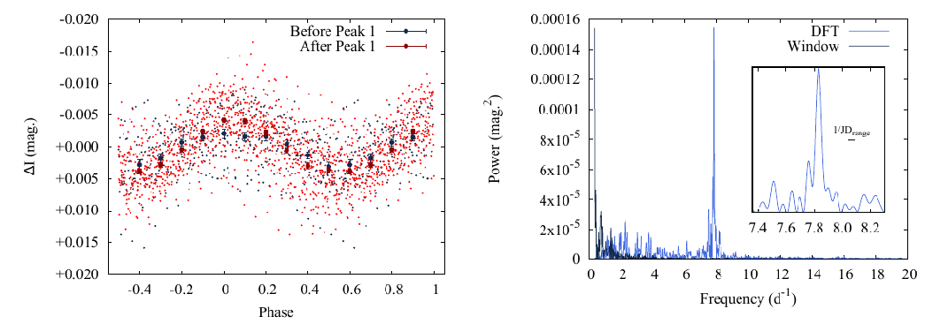
Periodic signal in V606 Vul
Sokolovsky et al. (2023, arXiv:2311.04903)

Slide 34
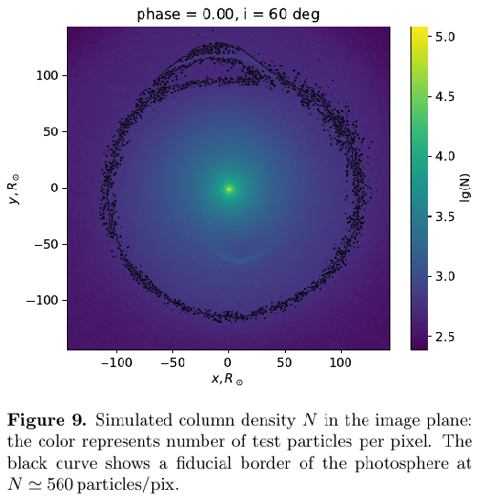
Periodic signal in V606 Vul
Sokolovsky et al. (2023, arXiv:2311.04903)

Slide 35
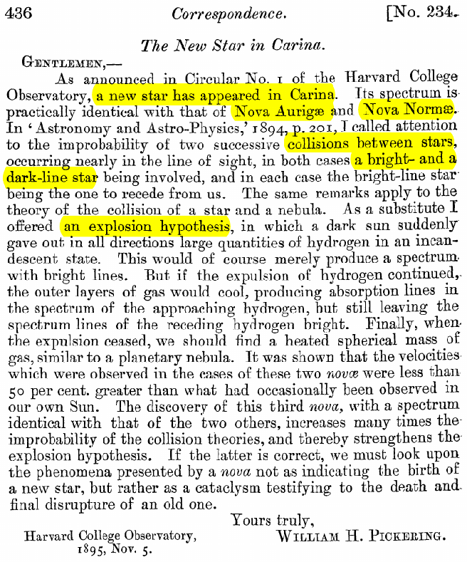
Novae - first recognized type of transients
First spectra of novae from late 19th century revealed P Cyg profiles hinting that we are witnessing some kind of explosion
Pickering (1895, The Observatory, Vol. 18, p. 436)
Nova V339 Del spectrum (Aydi et al. arXiv:2309.07097)

Slide 36
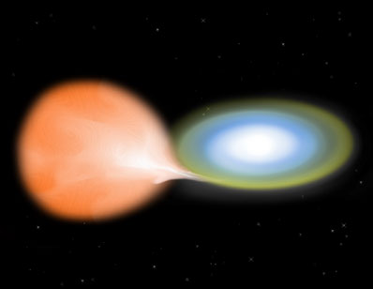
What is a nova eruption?
Sudden re-ignition of thermonuclear reactions in a H-rich layer on the accreting white dwarf. The binary brightens by 8-15^{m} reaching
M_{V}~ -4^{m} до -10^{m}
for days-months
NASA/CXC/M.Weiss

Slide 37
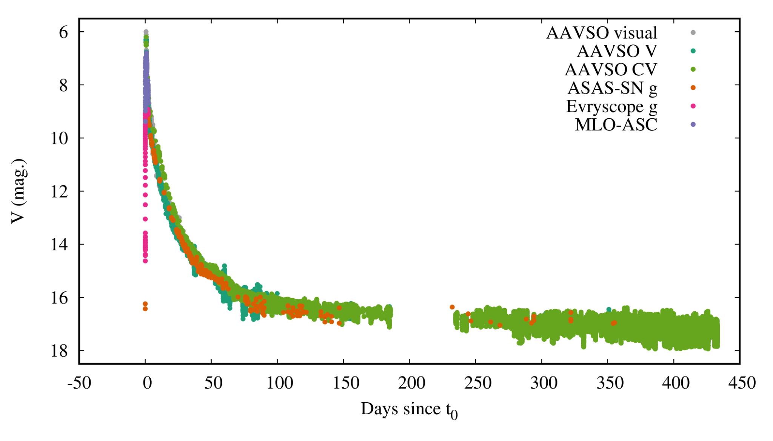
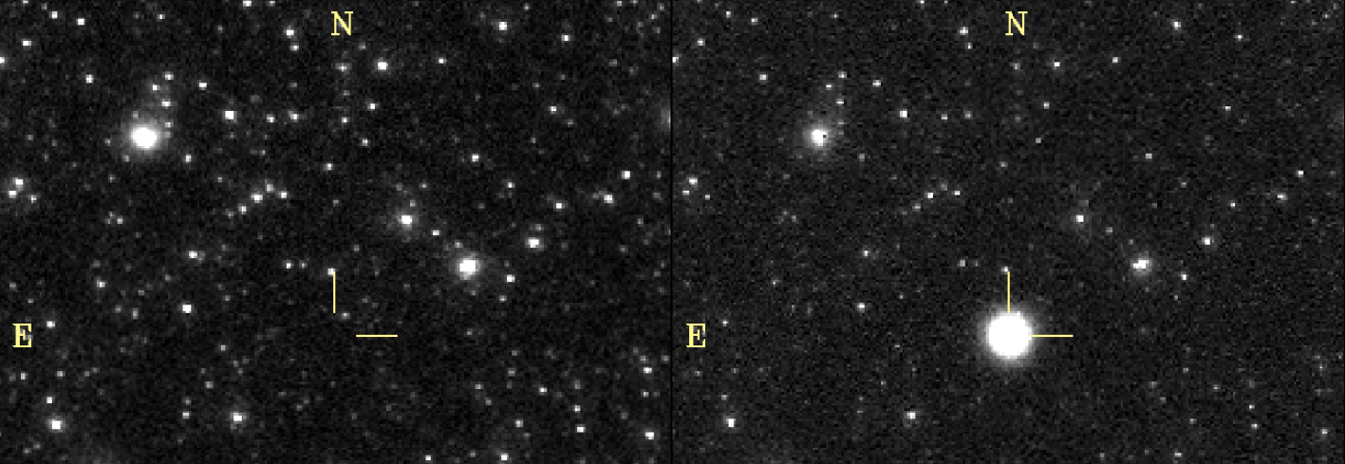
Lightcurve of a (very fast) nova V1674 Her
36’x25’ images before/after eruption 2021-06-12
Sokolovsky et al. (2023, MNRAS, 521, 5453)

Slide 38
Lightcurve of a slow nova V606 Vul
t₀ = 2021-07-15.384
Combined ZTF, ASAS-SN, Evryscope, AAVSO & TESS lightcurve

Slide 39
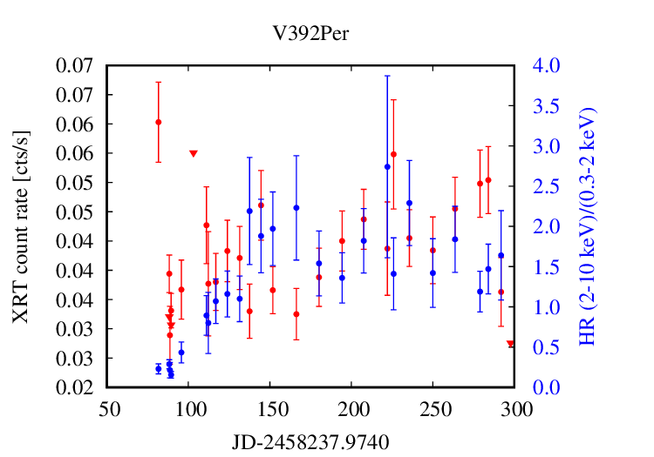
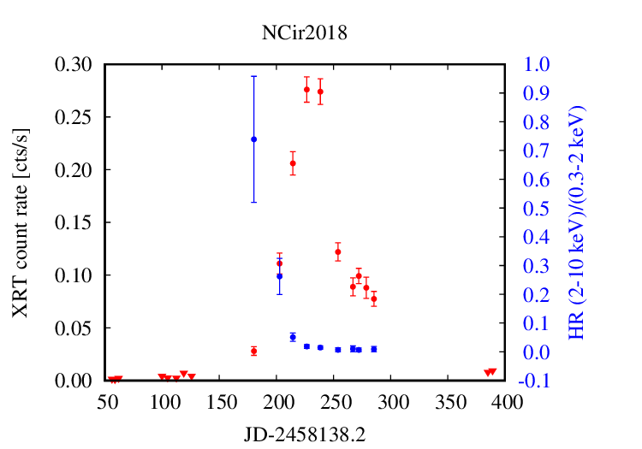
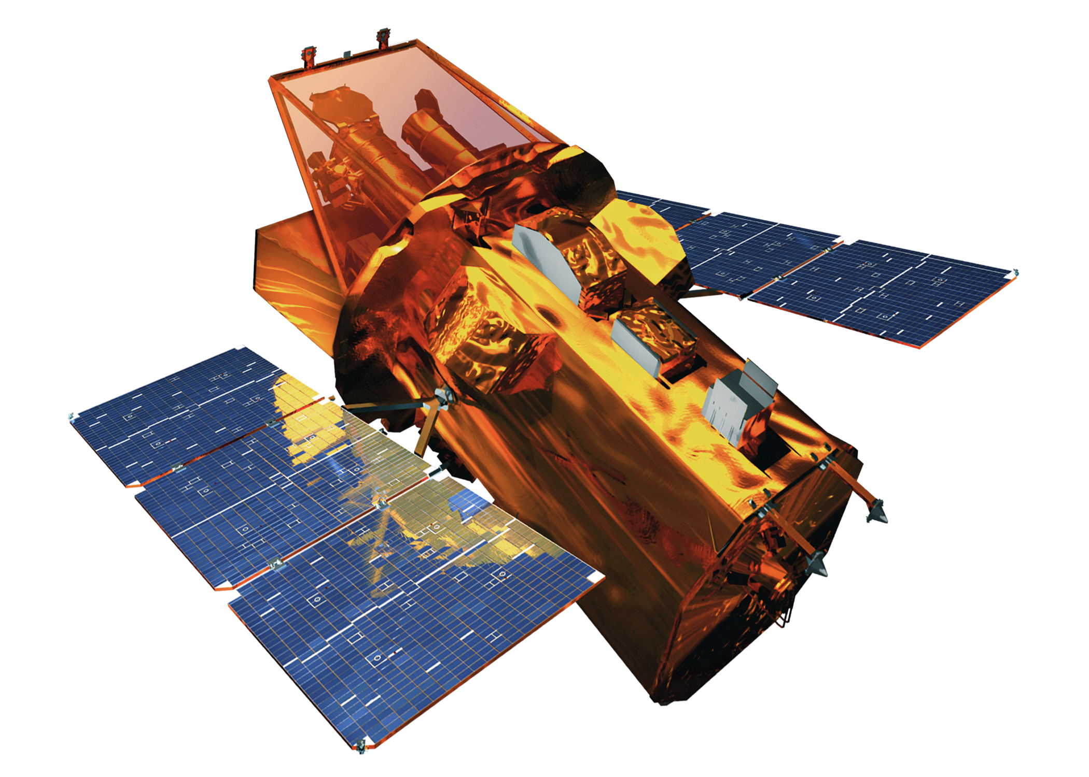
As SSS fades, accretion-powered X-rays take over
V392 Per -
Swift/XRT

Slide 40
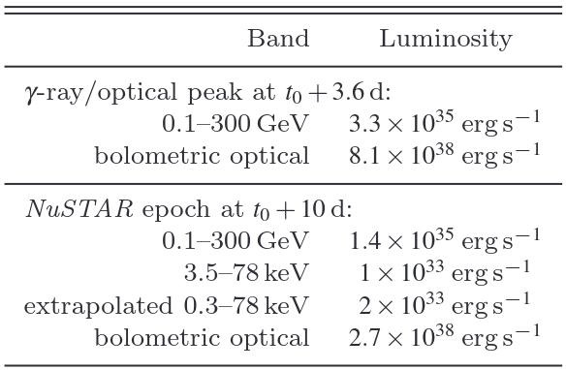
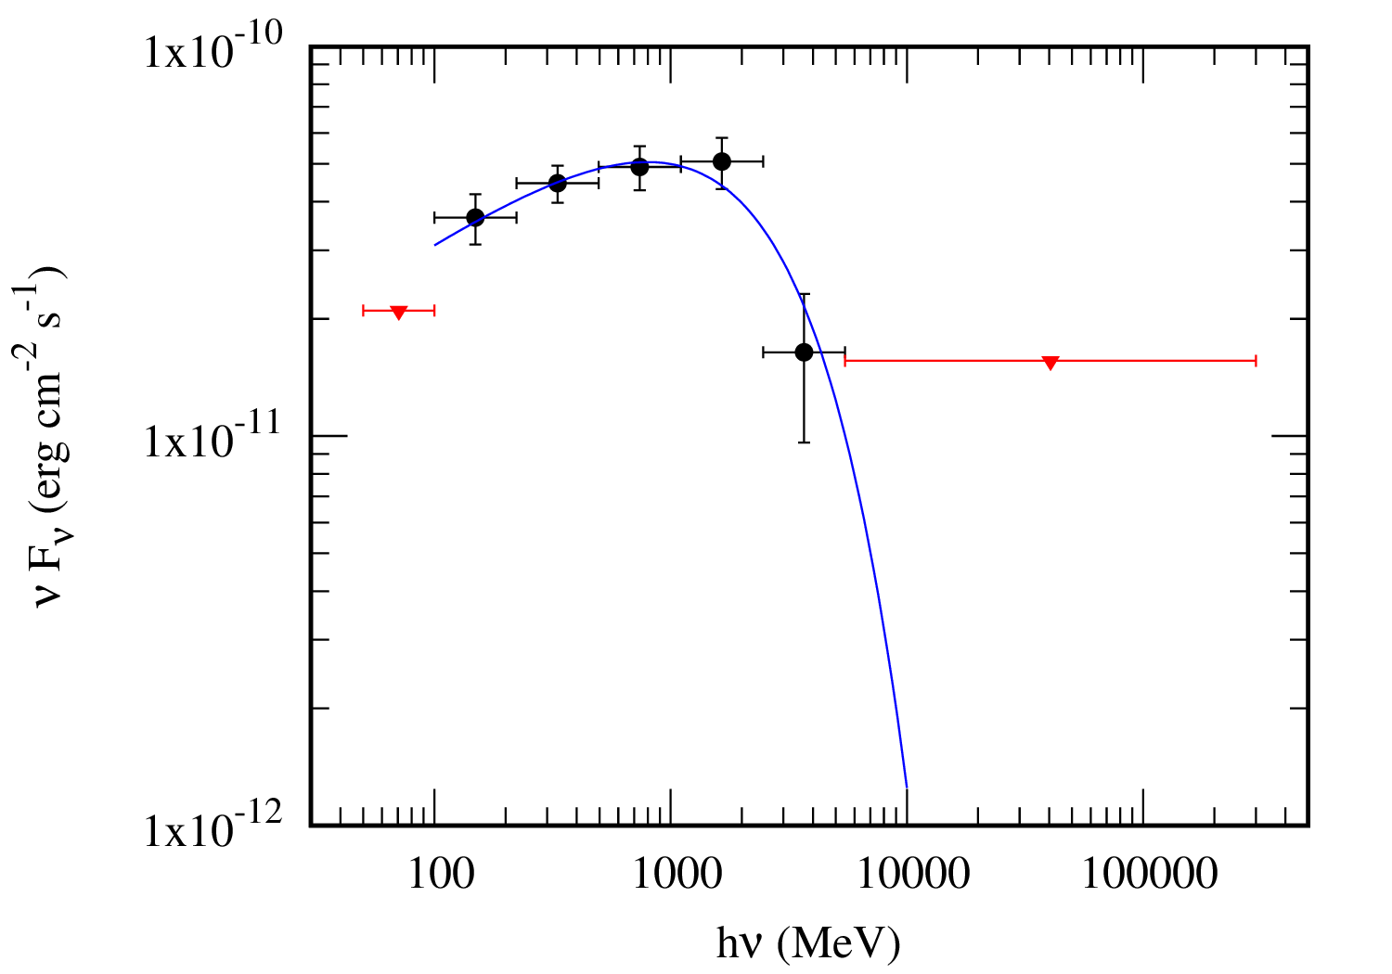
Back to the Shock phase - GeV emission
YZ Ret - Fermi/LAT
Modelling L_gamma/L_x - Metzger et al. (2015, MNRAS, 450, 2739)
Neutrino search with IceCube - Abbasi et al. (2023, ApJ, 953, 160)

Slide 41
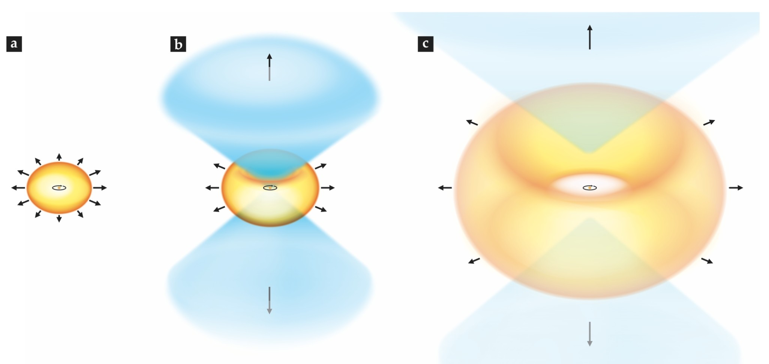
Slow torus and fast WD wind?
Optical spectra show 2 (or more) sets of lines with different velocities (Aydi et al. 2020, ApJ, 905, 62)
Line profile modelling and high-resolution IR/radio imaging

Slide 42
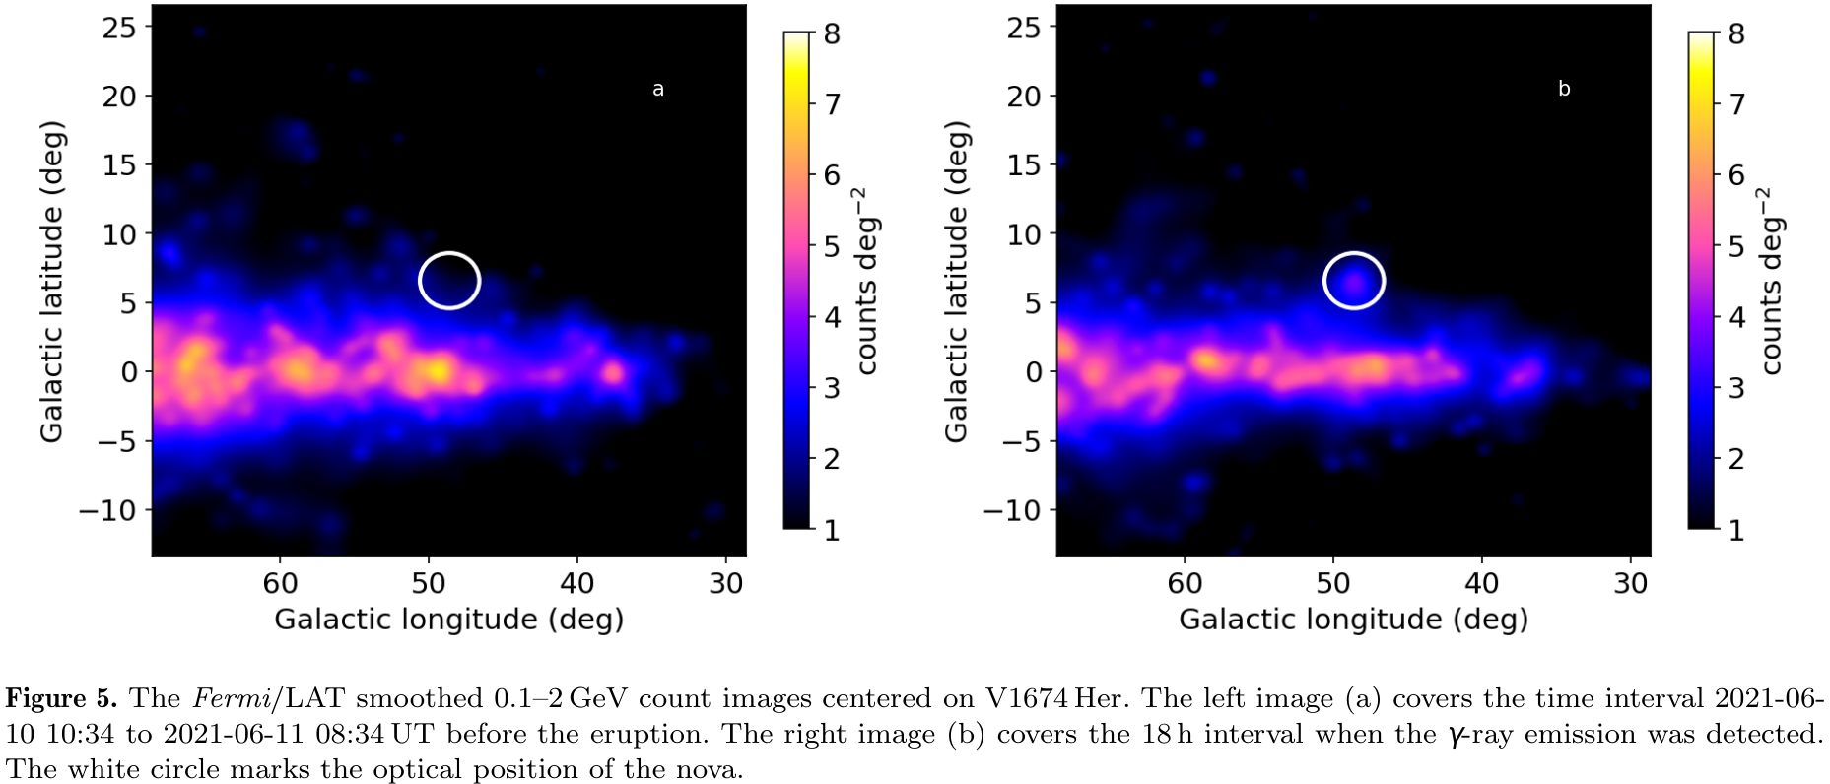
Fermi/LAT GeV view of V1674 Her
just 6 h after nova eruption start, but Porb = 3.67 ч

Slide 43
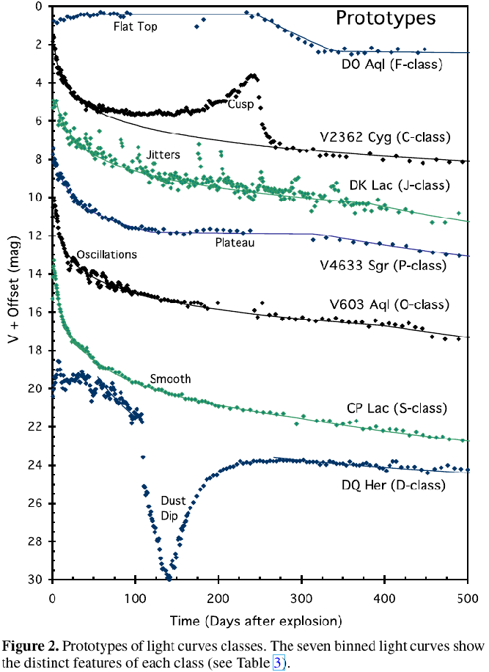
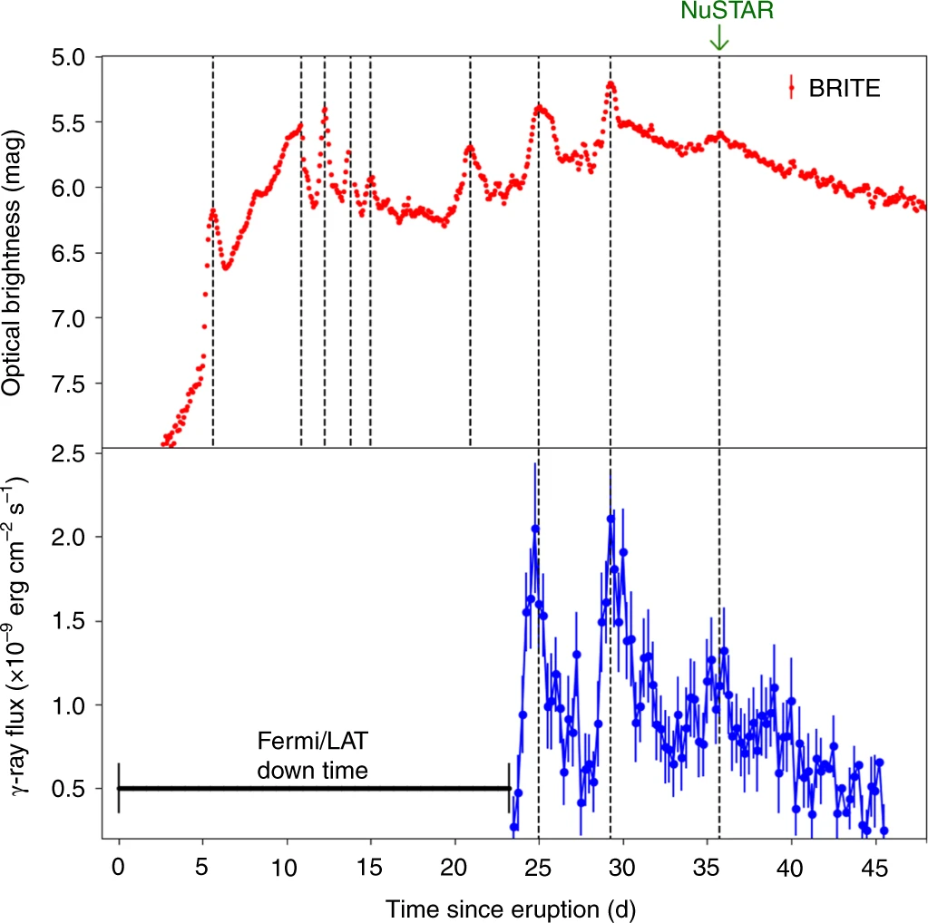
Shocks produce optical mini-flares
dust dips + shock-powered flares + unexplained features
Aydi et al. (2020, Nature Astronomy, 4, 776)
Strope, Schaefer, Bradley & Henden (2010, AJ, 140, 34)
V906 Car

Slide 44
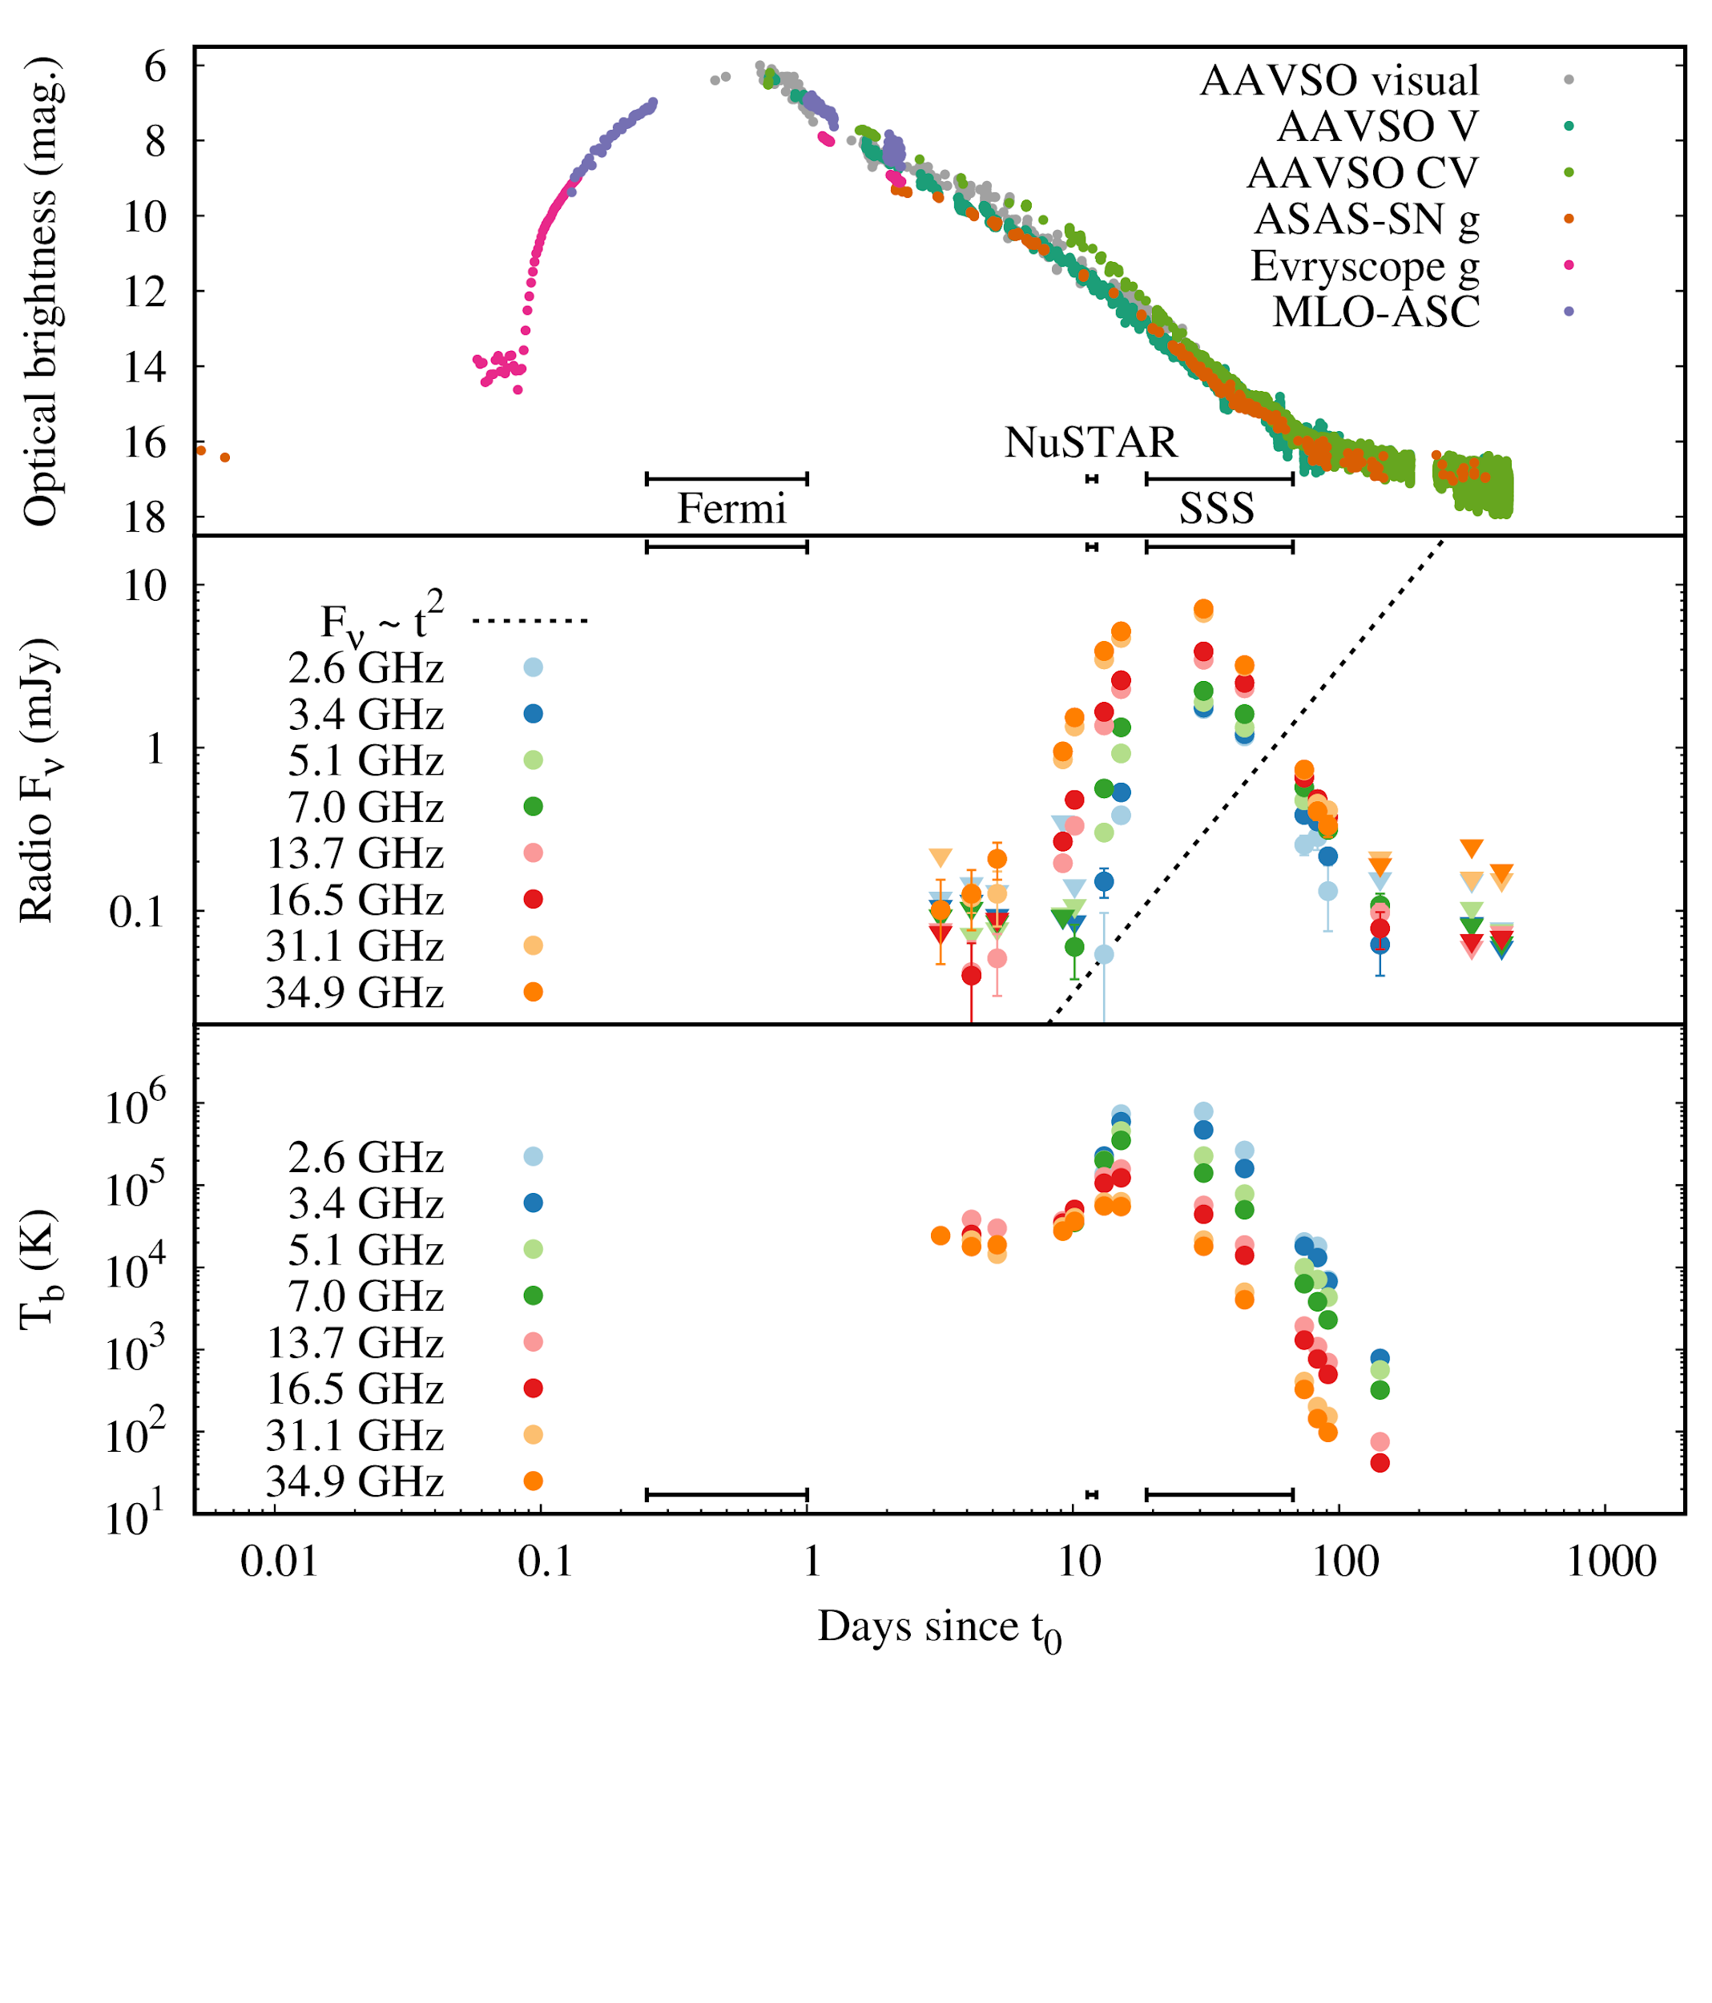
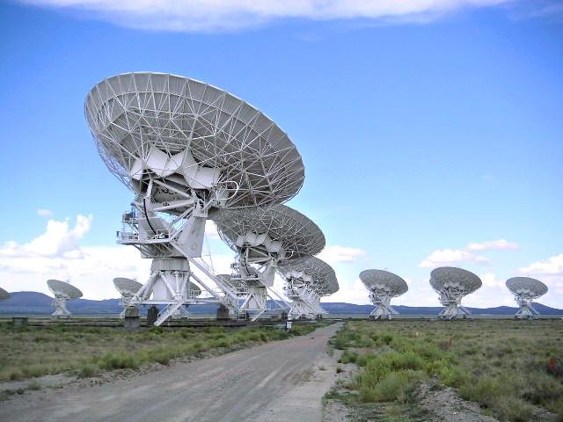
V1674 Her - VLA
Sokolovsky et al. (2023, MNRAS, 521, 5453)

Slide 45
High T_{b} points to synchrotron origin
thermal?
Sokolovsky et al. (2023, MNRAS, 521, 5453)

Slide 46
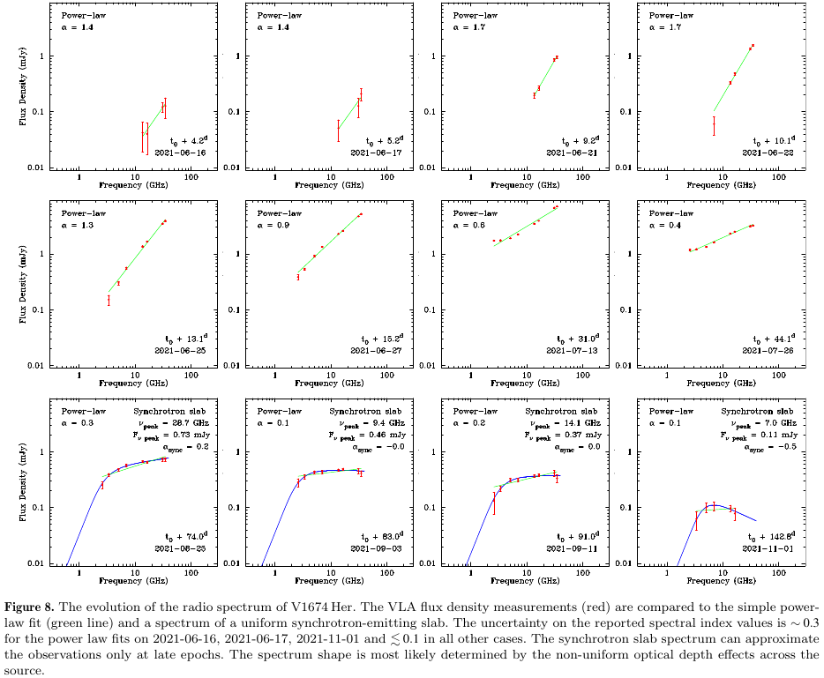
Sokolovsky et al. (2023, MNRAS, 521, 5453)

Slide 47
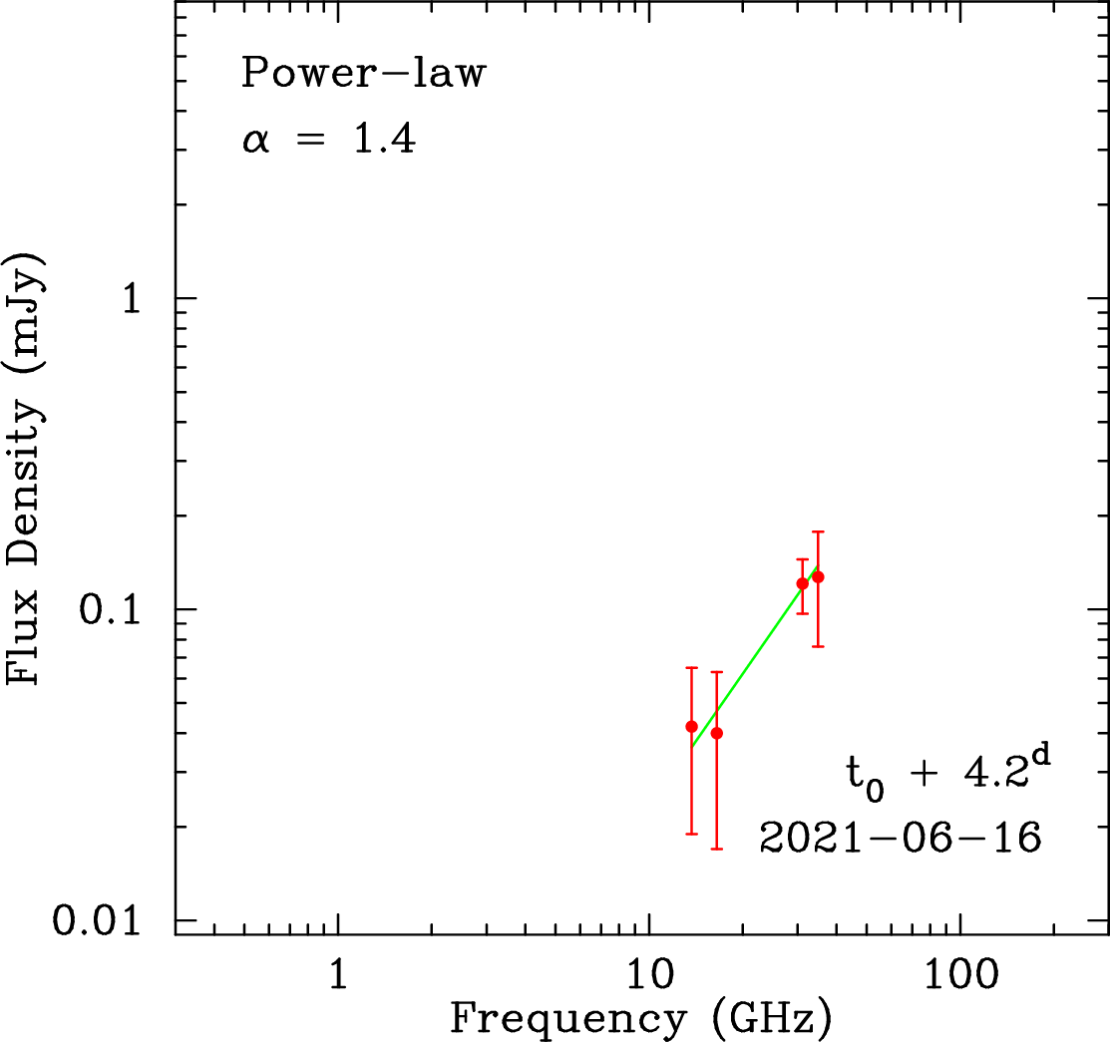
V1674 Her VLA spectrum evolution
Sokolovsky et al. (2023, MNRAS, 521, 5453)

Slide 48
V1674 Her - VLBA synchrotron emission images
5 GHz
Williams et al. (2023, AAS 242, 109.6)
t0 + 20 days t0 + 24 days

Slide 49
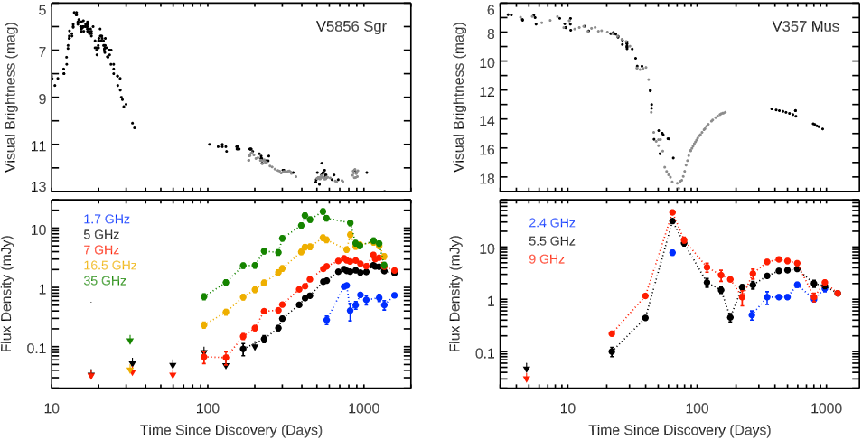
Thermal and synchrotron humps?
Chomiuk et al. (2021, ApJS, 257, 49)

Slide 50
Finding novae is not really solved
YZ Ret (2020) was discovered a week after eruption!

Slide 51
Should be 25/year (observed 10/year)
Why do we need more novae?
Test our understanding of nova population and their contribution to the Galaxy chemical evolution (most ⁷Li is from novae?? Kemp et al. 2022, ApJ, 933, L30)
Minimize eruption to discovery time for organizing MW follow-up with pointed instruments: NuSTAR, VLA, etc.
493 historical novae in Galactic coordinates
Simulated peak magnitudes of novae
g=15
Kawash et al. (2021, ApJ, 922, 25)

Slide 52
Novae are being discovered by professional and amateur surveys mostly in optical, but also NIR
amateurs in Japan, Australia, Brazil are especially active
Gaia Alerts
Koichi Itagaki
ASAS-SN

Slide 53
Amateur-led survey I participate in: New Milky Way
Stanislav Korotkiy - is the main force behind the survey
135mm telephoto lens + CCD camera (2 sets)
All Milky Way visible from the observing site down to ~13mag every clear night
Automated imaging control and transient detection pipeline

Slide 54
TCP J20315286+2740166 dwarf nova found by NMW

Slide 55
TCP J20315286+2740166 dwarf nova found by NMW

Slide 56
Non optical-IR nova searches? (V959 Mon)
Chomiuk et al. (2014, Nature, 514, 339)

